Slide 1
Trans* 101

Slide 2
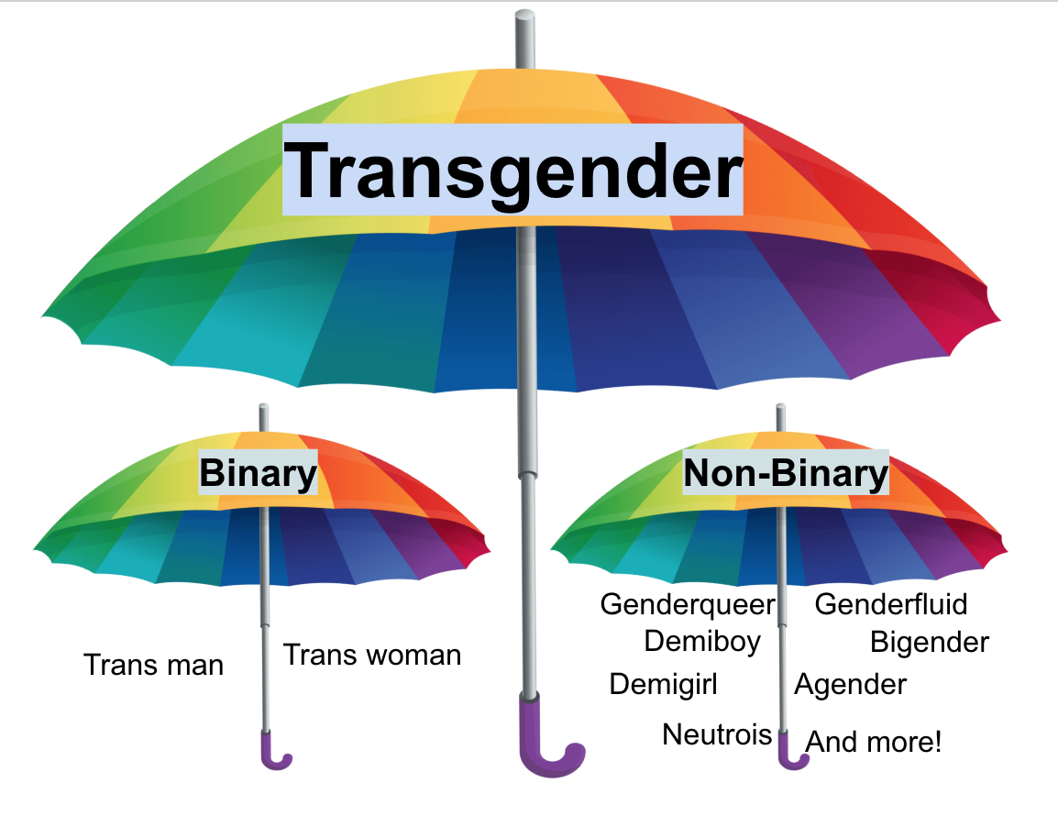
What is trans*?
Trans* or Transgender is where your gender identity does not match the gender you were assigned at birth
When born we are assigned either male or female based on the outward appearance of our genitalia.
Amab/Afab are acronyms for “Assigned Male At Birth” and “Assigned Female At Birth” respectively
Gender and Sex are two separate categories
Sex can correlate with gender, but that is not always the case

Slide 3
Trans vs Trans*
Trans is short for transgender, plain and simple
Trans* is an umbrella term that encompasses all trans identities like:
Transgender
Transsexual
Nonbinary
Genderqueer
Agender
Two-spirit
And many more

Slide 5
Intersex & Trans*
Intersex is not being directly biologically “male” or “female”
Example: being born with both primary sex organs
But some Intersex persons can identify as trans*
It’s a personal decision
Many intersex persons are assigned a gender through surgery, then later in life decide to transition to their true gender/sex
Some are nonbinary or even Agender
Regardless of sex (whether intersex, male or female) gender is entirely separate and does not have to correlate to your biological sex

Slide 6
Do you have to medically transition to be trans*?
No, medically transitioning is a very personal decision.
Some can not medically transition due to health concerns, but that doesn’t make them less trans
A Trans* individual does not have to change any bit of their biology to still be trans
Some choose to transition medically (HRT, GCS or SRS, FFS, Top surgery, etc.)
Some don’t and that’s fine, it’s a personal decision
And none of your business ;)

Slide 7
Why are pronouns so important?
When referring to a trans* person it is important to consider their safety
Misgendering someone can be potentially dangerous
ie) misgendering a transwomen in a women’s bathroom
Using the correct pronouns is simple just respectful.

Slide 8
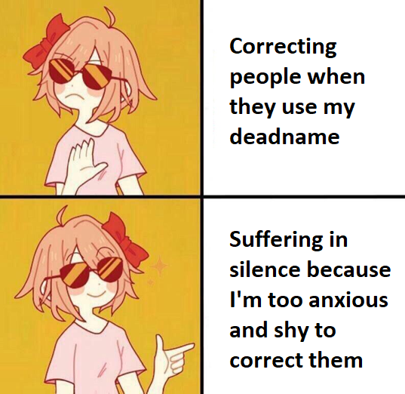
What’s a dead name?
A dead name is the name that was given to a trans* person at birth
Aka: Birth name, given name, assigned name, other-name, etc.
Is it okay to use a dead name?
No, unless the trans* person explicitly allows you to, or is in a situation where their safety is a priority.
Is it okay is ask a trans* person what their dead name is?
No, that is not information you need to know.
You may only learn a trans* persons dead name if they give it, but do not ask

Slide 9
Questions?

