Slide 1
EAB Navigate for Students

Slide 2
What is Navigate?
Navigate is a mobile advisor that gets you from orientation to graduation.
The app helps you to conveniently schedule with your advisor, choose the right major, navigate requirements such as financial aid, and stay on top of important dates and deadlines—all in the palm of your hand.

Slide 3
Why use Navigate? What are the benefits?
Know When Important Things Are Coming Up:
From attending orientation to preparing for finals, now there’s a clear timeline of what you need to do. Within each task, Navigate connects you to the links and resources you need to get things done. You can also add your own to-dos!
Find the Right Fit:
My Major connects your interests and goals to the right major at the college—fill out a short survey and Navigate takes it from there!
Connect to the Support You Need—Faster:
Have questions or run into a problem? Resources refer you to your designated support network, while Appointments gets you facetime with the people who can help. Best of all, the appointments sync onto your phone’s calendar.
Stay Ahead of Any Roadblocks:
Unpaid parking tickets and overdue library books could keep you from signing up for next semester’s classes. Get notified when you have a hold on your account and resolve them directly in the Holds Center.
Get the Most Out of College:
Navigate provides all the steps to start college on the right foot. Get handy tips and tutorials on everything from getting involved in student organizations to paying for college, and discover what’s going on around campus with notifications about events.

Slide 4
How can I start using Navigate?
You can download Navigate in the App Store or Google Play by searching for “Navigate Student”

Slide 5
How much do I have to pay for it?
It costs nothing for you to download Navigate.

Slide 6
Help, I can’t log in to Navigate!
Can you get to the school’s Sign-on webpage? If you get this far but your credentials are rejected by your university’s sign-on page, there is an issue with the school account. Try resetting your password.
If you successfully enter your credentials in the school’s SSO web page, but Navigate says “Uh-oh…” or “Something went wrong,” EAB must not have your username in their system. Contact NavigateTechSupport@eab.com with your full name, username, and email address.

Slide 7
The to-dos I’m seeing don’t look right to me…
What term of college are you in? Did you select the wrong term? Go to the More tab, under their name there’s a link to “Update year and term.”
If your selection is correct, in-app content might not be available for you yet. You can still use other features, and many of the to-dos for other semesters may still be relevant.

Slide 8
What do I do if my app is frozen or acting weird?
Try a hard close and relaunch the app.
• For iOS, double click the Home button then swipe the app preview away to “hard close.”
• On Android, open the app manager view and slide the app preview away to “hard close.”

Slide 9
I just resolved a Hold, why is it still showing up?
Holds are updated every 24 hours in Navigate, so check back tomorrow to see if it’s successfully been resolved in Navigate. If the issue persists, contact navigatesupport@eab.com.

Slide 10
How do I change my notification settings?
In the Settings tab you can personalize your notification preferences.

Slide 11
Something is wrong with “My Class Schedule.”
It takes 24 hours for the schedule to update once you add/drop classes. If the issue persists, then contact navigatesupport@eab.com to get it fixed.

Slide 12
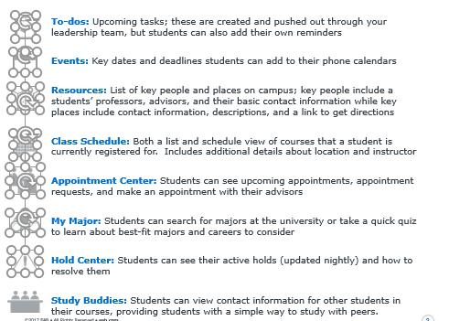
Navigate Cheat Sheet

Slide 13
Reference:
©2018 EAB Global, Inc. • All Rights Reserved

