Slide 1

Conflict Management in the Workplace

Slide 2

Understanding Conflict
What are examples of workplace conflict?
Impacts?
What triggers a conflict?
What behaviors or reactions are demonstrated during conflict?

Slide 3
Defining Conflict
A discussion between 2 or more people
The stakes are high
Opinions vary
Emotions run strong
Personal or emotional histories get in the way

Slide 4
Is This Really A Conflict?
Crisis: Interferes with productivity or safety
Clash: Differing opinions both with apparent value, stakes moderate
Blip: No visible value in engaging, no or low impact, issue has low stakes

Slide 5
Strategic and Empowered Responses
Responding versus reacting
Determining what’s at stake
Understanding history, personality and communication style

Slide 6
Conflict and Choice
Tools for Addressing Conflict
Effective Communication styles
Timing
Navigating the dialogue
Best/worst practices
Motive, intention and attitude
Consequences
Dealing with or ignoring

Slide 7
Benefits of Addressing Conflict
Allows focus to remain on behaviors, impacts, consequences, processes, outcomes
Avoids making an individual the center of the conflict
Encourages development versus defensiveness
Facilitates problem solving

Slide 8
Impacts of Ignoring Conflict
Misunderstandings continue
Damage to reputation
Impacts on team or unit
Impacts to productivity
Unspoken messages sent to team
Position/Workplace satisfaction
What else?

Slide 9
Conflict and Conversations
Critical Conversations
Performance Appraisals
Bullying and disruptive workplace behaviors
Managing Change
Meetings, collaborations
Challenging Conversations
Stakes/outcomes are high – extreme visibility
Opinions differ among stakeholders
Stakeholder histories differ
Organizational history challenges contributor’s input
Emotions run strong

Slide 10
Typical Reactions
Avoid, Deflect, Defend – the person with the authority wins!
Changing the conversation in the middle of a sentence
Grudges and gossip

Slide 11
Physical Preparation: Conflict as a Management Tool
Physical Preparation
Drunk on Adrenaline: The Amygdala and the Flight, Fright or Fight Response
How do I feel about the person, the discussion, the outcome?
Is this the right time to have this discussion?
  Have I eaten?
  Sleep deprivation?

Slide 12
Preparation: Situational Assessment
Situational Assessment
Do I have all the facts and information?
What is the value of this conflict?
What outcome do I hope to achieve?
Do I have motives contrary to the desired outcomes?
What are the emotional or political risks?
How will I open the discussion?
What challenges do I expect to encounter?

Slide 13
The Importance of the Conflict Management Skill Set
Managers with skill set avoid, or diminish the possibility of workplace violence
Save by addressing versus avoiding
Reduce costs when managing virtual or global team members
Accountability and productivity increase
Increases manager/leader influence and integrity
Notes:
2/3’s of managers and leaders who develop and nurture this skill set avoid, or diminish the possibility of workplace violence
Save an average of an 8=hour workday by addressing the conflict versus avoiding it
Reduce costs when managing virtual or global team members
Accountability and productivity increase based on clarity of organizational behaviors, work-related expectations and real-time dialogue and correction
Increases manager/leader influence and integrity

Slide 14
Myth vs Truth About Conflict
Myths
“Tell the truth and keep the peace”
“Speaking up now will have a cost later” – reprisals and grudges
What else?
Truths
Varying histories, education, work experience provide a rich context for growth, process development and efficiency
Respectful disagreement can be healthy – the best ideas surface!
Passion is often mistaken for conflict

Slide 15

Review: Your 6 Step Process
State the issue, challenge or problem
Describe the impact of the issue, problem or challenge
Provide opportunities for the other person to respond
Discuss or state the desired outcome or required change
Describe resources available, time frames and clarify expectations of understanding or correction
Conclude with Confidence
Notes:
Putting Conflict Management Skills to Work
Opportunities for using this process
Performance Reviews
Display of team member behavior that inhibits productivity, policy, or establishes an unsafe work environment
Defining workplace safety (bullying)
Other opportunities: meeting management
Change management
New policy, procedure change
Growth or contraction of services

Slide 16
Your Kepro EAPur Kepro EAP
EAP Services available to employees, any household members and dependents
Confidential
EAP Counselors available 24/7/365 via 833-539-7285
Up to 6 in person counseling sessions, per issue, per year
Management Consultations
Financial/Legal Consultation and Referral Service
Work/Life & Convenience Services
https://sowi.mylifeexpert.com Company code: SOWI

Slide 17
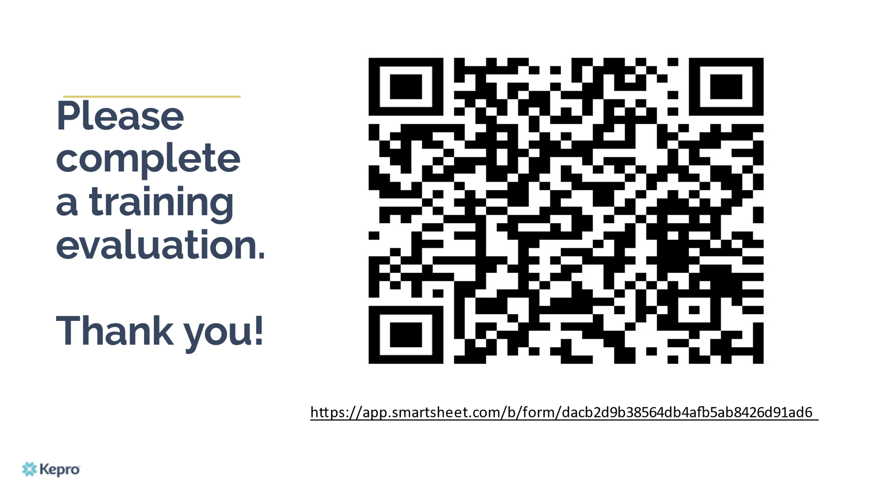

Slide 18

Questions & Answer
Conflict Management in the Workplace

