Slide 1
Recruitment & Hiring of Student Employees
Student Employee Supervisor Training – Part 1
July 31, 2023
Presented by:
Allen Voelker, Kay Voss, Bev Pence & Rachel Wautier
Notes:
BEV – Welcome and thank everyone for joining the training session in person or virtually.
My name is Bev Pence and I work in Human Resources as the Talent Acquisition and Engagement Specialist. Our training session today is part of a 4-part series that we have developed to aid Student Supervisors in the full life-cycle of student employment. Our focus today is on the Recruitment and Hiring of Student Employees. Joining me today is Allen from the Financial Aid Office, Kay from Career Services, and Rachel who is also from Human Resources. They will have an opportunity to introduce themselves as we go through the training today.

Slide 2
Agenda
Financial Side of Hiring a Student
Creating a Job Description
Handshake Overview
Career Services Resources
Interview Tips & Recruitment Best Practices
BP Logix – NEW Electronic Hiring Form
Notes:
BEV – Here is a quick look at our agenda for our session.
Allen – Financial side of hiring a student and Finacial Aid resources
Kay – Creating job descriptions, Handshake overview, and Career Services Resources
I will go in to Interview tips/best practices and Rachel will finish a review and demo of the new BP Logix forms for student employment

Slide 3
Financial Side of Hiring a Student
Notes:
BEV

Slide 4
Payment Rates
Federal minimum wage ($7.25 per hour)
Must not exceed rate for a permanent employee
Rate is independent of Federal Work-Study eligibility
UW Campus | Median | # of Student Hourly Positions in FY2023
UW-Eau Claire | $ 10.00 | 3,940
UW-Green Bay | $ 12.00 | 1,455
UW-La Crosse | $ 9.00 | 2,033
UW-Oshkosh | $ 11.00 | 2,166
UW-Parkside | $ 12.00 | 472
UW-Platteville | $ 12.00 | 1,982
UW-River Falls | $ 11.50 | 1,488
UW-Stevens Point | $ 11.20 | 2,481
UW-Stout | $ 10.00 | 2,354
UW-Superior | $ 11.00 | 865
UW-Whitewater | $ 10.00 | 2,789
Notes:
BEV – To start, we wanted to provide some basic information as it relates to payment rates/wages as you look at recruiting and hiring student employees.
There is a federal minimum wage of $7.25 per hour. When determining the pay rate for your student employee, their rate must not exceed the rate for a permanent employee. In addition, the rate is independent of Federal Work-Study eligibility. As a supervisor, you will be looking at your budget and determining how much you can pay the student and how many hours you have available to cover that.
The average pay rate at UW-Green Bay for student employees is currently $12 per hour which you can see in comparison to other UW schools.
Hand off to Allen to talk more about Financial Aid and Work-Study.

Slide 5
Financial Aid Resources
Student Employment
Federal Work-Study (FWS)
General
Free Application for Federal Student Aid (FAFSA)
Scholarships
Notes:
Allen

Slide 6
FWS: Basics
Need-based program
Students submit the FAFSA each year to determine eligibility
May not displace or replace other workers
May not schedule students during class periods
Federal funds cover 75% of qualifying wages
Notes:
Allen

Slide 7
FWS: Departmental Budget
WISER line item represents budget for departmental share
FWS Hourly: Acct 1781
Regular Hourly: Acct 1771
Stretch your budget with FWS hires
Department manages its budget and schedules employees accordingly
Student | FWS Offer | Gross Earnings | FWS Federal Share (75%) | Dept Share
Phlash | $0 | $2,000 | $0 | $2,000
Pheather | $2,000 | $2,000 | $1,500 | $500
Phlame | $2,000 | $3,000 | $1,500 | $1,500
 | TOTALS | $7,000 | $3,000 | $4,000
Notes:
Allen

Slide 8
FWS: Verifying Eligibility
No separate hire form required to employ FWS students
Student will need to provide documentation
Screenshot from SIS
Biweekly balance report during academic year
FWS Waitlist available as funding is limited
Offer amounts may change
Part-time enrollment
Receipt of additional aid
No longer meeting Satisfactory Academic Progress standards
All eligible positions pull from FWS balance by default
Supervisor may email studentemployment@uwgb.edu to deactivate FWS funding for their position
Notes:
Allen

Slide 9
Career Services
Notes:
Kay

Slide 10
Career Services is here to help with...
For Supervisors:
Creating attractive job descriptions
Creating employer accounts in Handshake
Posting jobs in Handshake
Helping to promote the value of on-campus employment
For Students:
Direct students to search for openings in Handshake
Creating student accounts in Handshake
Searching for openings in Handshake
Helping students add their on-campus employment to their resume
Notes:
Kay

Slide 11
Creating a Job Description
Notes:
Kay

Slide 12
Template Basics to Gather
How should students apply? | Apply in Handshake
Job Title | Specific Job Title for the Position i.e. Office Assistant, UREC Lifeguard, Food Service Worker, Admissions Call Team Member
Job Type | On-Campus Student Employment
Employment Type | Part-Time
Duration | Permanent Temporary/Seasonal (will need start/end date)
Hours Per Week | 10-15 per week is common, depending on availability
Is this a Work Study Job | Yes No
Hourly Pay Rate | Exact Amount or Range
Federal Work Study Eligibility
Notes:
Kay

Slide 13
Description
Provide a detailed description of...
the office, service, organization, or the department
Incoming students are not familiar with campus, the offices, etc. Offer a snapshot into the services offered
Provide a detailed description of the duties
Offer a snapshot into an average day. Think about experiences students may have already had – offering customer service, answering phone calls, social media posts, scheduling appointments, etc.
Your ideal candidate
Transferable skills – organization, ability to learn new programs, verbal and written communication skills, social media platforms, teamwork, etc.
Class schedule
Majors
Language Skills
Hours per week
Notes:
Kay

Slide 14
Example
Description:
Student Accessibility Services provides students with documented disabilities the opportunity to reach their full potential by providing academic accommodations and support services along with promoting independence and self-advocacy.
Job Duties and Responsibilities:
Some of the daily tasks of this position include scheduling appointments, uploading documentation, proctoring exams, picking up or dropping off exams, and helping students and staff with any questions they might have.
This position will start at the beginning of the 2023-24 school year. We will need someone Tuesday and Thursday afternoons from 12:00 pm- 4:30 pm as well as some hours on Fridays between 7:45 and 4:30 pm.
Notes:
Kay

Slide 15
Example
Description:
GBOSS assists students, parents, faculty, staff and the general public with routine transactions and inquiries in relation to admissions, registration, financial aid, academic advising, graduation, international education, and course scheduling. We work to educate clients about university policies, procedures and resources, advise clients about alternative courses of action, and work collaboratively with other university offices and external agencies on behalf of clients to expedite problem resolution. The University of Wisconsin Green Bay strives to create a welcoming, equitable, and inclusive work environment.
The Green Bay One Stop Shop (GBOSS) is looking to hire a student assistant to provide Spanish translation services, and to support our day-to-day activities at the Green Bay location. The Student Services Assistant will provide Spanish language translation services for GBOSS activities, collaborate with GBOSS staff to deliver the day-to-day operations of the office, as well as assist with special projects.
Essential Job Functions/Responsibilities
50% - Provide Spanish language translations for GBOSS activities including interactions with students and families, social media posts, printed material (brochures, flyers, posters), video screen content, presentation materials
30% - Assist GBOSS Staff in day-to-day operations, including phone coverage; assisting with walk-ins; answering basic questions related to admissions, advising, registration, financial aid, and other university services; walking guests to various campus locations
15% - Assist GBOSS staff with processing Salesforce (CRM) cases and processing admissions-related documents
5% - Maintain brochure table inventory
Notes:
Kay

Slide 16
Example
Description:
The Learning Center hires student peer tutors to support academic success for all UW-Green Bay students. We currently employ tutors to support course-specific content, including language courses, and academic writing. Qualified students can tutor in multiple subject areas.
Tutor Prerequisites
Currently enrolled as a student for at least 1 credit, with at least two semesters remaining
Must have a cumulative grade point average of 3.0 or better and have earned a grade of A or A/B in the subjects/courses to be tutored, or have a professorial recommendation for the position
Show genuine willingness to provide academic assistance to students with various backgrounds and prior learning experiences seeking services to include individual tutoring/mentoring and small group work in multiple modes of delivery - online and in-person
Have the appropriate course and outside work schedule to meet employment hours needed
Provide a minimum of three faculty/instructor references in the application
All TLC student employment opportunities are Federal Work Study eligible, and bilingual applicants are encouraged to apply.
Students interested in being a writing tutor should be prepared to upload a recent sample of their academic writing from any college-level class they've completed.
Notes:
Kay

Slide 17
Navigating Handshake
https://uwgb.joinhandshake.com/edu
Notes:
Kay

Slide 18
Career Services Resources
Handshake Resources on Career Services webpage
Create an Employer Account in Handshake (link to how-to video)
How to Post a Job (written instructions)
Student Instructions for Getting Started in Handshake
Notes:
Kay

Slide 19
Human Resources
Notes:
BEV – check time for break? See if one is needed?

Slide 20
HR is here to help you with...
Student Entry
I-9 Form/CBC
Hiring Help
Time/Approval Help
Employee Relations
Employee Engagement
Notes:
BEV – So, now that you've heard a little more about how Financial Aid and Career Services can help you – let's talk about how the Human Resources Office can help!
All entry to hire a student in to the system is done in our office. We also will complete all I-9 initiation and verifications which is different than what has been done in the past. We will talk a little bit more about what that looks like after we get through the new BP Logix forms.
In addition, our office can assist with time/approval help, employee relations, and employee engagement - all of which we will be covering in our next training sessions.

Slide 21
Interview Tips/Best Practices
What to ask during interviews
Open-ended questions
Avoid close-ended questions
Same questions for all candidates
Interview Question Bank
Provide realistic timelines of communications with students
What happens next after the interview
Be transparent
Provide opportunity for candidate to ask questions about the job
Notes:
BEV – We also thought it would be helpful to provide some reminders on interview tips/best practices when you are going through your recruitment process for student employees. You can see here, that I have some general reminders, such as to be sure to ask open-ended questions and try to avoid having all close-ended questions. Can anyone give me an example of some open-ended questions that would be appropriate to ask during an interview?? Or, maybe, a question that you use in all your interviews that you have found provides the best response and information you are trying to obtain?
Examples of open-ended questions:
Tell me about yourself.
Why are you interested in this position?
How would others describe you?
What environment would you work best in?
What motivates you to do your best work?
Explain how you would...
Provide an example of....
Describe a situation...
Examples of close-ended questions – generally yes or no responses or single word responses:
How many years experience do you have?
Do you have experience in...?
Do you prefer team setting or working individually?
Of course, we also want to be sure to avoid any questions relating directly or indirectly to race, color, religion, sex, sexual orientation, gender and/or gender identity or expression, marital or parental status, national origin, ethnicity, citizenship status, veteran or military status, age, or disability.
In addition to the types of questions to be asking, you should also be sure that you are using the same sets of questions for all the candidates you would be interviewing to allow for consistency and equitable hiring practices. Our office is also working on developing an Interview Question Bank to assist with recruitment and this will be coming soon. If anyone is interested in access to this, feel free to reach out to me or Julie.
So, as we are working through and interviewing candidates, we also want to be sure we are being transparent about the pay, hours, and job duties – as well as providing realistic timelines of communications that will be happening (like what happens next after their interview). I think it is also important to be mindful that this may be the very first time a student is interviewing for a job and we want to be able to provide a good experience for them. They may not know they are allowed to ask questions or what questions they should be asking, so we want to be sure we allow those opportunities for them to ask questions as well.

Slide 22
New Student BP Logix Forms
Notes:
Rachel

Slide 23
Why the Switch?
Easy to complete
Create consistency
Have forms saved in BP Logix to look back on
Notes:
Rachel

Slide 24
BP Logix Forms
3 Types of Forms
Student Employment Request Form – Form to hire student employee
Multiple Student Employment Request Form – Form to hire more than 5 employees in same position
Student Employment Change Request Form – Make changes to student employee’s position
Notes:
Rachel

Slide 25
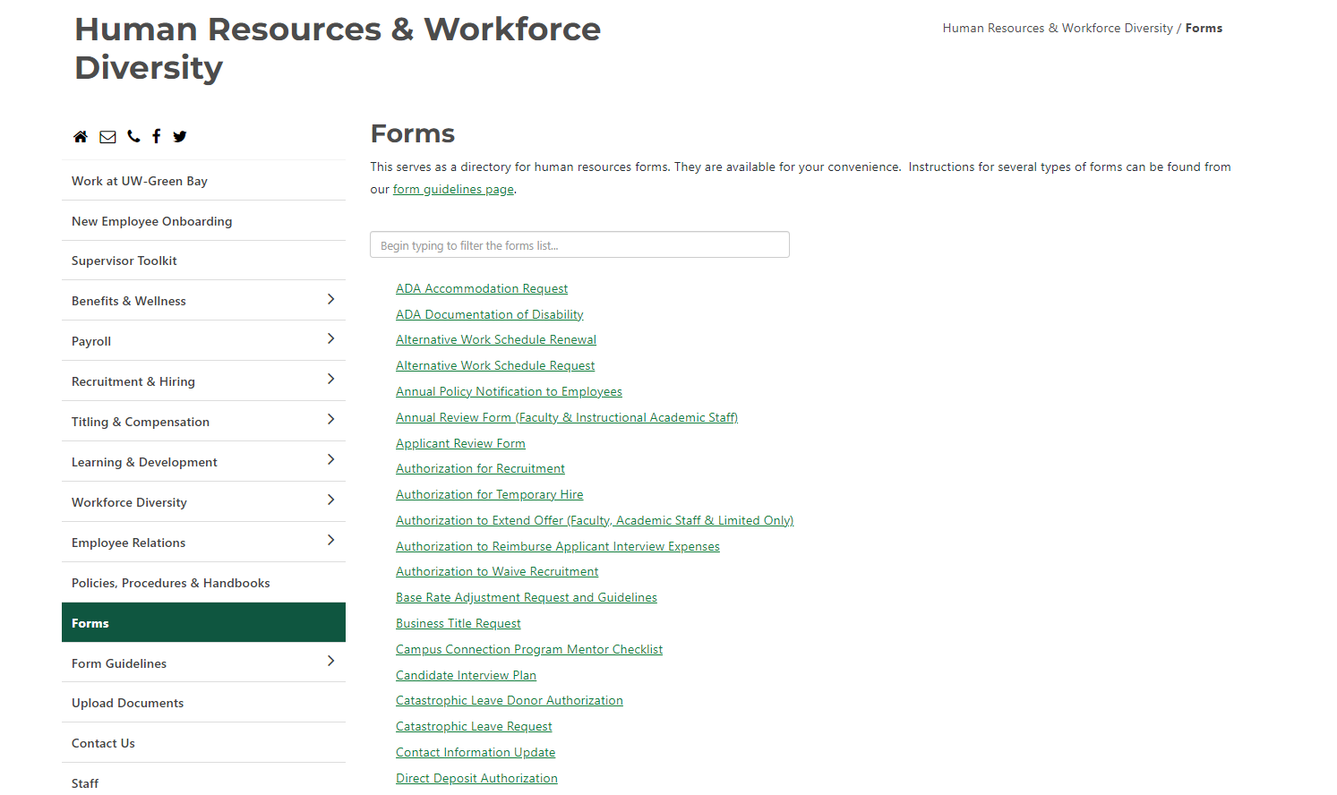
Where to go?
Human Resource Website>Forms
Can type into search
https://www.uwgb.edu/human-resources/forms/
Notes:
Rachel

Slide 26
Demo
Student employment request form (hire student into new position): https://uwgb.bplogix.net/form.aspx?pid=e6634b2b-e441-4279-8c38-a89adb52152c&formid=112548f4-ab82-4f1f-a808-9ca0725ea0e3&nohome=0&completepageprompt=0&completepage=custom//Redirect.html&completetext=
Multiple student employment request form (hire 5 or more students into the same position): https://uwgb.bplogix.net/form.aspx?pid=e6634b2b-e441-4279-8c38-a89adb52152c&formid=74d1ca11-f4e5-4ad7-9caa-83d723bdc389&nohome=0&completepageprompt=0&completepage=custom//Redirect.html&completetext=
Student employment change request form (change funding, pay rate, approver, etc. for existing student position): https://uwgb.bplogix.net/form.aspx?pid=e6634b2b-e441-4279-8c38-a89adb52152c&formid=1349ae31-c1cd-40d7-aa26-15581e2fd4f1&nohome=0&completepageprompt=0&completepage=custom//Redirect.html&completetext=
Notes:
Rachel

Slide 27
Centralization of I-9 Processing
Old Process
New Process
Department is responsible for:
Initiating the I-9 in HireRight
Providing communication and reminders to employee to bring in their documents
Verify documents and complete section 2 of the I-9 form
HR is responsible for:
Initiating the I-9 in HireRight
Providing communication and reminders to employee to complete section 1 / present documentation
Verify documents and complete section 2 of the I-9 form
Notes:
Rachel

Slide 28
Questions?
Student Employment Fair during GB Welcome
Sunday, Sept. 3, 12:00 – 1:00pm
Notes:
Rachel

