Slide 1


RESILIENCY:
LOOKING BACK TO MOVE FORWARD

Slide 2

Resiliency
The capacity to recover quickly from difficulties; toughness.
What has been your proudest moment of resiliency since the pandemic began & why?
Notes:
Introduce the topic by saying it is a personal responsibility to create and maintain a positive work environment – you as the trainer, are there to challenge each participant to do what they can do to make a positive work environment.

Slide 3
Spring 2020 – The Early COVID Era
After decades of warning, a global pandemic arrived in 2020 – the Novel "New" Coronavirus
How did your own behaviors change in early 2020?
  Washed groceries
  Stored paper goods
  Disinfected everything while wearing rubber gloves
How did society change in early 2020?
  Our worst fears were realized
  Civil unrest picked up
  Covid continues
Notes:
Trainer: This is a brain storming exercise – have the group call out all the things they associate with a NEGATIVE work environment.

Slide 4
The Whole World Changed in the Blink of An Eye...
Take a moment to reflect on how quickly you:
Pivoted to working from home
Adapted to new technologies… fast!
Readjusted your family's schedule
Lifechanging behaviors
  Face coverings
  Social distancing
  Outdoor socialization
Notes:
Trainer: Continue the brain storming exercise – have the group call out all the things they associate with a POSITIVE work environment. This session is meant to help us get there.

Slide 5
A World in Crisis Greets You Every Morning...
We wake up to alerts and headlines about:
Natural disasters
War & terrorism
Mass shootings
Police brutality
Hate crimes
Notes:
Quickly introduce the topics that will be covered today.

Slide 6
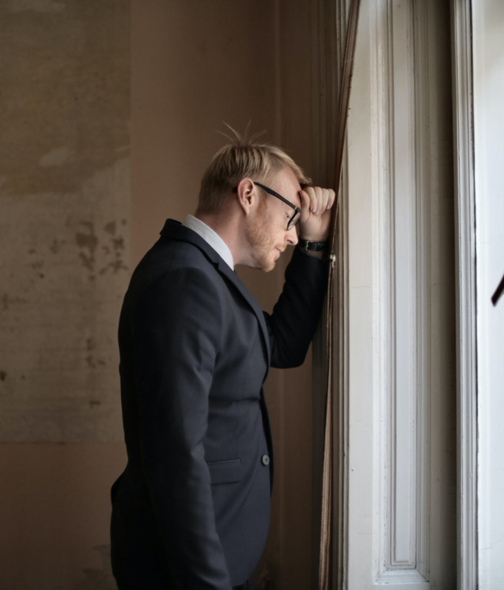
The Pandemic Made Us EXHAUSTED From...
Sleep deprivation
"Zoom" Fatigue
Constantly having to readjust to external circumstances
Conflict fatigue
Compassion fatigue
Discussion:
Which of the above affected you the most?
Over the last 3 years, what were you able to manage the best? What do you wish you handled better? Why?
Notes:
Trust in an integral ingredient in a positive work environment – have a story you can tell about a work environment in which you had to deal with a person you did not trust versus one you did trust. Remember: this is one of the foundations of building a positive work environment so pace yourself there will be more.
Talk about and ask if successful in returning all emails and phone calls…. If not, how can you get there. Credibility and reputation… within 24 hours.
Big part of building trust comes down to organization! Be organized and walk the talk… be reliable.
Ask for other ideas that help colleagues build trust with one another.
Use an example or story….
Office gossip – remember everyone is a human being with human feelings… gossip can destroy a work environment.
Ask yourself – what can you do to be a more trust worthy person.

Slide 7
For the past few years, we've all found ourselves wondering...
"When will this all go back to 'normal' already?"

Slide 8
Present Day – What Have We Learned?
Great readjustment
  Not expecting for this to last
Great resignation
  “Soul searching” & finding a new work/life balance
Great regrets
  Maybe should not have made that change
Quiet quitting
  There's more to life than work
Quiet firing
  Recession are layoffs are looming
Notes:
People can manage disappointments if they are honest. A positive work environment manages realistic expectations. Ask yourself “what realistically can be done in one business day, week month.”
By people understanding that the workload is reasonable and that we are not after perfection this contributes to a positive work environment even when there is pressure – Acknowledge that we are all working harder today than a year ago,
Today's work place does deal with a great deal of disappointment and the feeling that it is not what it used to be…. So we need to acknowledge that and then move on. The expectations today are greater than ever before

Slide 9
The Future – What Comes Next?
Change is Inevitable. Growth is Optional.
The world will continue to change in our lifetimes
We have the power to accept change, adapt and grow
Be prepared for change; not a matter of “if” but “when”
Black Swans vs Grey Rhinos
Black Swan events can't be predicted and have a profound impact
Grey Rhino events are major indicators of future danger that are ignored until it is too late
Do you think the past few years were a Black Swan or Grey Rhino? Why?
Notes:
Trainer: in preparation, check out this link for the genesis of the positive work environment concept at Zappos:
http://www.chartcourse.com/zappos/
Shaking it up and doing new and fun things… celebrate the good. Come up with different solutions and make it individual as we all enjoy different things..
Idea: wall of – “what did well” or “job well done” being publicized
Attach recognition to “real” accomplishments and goal achievement as negotiated in a performance development plan. Make sure the recognition meets above the stated requirements.
Make the recognition random -- with an element of surprise.
Look for employee reward and recognition activities that build positive morale in the work environment. i.e. The Pall Corporation, in Ann Arbor, MI, has a “smile team” that meets to schedule random, fun events. They sponsor ice cream socials, picnics, “the boss” cooks day, etc.
Determine what behaviors your work place wants to recognize. i.e. recognizing team work, going the extra mile, and years of service.
Identify and communicate the criteria by which the proposed recipients will be judged or assessed, making it clear what employees need to do to qualify for recognition.
Magnify the value of the recognition by: naming the employee publicly, placing employee names in the newsletter, sending out a company-wide e-mail announcement, etc.
Avoid employee recognition traps that:
Single out one or a few employees
Zap the morale of the many who failed to win
Confuse people who meet the criteria yet were not selected
Seek votes or other personalized, subjective criteria to determine winners

Slide 10
Goals: Authentic Positivity
Practice self-awareness
  Be mindful to focus on the positive events while accepting the negative
Join a positive community
  Find like-minded individuals who celebrate and lift you up
Get support
  Acknowledge the past few years and the impact it had on you
Seek the positive
  Embrace gratitude journals and express gratitude toward others daily
Avoid Toxic Positivity: Do not pretend or hide your emotions.
  Everything is not alright
  We all are exhausted
  Perky facades are not the answer
Notes:
Reference: Marshmellow challenge
Explain the difference between empathy and sympathy.
Does your team enable you to be such a great team and have such a safe environment that when you make a mistake its ok…. And others support you to move forward?

Slide 11
Recognize Your Potential Future...
What does it look like?
What does it feel like?
What does it sound like?
What positive impact have you learned?
Notes:
People need to know what they do matters. Re read the book Man Search for Meaning by Victor Frankel. Which shows that people who help people are more likely to survive and thrive then those who take.
Ask participants why their job matters? Why does saying hello matter? What meaning does their job have? Or should have?
Talk about the difference between a job and a career…..

Slide 12
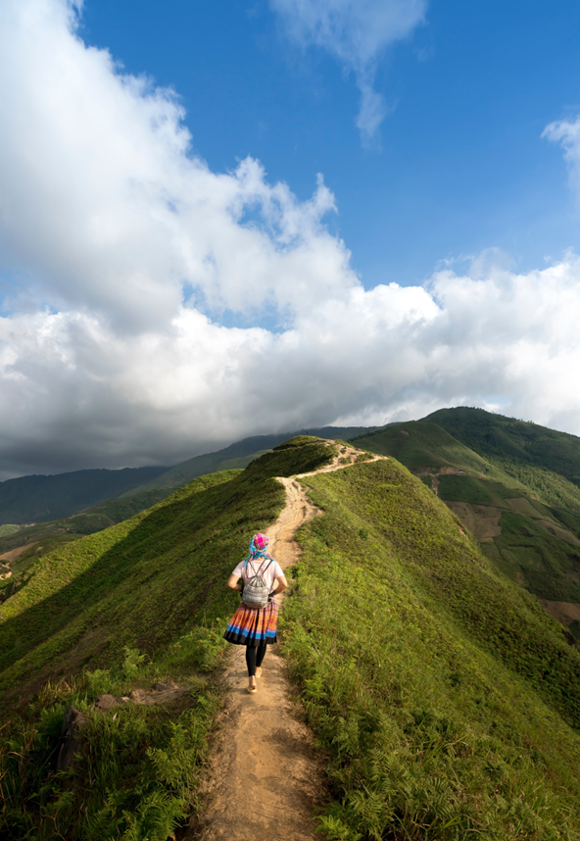
Focus on Perseverance & Persistence
"Post-traumatic growth could take five different forms: finding personal strength, gaining appreciation, forming deeper relationships, discovering more meaning in life, and seeing new possibilities.“
— Sheryl Sandberg
"Perseverance is not a long race; it is many short races one after the other."
Notes:
Have an honest dialog that maintaining a positive attitude at work will have some challenges. It is easy to remain positive when things go well – but when they don’t we must remember that we cannot control the stressor – but we can control our response.
It is good time to re-introduce and remind the participants of business etiquette today.
We have to be prepared and responsible for the good, bad and ugly. Look at when you have handled the stressors well and when you haven't handled them well. Reflect to be able to move forward..

Slide 13
Your EAP Benefits
EAP Services available to employees, household members and dependents
Completely Confidential
EAP Counselors available 24/7/365 via 833-539-7285
Up to 6 in person counseling sessions
Management Consultations
Financial/Legal Consultation and Referral Service
Work Life Support & Referral Services
Online tools and Resources - https://sowi.mylifeexpert.com Company code: SOWI

Slide 14
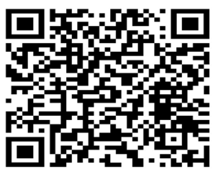
We want to hear your feedback!
Please complete a training evaluation. Thank you!
https://app.smartsheet.com/b/form/dacb2d9b38564db4afb5ab8426d91ad6
Notes:
Trainer please copy and paste the link into the chat

Slide 15
Questions?
Resiliency: Looking Back to Move Forward

