Slide 1
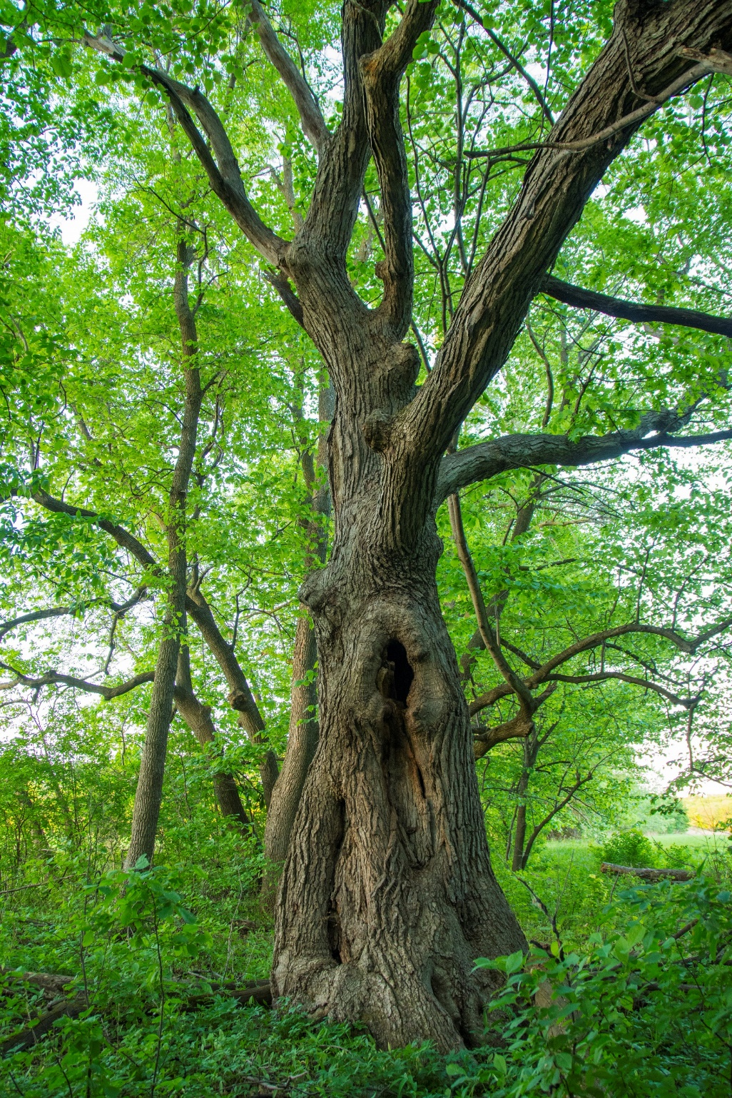
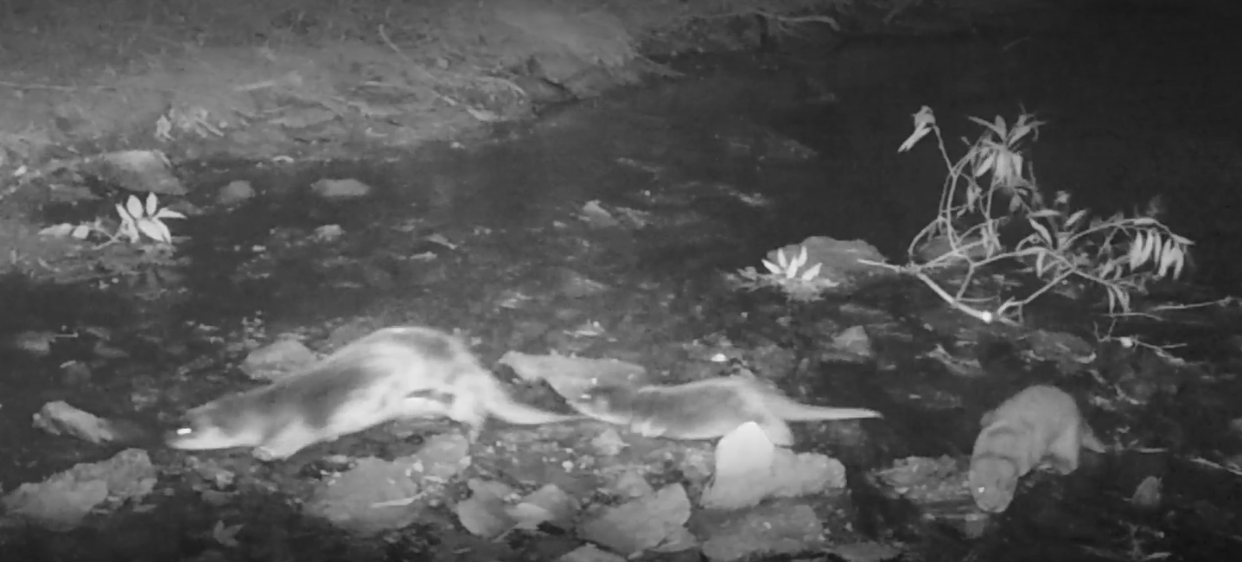
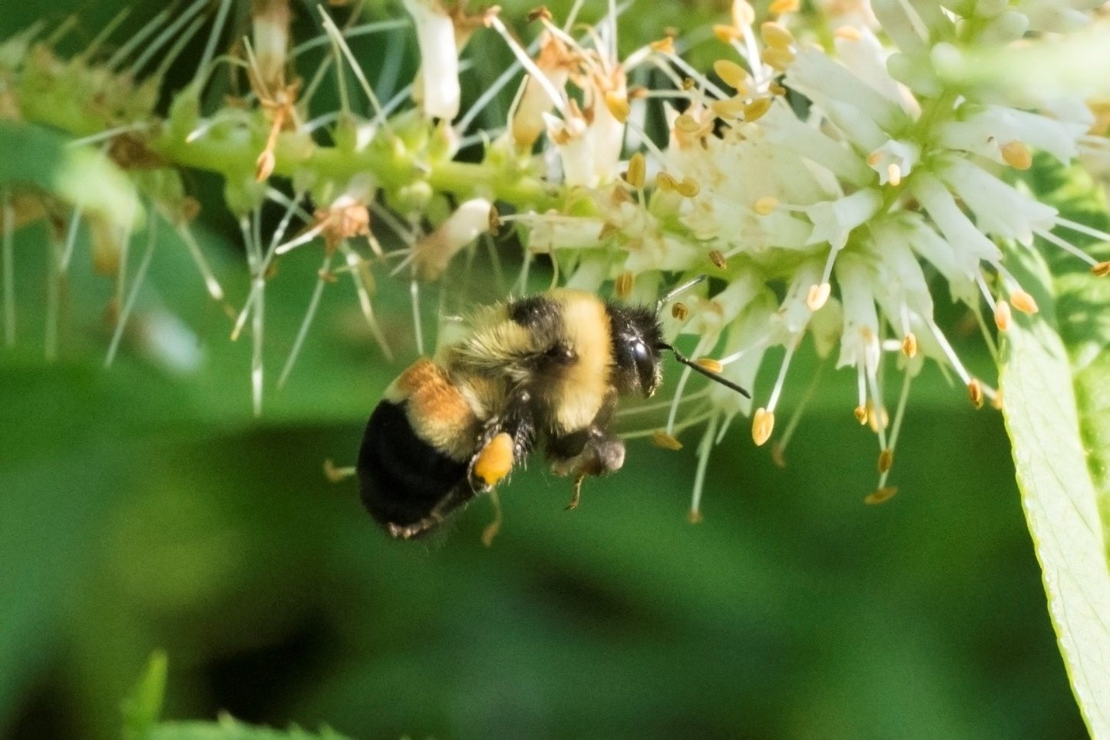
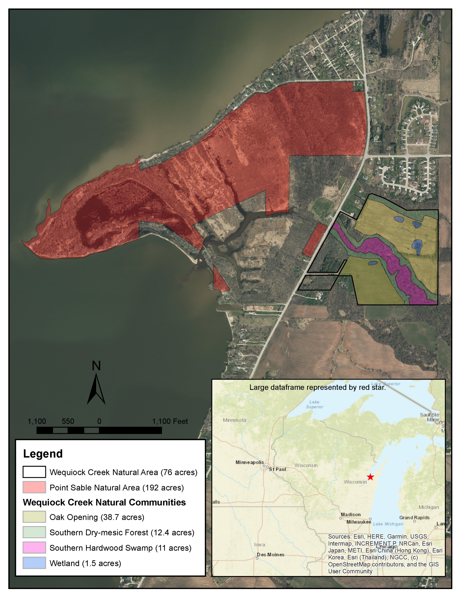
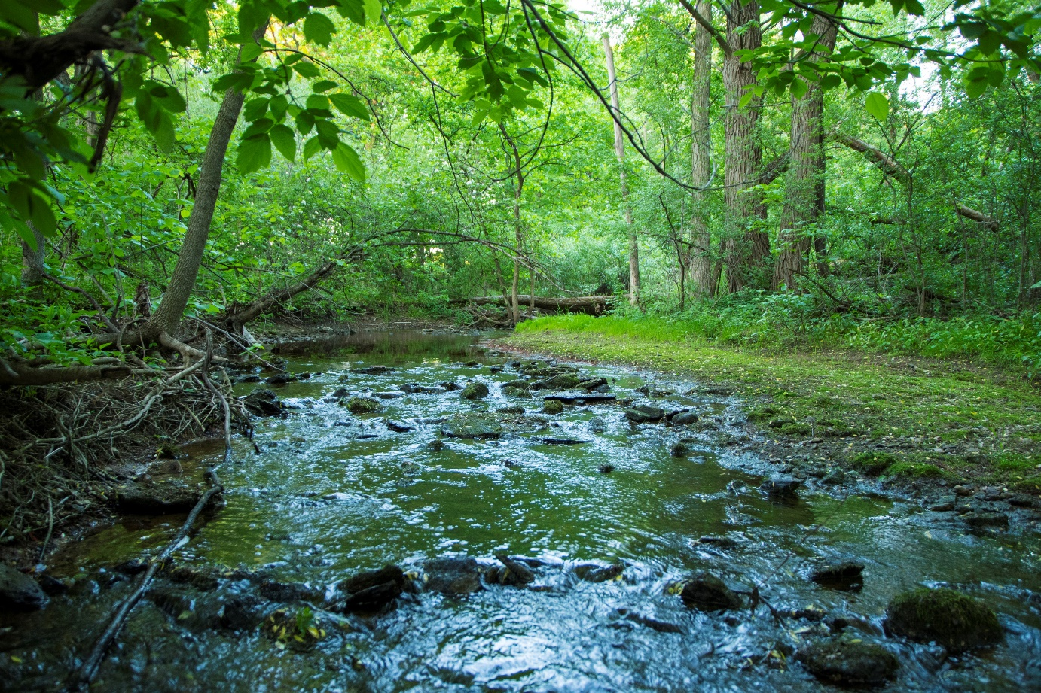
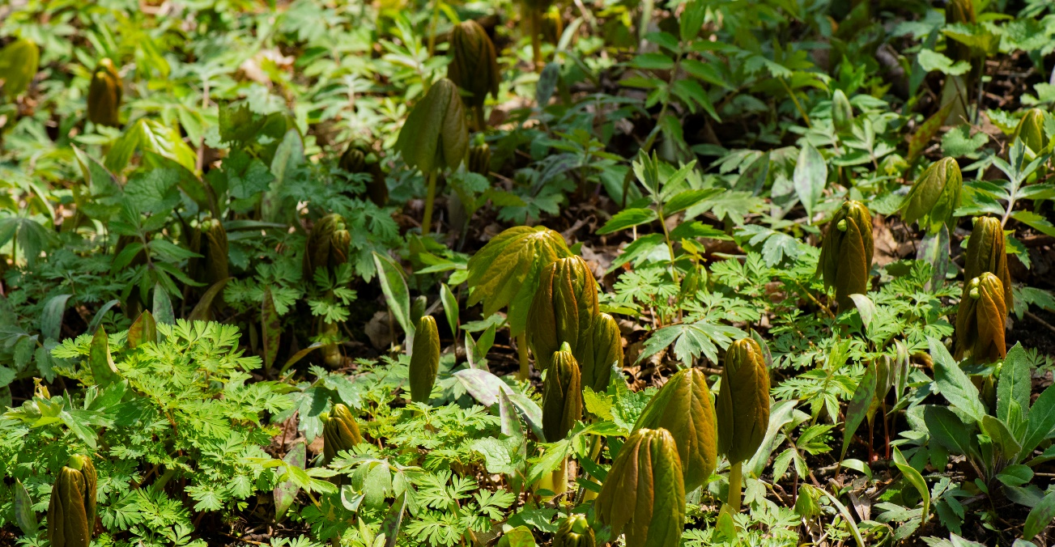
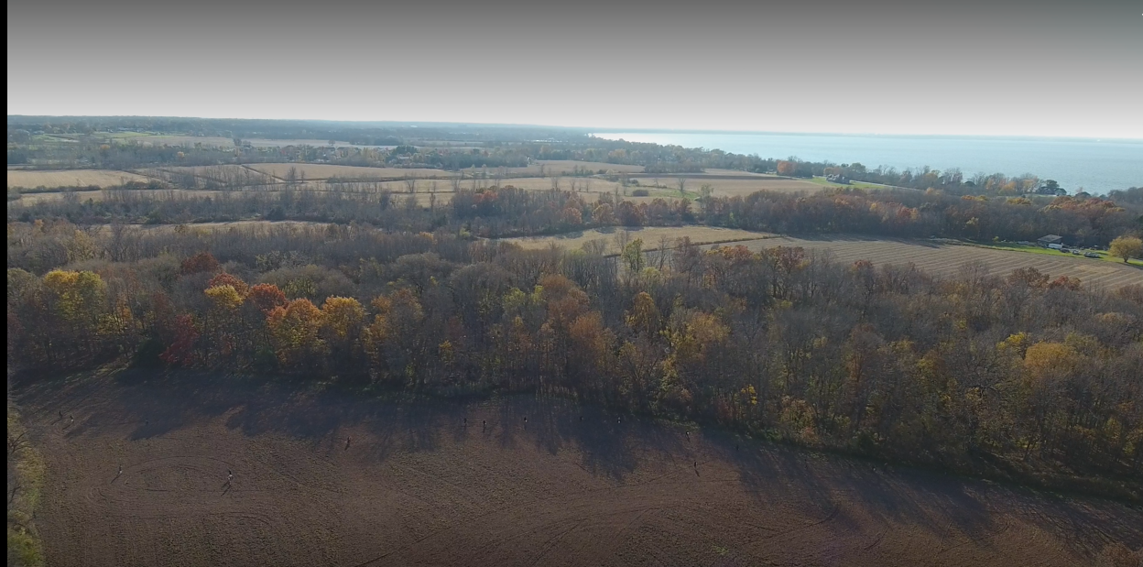
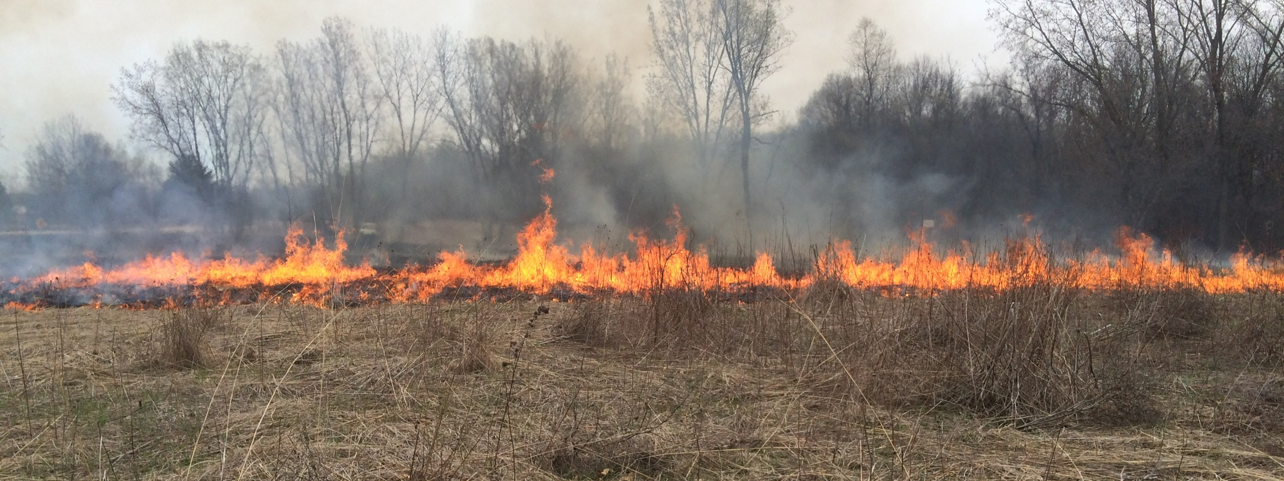
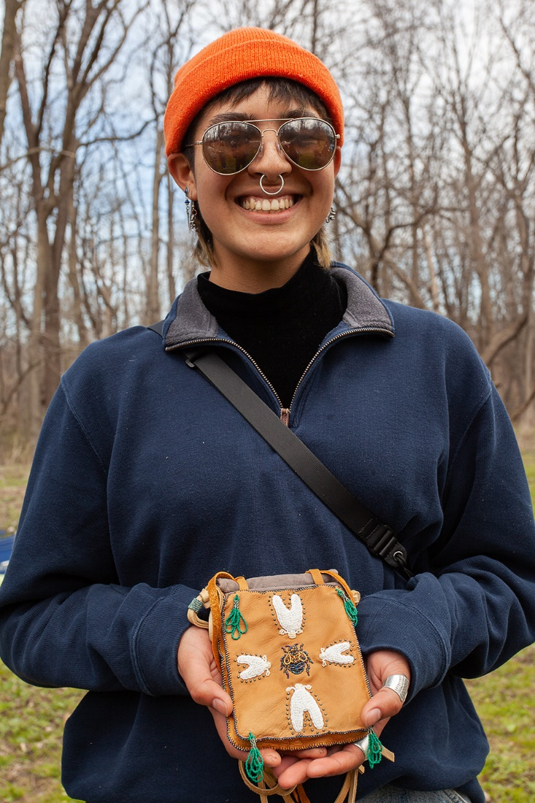
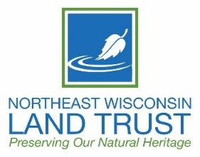
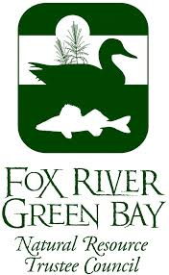
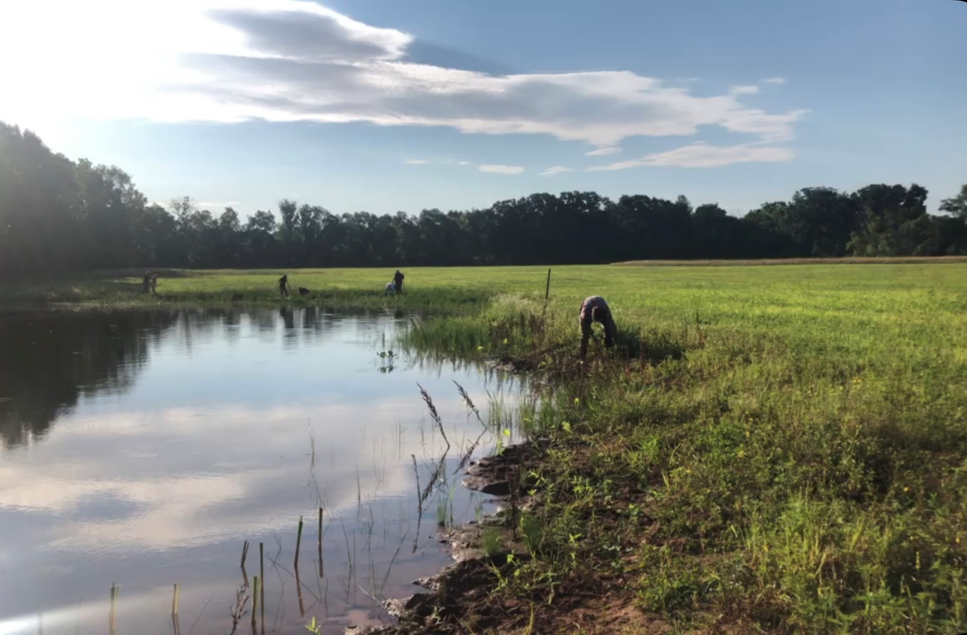
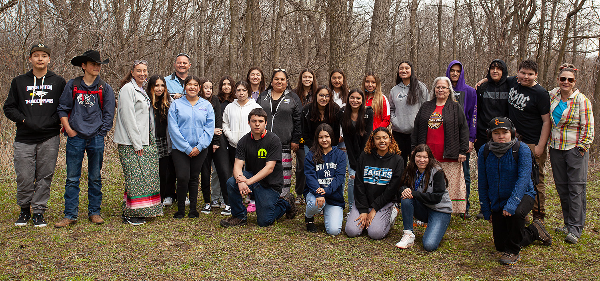
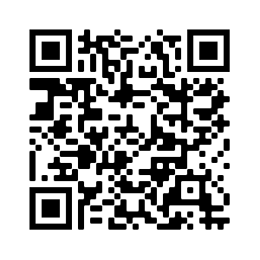
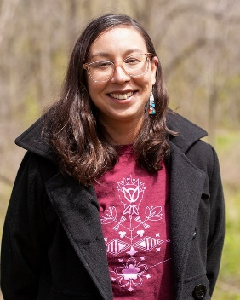
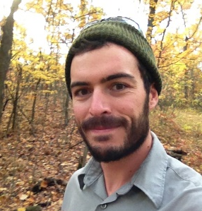
Wequiock Creek Natural Area: Reciprocal relationships with restoration and protection efforts Stephanie Dodge, Andrew LaPlant, Bobbie Webster
ECOLOGICAL & CULTURAL SIGNIFICANCE
UW-GREEN BAY LAND ACKNOWLEDGMENT
PRELIMINARY RESULTS
This land
Is ancestral homelands of Ho-Chunk, Menominee, and Potawatomi people who stewarded this land for millennia.
Is also important to Oneida people who have since settled in the Green Bay area.
Contains culturally and archaeologically significant sites.
Is part of a 450+ acre corridor of undeveloped or restored green space between the east shore of Green Bay and the middle Wequiock Creek watershed
We at the University of Wisconsin-Green Bay acknowledge the First Nations people who are the original inhabitants of the region. The Ho-Chunk Nation and the Menominee Nation are the original First People of Wisconsin and both Nations have ancient historical and spiritual connections to the land that our institution now resides upon. Today, Wisconsin is home to 12 First Nations communities including the Oneida Nation of Wisconsin, Forest County Potawatomi, Ojibwe Nation communities, Stockbridge-Munsee Community Band of Mohican Indians, and the Brothertown Indian Nation.
We acknowledge the First Nations Peoples of Wisconsin.
Establishing Relationships
> 35 Native youth engaged in learning about the area by touring and assisting with archaeological research
Planning is in progress for a fall visit by additional native youth.
Regular updates are provided to Tribal Historic Preservation Officers.
Additional conversations and brainstorms are happening and connections are being made.
Key habitat and connectivity
Includes old fields lined by small remnants of oak savanna; southern dry-mesic forest on steep slopes; and southern hardwood swamp along the creek.
$1/2$ mile upstream from the mouth of Wequiock Creek and $1/{3 }$mile downstream of Wequiock Falls flowing over Niagara Escarpment.
Set in a matrix of farmland and rapidly urbanizing suburban lands adjacent to an important coastal wetland complex.
WEQUIOCK CREEK NATURAL AREA
Important habitat for:
small mammals.
anurans.
fish, including river redhorse (Moxostoma carinatum) and perch (Perca flavescens).
macroinvertebrates.
Family of river otters ( crossing Wequiock Creek in summer 2022, (Lontra canadensis) caught on one of the 8 trail cameras that are used for monitoring wildlife.
Photo credit: Dr. Amy Wolf
federally endangered northern long-eared bat (Myotis septentrionalis) documented at Point Sable.
several important pollinators (see Preliminary Results) including the monarch butterfly (Danaus plexippus) and rusty patched bumblebee (Bombus affinis).
Rusty patched bumble bee (Bombus affinis) collecting pollen on a Culver’s root (Veronicastrum virginicum) flower.
Biota and habitat
84 plant species documented on over 132 1 m² plots and meander surveys.
At least 5 bat species detected (2 state threatened 1 state special concern) (Boulanger 2020, Paplham 2022).
8 bumblebee (Bombus) species recorded, including 1 federally endangered bee (Bombus affinis) (Wolf 2022).
At least 12 butterfly species identified, including monarch butterfly (Danaus plexippus).
51 bird species recorded using the site since late June 2022.
13 mammal species documented since early 2022.
12 aquatic macroinvertebrate species recorded.
At least 3 frog species and 1 turtle species recorded.
Photo credit: Dr. Robert Howe
over 200 bird species (documented at Point au Sable).
Bur oak (Quercus macrocarpa) in the wooded riparian buffer that includes remnant oak savanna near Wequiock Creek. Large diameter, open-grown trees like this are indicative of a former oak savanna community, which would not exist if not for stewardship by First Nations people (Dorney & Dorney 1989). Trees like this are important for cavities for nesting birds and roosting sites for resident and migratory bats.
FUTURE
Protects coastal wetlands and intact floodplain
Protects over 50 acres of declining coastal wetland habitats, including palustrine emergent wetland, palustrine forested/shrub.
Protects a uniquely undisturbed stream corridor that meanders freely within a relatively undisturbed floodplain.
Infusing Land Back practices into our work.
Returning foods
Incorporate traditional food practices that various First Nations are revitalizing within their communities.
Returning medicines
Further enhance plant communities with culturally important plant species.
Returning language & place names
Develop and install educational and trail signage using
Indigenous languages of the region.
Possibly re-name WCNA areas using words that can translate
into various Frist Nation languages.
Photo credit: Dr. Robert Howe
Photo credit: Dr. Robert Howe
Newly emerged spring ephemerals, mayapple (Podophyllum peltatum), trout lily (Erythronium americanum), and dutchman’s breeches (Dicentra cucullaria) in the floodplain forest. These are just a few of the spring ephemeral species present at WCNA. This component of the understory will be emphasized in part because of its high importance to early emerging insects including bumble bees.
Wequiock Creek and floodplain
CREATION STORY OF WEQUIOCK CREEK NATURAL AREA
Returning practices & natural communities
Develop and implement a land management plan in collaboration with First Nations associates that incorporates traditional methods used by Indigenous people of the region such as prescribed burning (Dorney & Dorney 1989)
Return oak trees and fire to begin the centuries-long process of restoring old fields to oak savanna. The first planting of fire-resistant-sized (> 2 inch) oak saplings will be installed sparsely, beginning in Fall 2022 with more to follow.
Time immemorial
Ho-Chunk Nation and Menominee Nation both hold ancestral land claims deriving from creation stories that take place along the banks of Green Bay.
Potawatomi nations also have settlements in the
the area that have been documented by archaeologists.
Settlement
Oneida Nation relocated to the area in the 1800s and
is a growing presence in the Green Bay area.
Recently (the late 1800s) the site was settled by
European colonists and was grazed and cropped for decades.
Urban sprawl
Most recently (since the early 2000s), a real estate development group owned most of the land and it was platted for housing development.
Local government leadership
Combined factors kept this land undeveloped, including the global financial crisis of 2007-2008 and the Town of Scott steadfastly upholding rules and procedures related to streambank setbacks and city water expansion.
Officials from the Town of Scott have maintained a relationship with local First Nations contacts and UW Green Bay for well over a decade. In addition to committing to these relationships, they have strived to honor and address the ecological and archaeological significance of land in the town by developing special planning documents and ordinances.
Partnerships
After decades of farming and grazing, this land was purchased by the Northeast Wisconsin Land Trust and Town of Scott in 2019, in partnership with the Cofrin Center for Biodiversity at UW-Green Bay.
Because of the ecological, archaeological, cultural, and community significance of this place, the partnership was able to compete for funding for the acquisition from several sources including a National Coastal Wetland Conservation Grant from the US Fish and Wildlife Service, and several others.
Photo credit: Jacob Woulf
ANNUAL TOBACCO BLESSING
Photo credit: Dr. Dan Meinhardt
Aerial view of old fields and floodplain forest at WCNA with Green Bay in background
It is customary with many Indigenous cultures to offer tobacco prior to disturbing the land and/or water.
Photo credit: Dr. Dan Meinhardt
In alignment with this cultural practice, the UWGB Center for Biodiversity and UW Sea Grant hosted the first Wequiock Creek Tobacco Blessing in 2021, formally requesting the presence of the area First Nation communities’ Tribal Historic Preservation Officers, who also have legal standing as interested parties in this project.
This land and water hold a great significance for First Nations peoples and honoring the history, ancestry, and ongoing relationship with this place is an important component of the restoration work.
Photo credit: Dr. Robert Howe
Photo credit: Dr. Dan Meinhardt
A prescribed burn at a prairie on the UW-Green Bay campus, 4 miles south of WCNA. Similar fire behavior will be expected here.
UW student Ava Padilla created a custom leather tobacco pouch for the Cofrin Center for Biodiversity, presented at the 2022 Tobacco Blessing.
Advisory Council
Establish an advisory council with representation by all partners and First Nations Interested Parties to review land management, outreach, and educational plans and decisions.
Land acquisition
Assist partners as they implement a plan to purchase land to create a corridor from Wequiock Creek Natural Area to Wequiock Falls County Park.
We are working with area First Nations to ensure cultural sensitivity is respected, honored, and valued as we conduct ecological restoration work. This is part of building ongoing relationships with the nations to foster land back practices and ensure First Nations people continue to have oversight of the management of the Wequiock Creek Natural Area.
The tobacco blessing has been designated an annual event to help foster ongoing reciprocal relationships with First Nation communities and all of creation for future generations. In 2022 the event grew with the invitation of students from Menominee Indian High School and Oneida Nation High School Singers who blessed us with a water song and other longhouse songs. Both events were honored with words from elders from many of the nations invited along with a prayer for the work that will take place in the year to come.
SOURCES
Boulanger, N. 2020. A survey of resident bats at the Wequiock Creek Natural Area in Brown County, WI. Master of Science thesis. The University of Wisconsin-Green Bay. Dorney, C., Dorney, J. 1989. An Unusual Oak Savanna in Northeastern Wisconsin: The Effect of Indian-Caused Fire. American Midland Naturalist: (122) 1 pp. 103-113.
Overstreet, David. 2021. Documentation of Archaeological Sites and Properties-A Baseline Study of the Environs Associated with the Wequiock and Savoch Land Acquisition Parcels
Paplham, H. August 2022. personal communication.
Wolf, A. August 2022. personal communication.
RESTORATION ACHIEVEMENTS
2 Archaeological assessments conducted
4 wetland scrapes (1.5 acres) installed (August 2021)
2 acres wet-mesic prairie hand seeded (November 2021)
36 acres of prairie installed in the old fields (November 2021)
31 acres no-till, 5 acres hand sown
37 acres treated for woody invasives (Fall 2020, 2021)
34 acres treated for herbaceous invasives (Spring 2021, 2022)
5500 native trees and shrubs planted (May 2022)
3500 wetland plant plugs installed (July 2022)
ACKNOWLEDGMENTS
Restoration funding has been provided by: National Fish and Wildlife Foundation – Sustain Our Great Lakes Program, Fox River Trustee Council, US Fish and Wildlife Service – Coastal Program, and a private foundation. Restoration Project Principal Investigators are Dr. Robert Howe, Dr. Karen Stahlheber, and Dr. Amy Wolf. The Cofrin Center for Biodiversity Natural Areas Crew contributes significantly to restoration and biological monitoring activities.
CONTACT US
Photo credit: Bobbie Webster
Stephanie Dodge (She, Her, Hers)
Yakohkwali (Oneida), Awahsuki (Menominee)
First Nations Graduate Assistant-UW Sea Grant
First Nations Education Doctorate Candidate
dodges@uwgb.edu
Andrew LaPlant (He, His, Him)
Conservation Biologist
Cofrin Center for Biodiversity
laplanta@uwgb.edu
UWGB students install emergent wetland plants in wetland scrapes, August 2022
Photo credit: Dr. Dan Meinhardt
View videos of restoration activities at WCNA
Bobbie Webster (She, Her, Hers)
Natural Areas Ecologist
Cofrin Center for Biodiversity
websterb@uwgb.edu
Menominee Indian High School students, UWGB First Nations Ph.D. Candidate Stephanie Dodge, Oneida Nation High School Singers, at the 2022 Tobacco Blessing

