Slide 1
EAB Navigate for Staff/Faculty
Getting Set Up

Slide 2
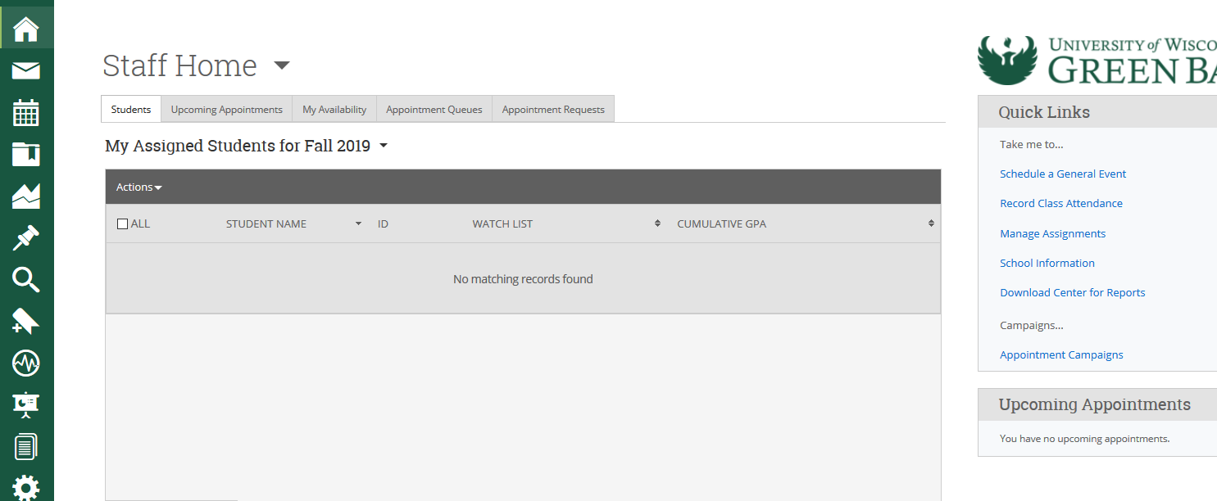
Understanding the Staff Home Page
The Staff Home page will be the page you land on when first logging into Navigate.
It can also be accessed at any time by clicking the icon which looks like a house on the left-hand navigation panel.
As an advisor, it shows students that may be assigned to you in an official capacity.
As a faculty member, it shows what classes you are teaching.
Staff Home also includes upcoming appointments, quick links to important information and the location to manage your availability.
Note: Features available within the Staff Home are configured to the needs of each institution. Certain tools may not be enabled for your role.

Slide 3
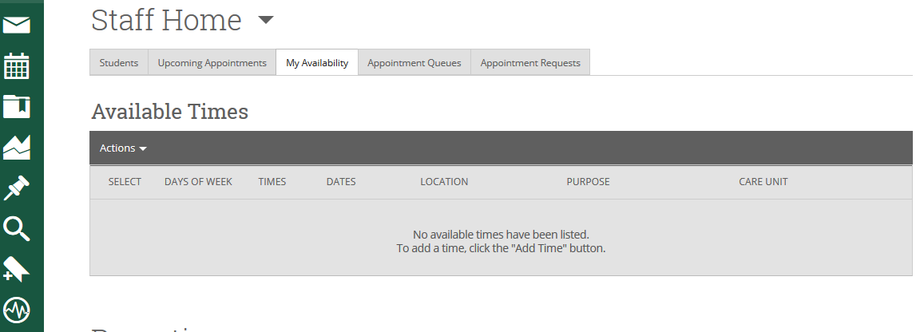
Setting Up Appointment Availability
Setting up your availability (accessible from the Staff Home page) is the most important step you must take if you intend to schedule and manage appointments with students in Navigate.
Setting up your availability impacts when and how students experience the scheduling workflow from their perspective.
Availability impacts your ability to take part in appointment campaigns (either sent by you or your department manager).
Availability should be set before syncing your calendars.

Slide 4
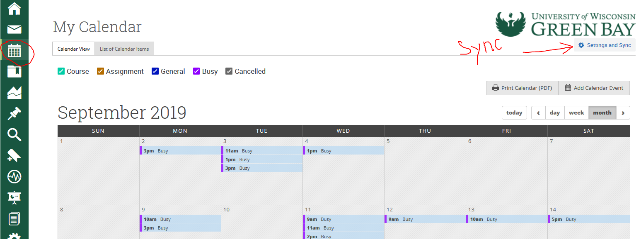
Syncing your Calendar with the Navigate Calendar
Syncing your primary work calendar with your Navigate calendar is key. This allows the two calendars to talk to one another and share information. That way, you do not have to cross-reference two different calendars to plan your day. It will eliminate the possibility of double booking.
The other benefit of syncing calendars is that when you have a new appointment on your work calendar (whether for a department meeting or personal doctor’s appointment) it will automatically update the availability students see for you in Navigate.

Slide 5
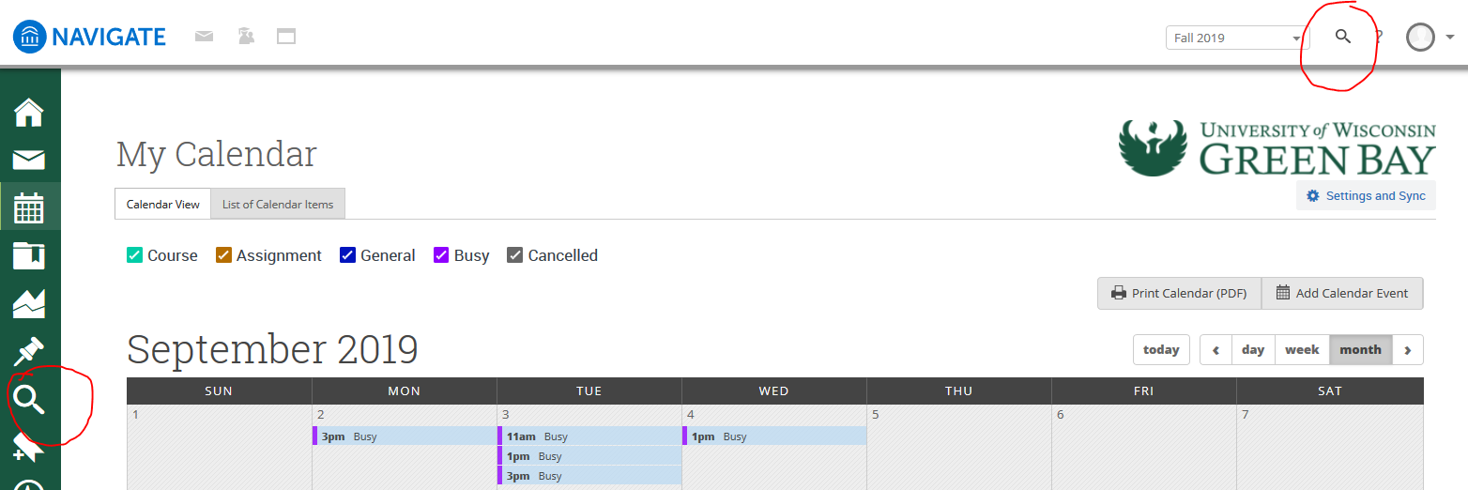
Searching for Students
You can access more information about students in the platform in several ways. Students assigned to you will obviously be visible on the Staff Home page. Students in your classes will also be available on Professor Home if you are a faculty member.
Typing a student's name in the quick access magnifying glass at the top right corner of the page, will bring you to that student's profile.
You can also search for other students with specific attributes by using the Advanced Search functionality. The Advanced Search can be access by clicking on the eye glass icon on the left-hand navigation panel.
After completing an Advanced Search, you can save your searches as a Watch List or Saved Search.

Slide 6
Conversations and Communication
The last key functionality to get you successfully started using Navigate is Conversations. This can be accessed by clicking the envelop icon on the left-hand navigation panel.
Conversations allow you to see all communication you have sent through the Navigate platform, including appointment notifications or changes, text messages, and emails.

Slide 7
Staff Home
This feature is the primary landing page for staff upon entering Navigate. This feature is enabled if you are able to log in to Navigate. Depending on your role configuration within Navigate, there may be some parts of this feature that are not visible to you.

Slide 8
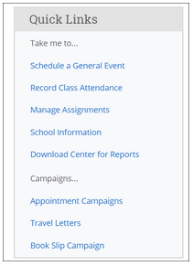
Quick Links
Quick Links is a section on your Home page that provides easy access to different features within the platform, such as scheduling, recording attendance, or tracking appointment campaigns. Clicking on a quick link will direct you to different locations in the Navigate platform. The links that display are specific to your role at your institution and may not exactly mirror those shown in the screenshot below.
Note: If you have more than one role, your Quick Links may be affected by the permissions for both roles.

Slide 9
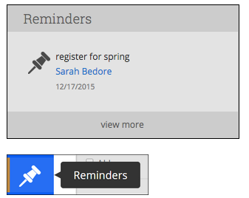
Reminders
Once you have taken an initial action, like setting up a meeting with a student, you may have no further work to perform at the present time. However, you may want to revisit the student’s information in the future. In this case, the platform provides staff and faculty with the ability to set a Reminder about a particular student.
Note: Reminders are ONLY visible to the person who created them and NOT visible to the student.

Slide 10
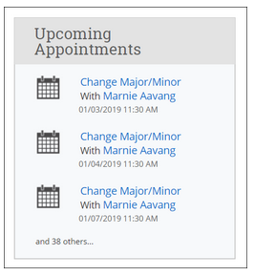
Upcoming Appointments
The Upcoming Appointments box shows you quick details of your next three scheduled appointments. Appointments are listed in chronological order.
For more detailed information, click on the Upcoming Appointments tab where you can see all of your upcoming appointments in the next 30 days. Clicking on the appointment link itself will take you directly to the appointment details.

Slide 11
Students Tab
The Students tab collects student-specific content for staff members, including information regarding assigned students
The My Assigned Students grid gives you a quick and easy way to view and interact with groups of students that have identified as being of particular interest to you. You will notice several key pieces of information next to each student’s name in the grid: their student ID, whether they are on one of your Watch Lists, their cumulative GPA, and their predicted risk level
From this grid, you can take many different actions on these students, depending on your user permissions. These actions could include: sending messages, creating appointment summary reports, scheduling appointments, adding a student to a watch list, issuing alerts, adding notes, or exporting a list of included students

Slide 12
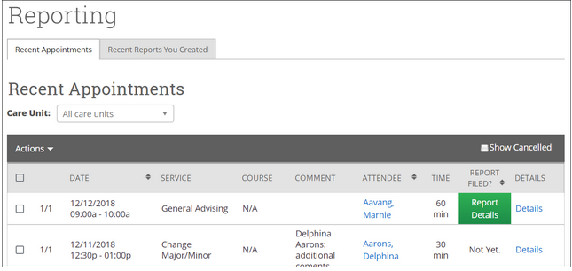
Reporting
At the bottom of Staff Home page is the Reporting section. Here, you will find a list of all your recent appointments as well as any appointment reports you have filed.

Slide 13

Reference:
©2018 EAB Global, Inc. • All Rights Reserved

