Slide 1
EAB Navigate for Tutor
Document Subtitle

Slide 2
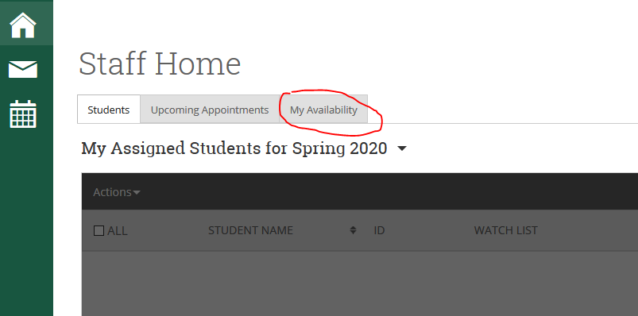
Setting Up Appointment Availability
Setting up your availability (accessible from the Staff Home page) is the most important step you must take if you intend to schedule and manage appointments with students in Navigate.
Setting up your availability impacts when and how students experience the scheduling workflow from their perspective.
Availability should be set before syncing your calendars.

Slide 3
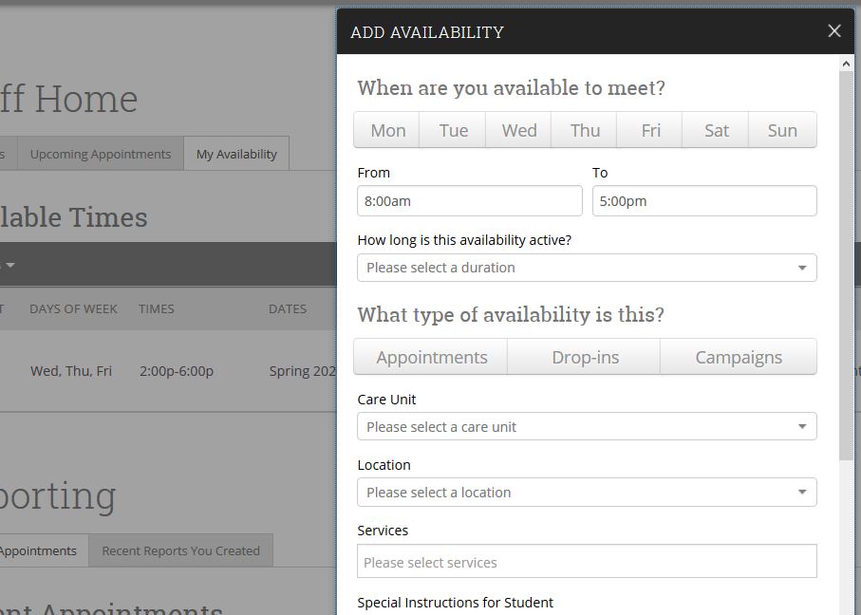
Setting Up Appointment Availability

Slide 4
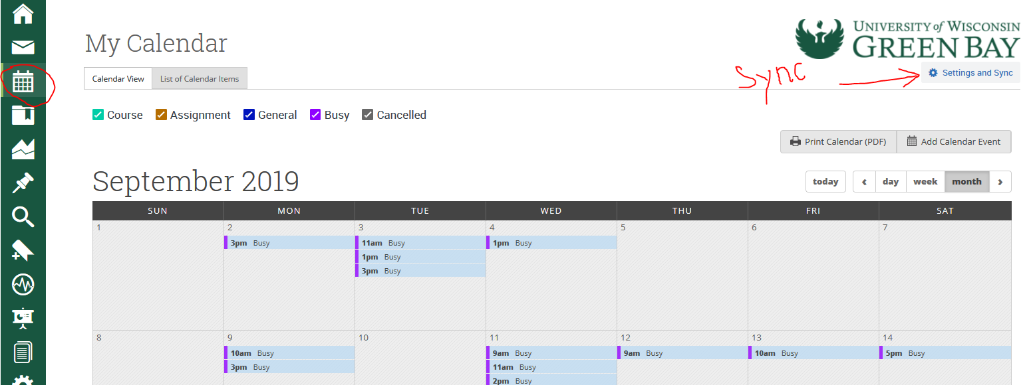
Syncing your Calendar with the Navigate Calendar
Syncing your primary student/work calendar with your Navigate calendar is key. This allows the two calendars to talk to one another and share information. That way, you do not have to cross-reference two different calendars to plan your day. It will eliminate the possibility of double booking.
The other benefit of syncing calendars is that when you have a new appointment on your student/work calendar (whether for a meeting or personal doctor’s appointment) it will automatically update the availability students see for you in Navigate.

Slide 5
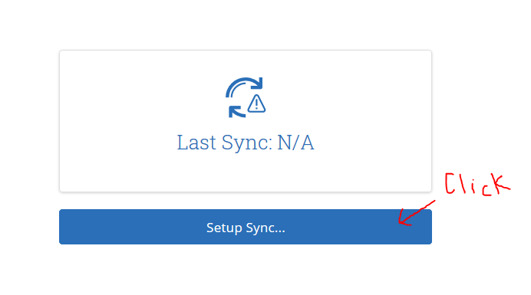
Syncing your Calendar with the Navigate Calendar

Slide 6
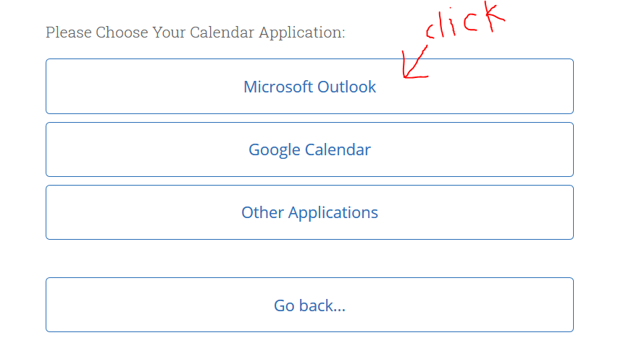
Syncing your Calendar with the Navigate Calendar

Slide 7
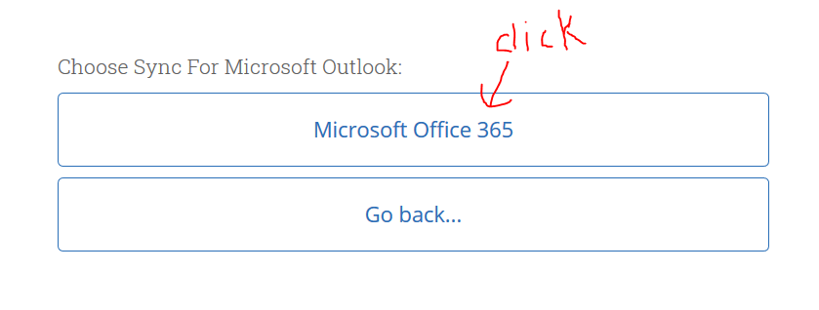
Syncing your Calendar with the Navigate Calendar

Slide 8
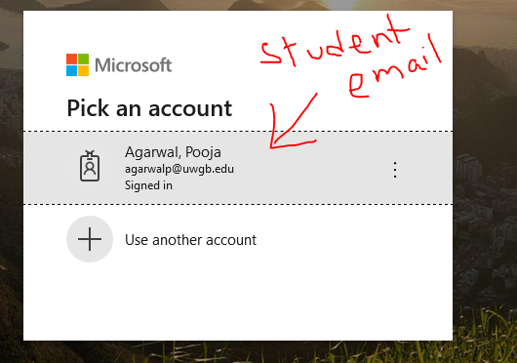
Syncing your Calendar with the Navigate Calendar
Enter your student email and password as prompted.
Click ‘Accept’ for the calendars to sync.

Slide 9
For any assistance/questions please reach out to Pooja Agarwal @ 920-465-2327 or agarwalp@uwgb.edu.
Thanks!!

