Slide 1
How to bookmark EAB on Chrome

Slide 2
Go to the EAB Navigate site via this link: type or copy-paste in the browser
https://uwgb.campus.eab.com

Slide 3
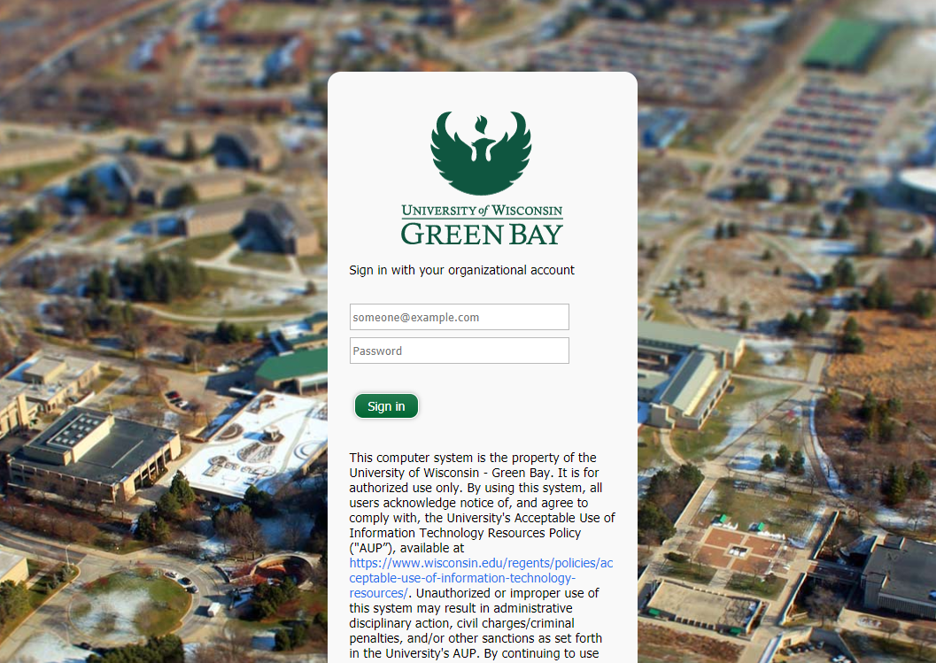
Type in your UWGB credentials to log in into EAB Navigate

Slide 4
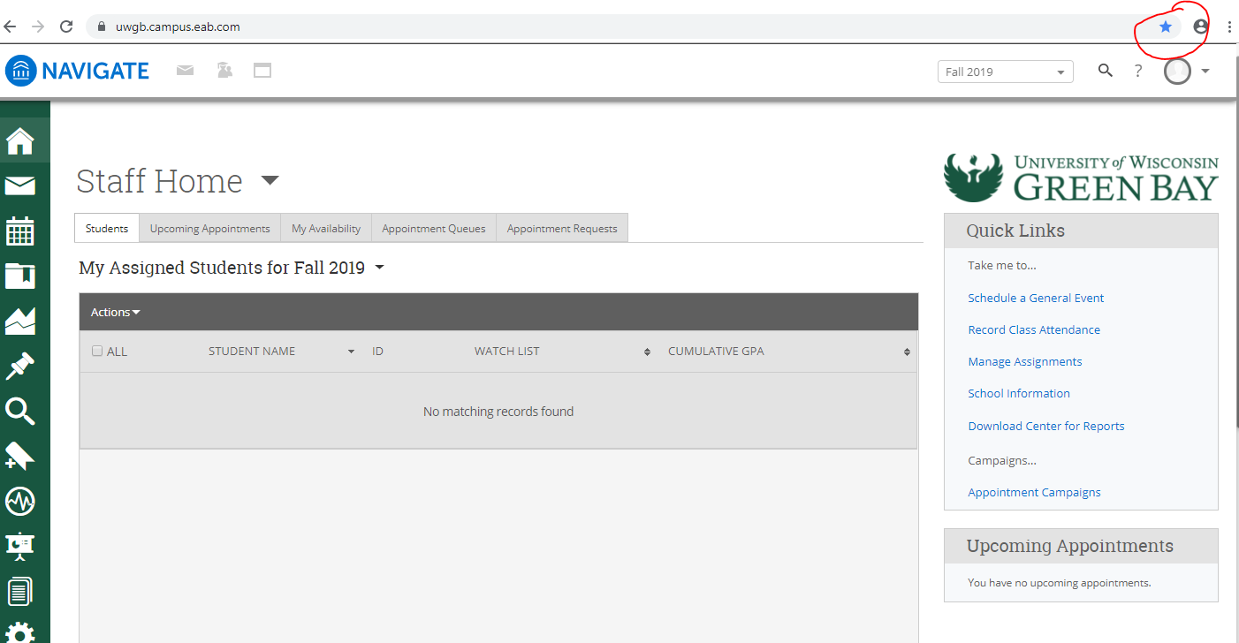
After logging in, click on the star on the right hand side of the browser

Slide 5
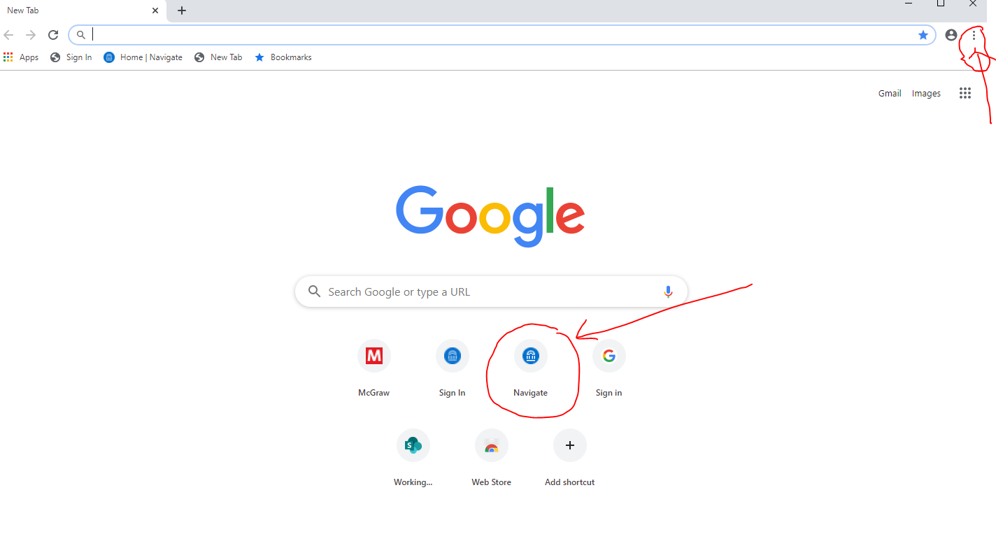
Once bookmarked, the Navigate homepage is going to appear on your chrome home screen as shown in the picture below or can also be accessed via the three dots in the upper right corner by clicking on the bookmarks.

