Slide 1
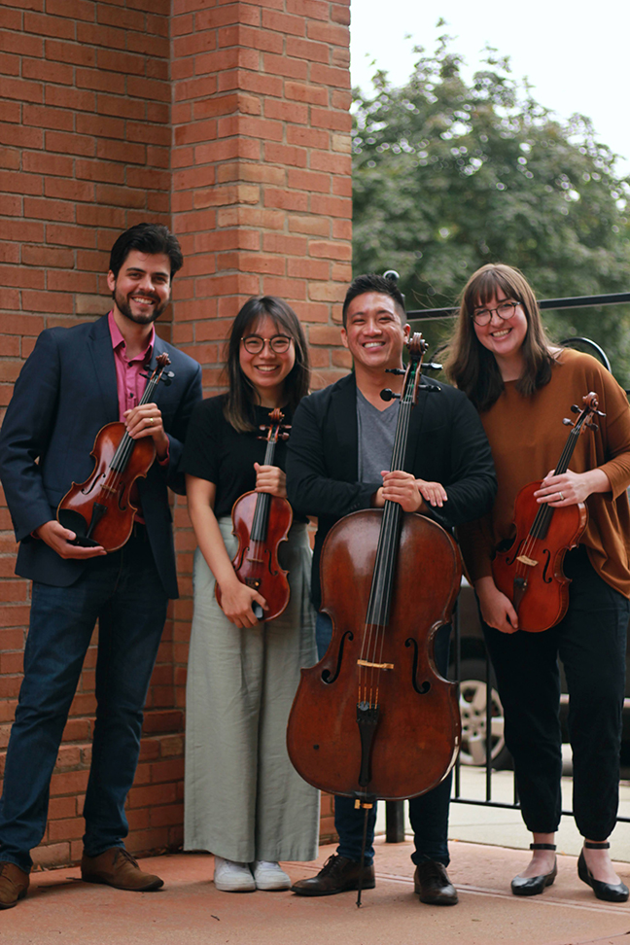
The Griffon String Quartet
By: Caitlyn Belson, Abby Turner, Emily Krause, Angela White, & Elsie McElroy
01
Notes:
Abby

Slide 2
Agenda
Background
Quartet Members
Goals as a Music Group
Mission Statement
Analysis of the Mission Statement
KISS Chart - Audience Analysis
Current Website Analysis
Website Uses of Other Music Groups
Website Analysis Suggestion
Website Mockup
Current Social Media Presence
Social Media Uses of Other Music Groups
What Social Media would be the Most Effective
So What Should Be Done?
So How Should this be Implemented?
Post Examples
Ideal Links & Nodes
5 C’s
Lessons Learned
References
Notes:
Abby

Slide 3
Background
Founded in 1990 - Midsummer’s Music
Third year of the Griffon String Quartet.
Started in 2018
As a group, they currently work with the kids of Northeastern Wisconsin.
They present mini concerts.
Their primary demographic ranges from kids to adults and people with dementia & Alzheimers.
Most of their events are free to the community.
Notes:
Abby

Slide 4
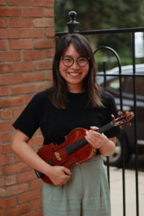
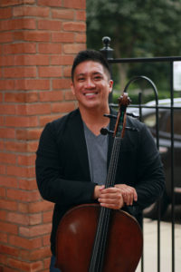
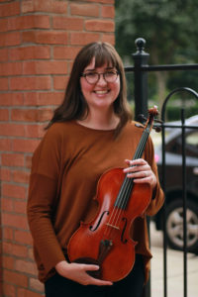
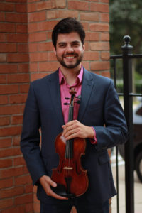
Quartet Members
Who they are & what they play
Ji-Yeon Lee Ryan Louie Blakely Menghini Vinicius Sant’Ana
Violin Cello Viola Violin
Notes:
Abby

Slide 5
Goals as a Music Group
Make people love music.
Make the public go to concerts.
Increase donations and donors.
Increase awareness of music group.
Grow and make a name for themselves independent of Midsummer’s Music.
Notes:
Caitlyn

Slide 6
“Actively embedded in our community, captivating every generation through music. Educate. Enrich. Excite.”
Mission Statement
Notes:
Abby

Slide 7
Mission Statement Analysis
Educate: The quartet teaches music lessons through the Boys and Girls Club, scholarships, and school visits for the less fortunate.
Enrich: Outreach in the community, the quartet goes to senior/memory care facilities and performs.
Excite: Performances for the public, the quartet goes to different venues and quirky locations, and performs pop up concerts, to get people excited about music.
Notes:
Elsie

Slide 8
KISS Chart: Audience Analysis
Audience | Know | Infer | So What? | So What Not to do?
Donors | Strong group, very passionate about the future of music, believes heavily in the quartet. | Would like to stay updated, frequent updates may be best. | Have an online update section where updates can be posted for donors to hear about what the quartet has been up to. | Do not keep donors out of the loop.
Kids & Parents | Kids take music lessons from the quartet sometimes through schools, parents need a way to be educated about lessons and resources for their kids. | Kids like visuals and sounds, parents would like a way to get information for their children quickly and efficiently. Take out the school middle man. | Post videos online for children to watch and create excitement, have an online platform for parents to get information about lessons for children. | Do not rely on only the school or the children to relay information to parents. Do not describe the quartet to children using only pictures or words.
Notes:
Emily
North Eastern Wisconsin// Brown/Door county

Slide 9
KISS Chart: Audience Analysis
Audience | Know | Infer | So What? | So What Not to do?
Senior Care Patients & Their Families | The Seniors really enjoy music and when the quartet comes to visit, their families could be potential donors. | Seniors may not use social media, get their information from their caretakers families, their families could use quick updates and event locations. | Use an online platform to quickly relay event/location information to families. | Do not keep families of senior care patients out of the loop about quartet performances.
The Public | Located in northeast Wisconsin (Brown + Door County), located at many different venues, those who go to concerts enjoy this kind of music. | Need event location updates on a widespread scale. Want venues located in their area. Those who are not as versed in the quartet may want to see and hear what they are like. | Use an online platform with a large reach to give event/location information to the general public. | Do not only advertise performances using word of mouth or physical posters.
Notes:
Emily

Slide 10
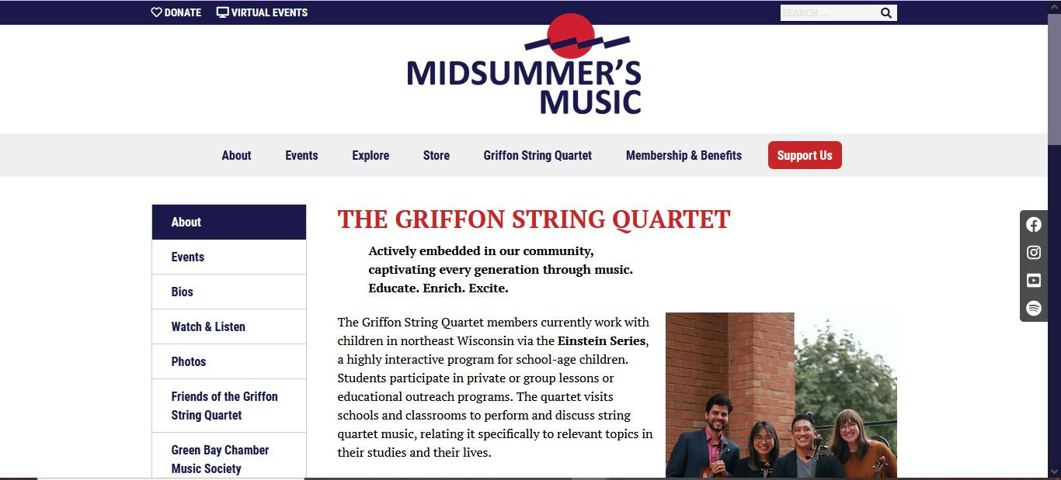
Current Website Analysis
Housed under Midsummer’s Music
Loses attention - average user gives 15 seconds
Does not have any links to any social media accounts - personal or group’s
Outdated content in sections
Zero indication of levels of donations’ rewards listed in PDF in the store’s offering
Old member still on PDF and Support page
Notes:
Elsie

Slide 11
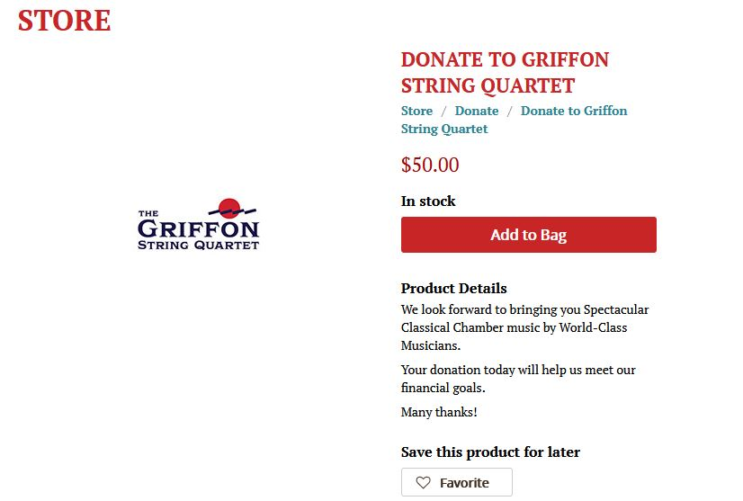
Notes:
Elsie

Slide 12
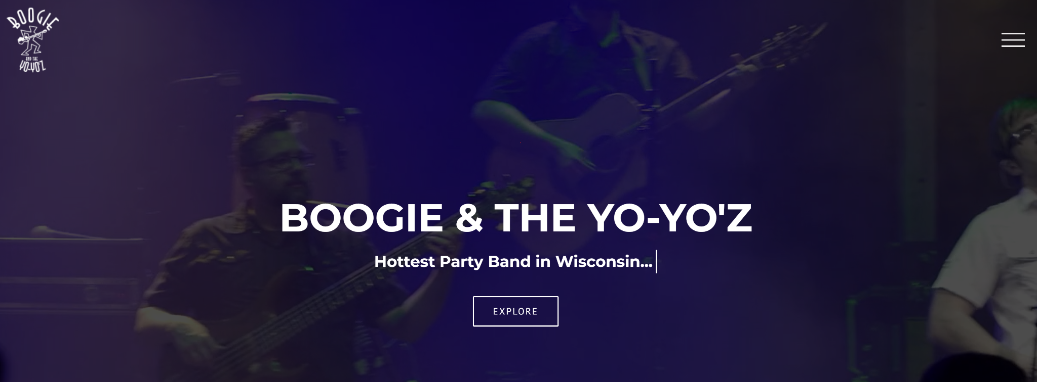
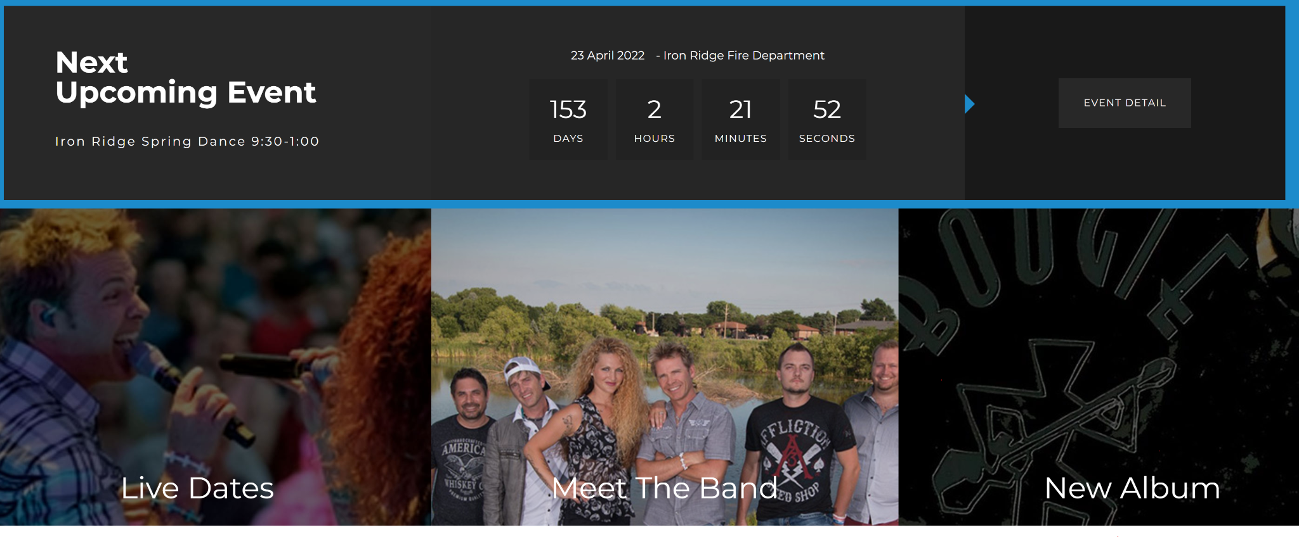
Website Use of Other Music Groups
Boogie & The Yoyoz (Another Music Group in Local Wisconsin)
“Hottest party band in Wisconsin... and maybe Iowa.”
Their website includes
Next Upcoming Events/Live Dates
Meet the Band
New Album
Stories From the Road/Latest News
Promo Video
Tour Schedule
Contact us
Notes:
Angela

Slide 13
Website Analysis Suggestion
Ideally: Create new website for Griffon Quartet
Can utilize original sections
Can link back to Midsummer’s Music
Link actively used social media
Potentially emulate blog-like atmosphere
…learners tend to be more active and engaged with blogs than they do in other pedagogic and web-based environments (1)
Notes:
Elsie

Slide 14
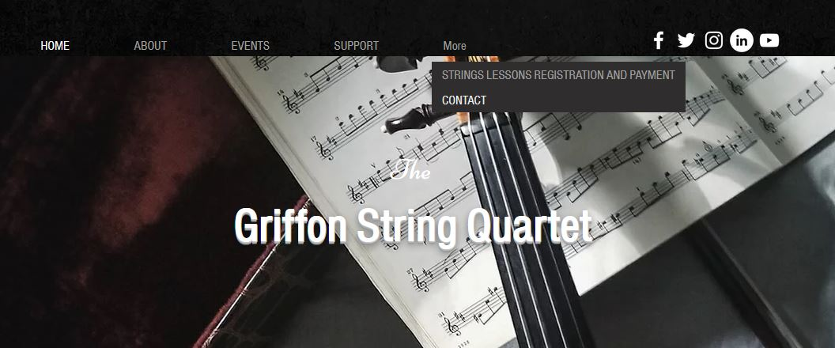
Website Mockup
Notes:
Elsie

Slide 15
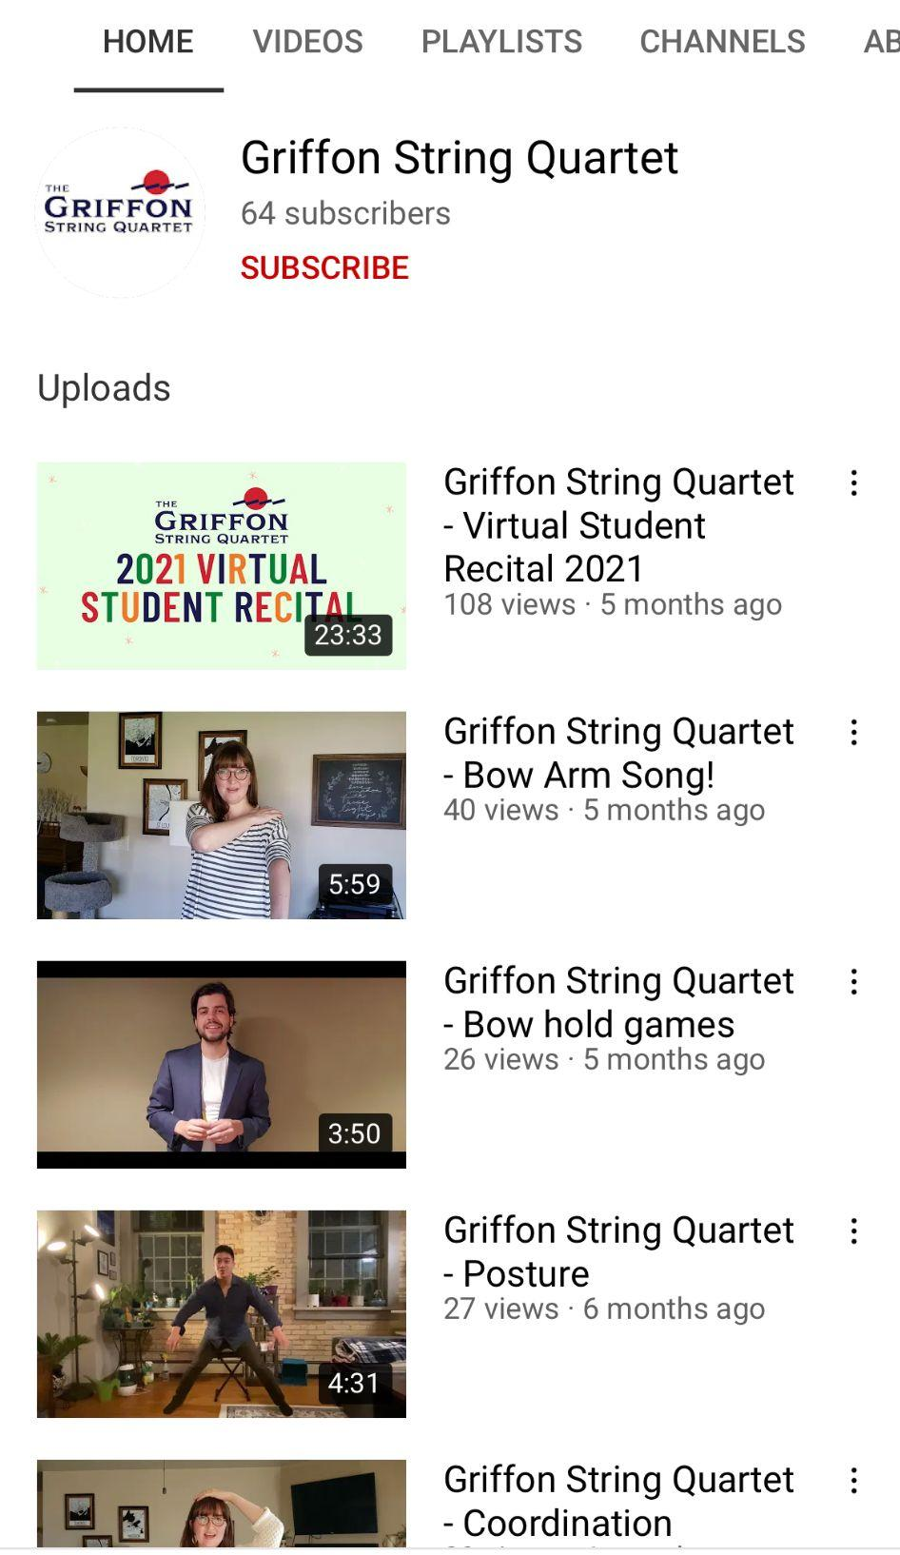
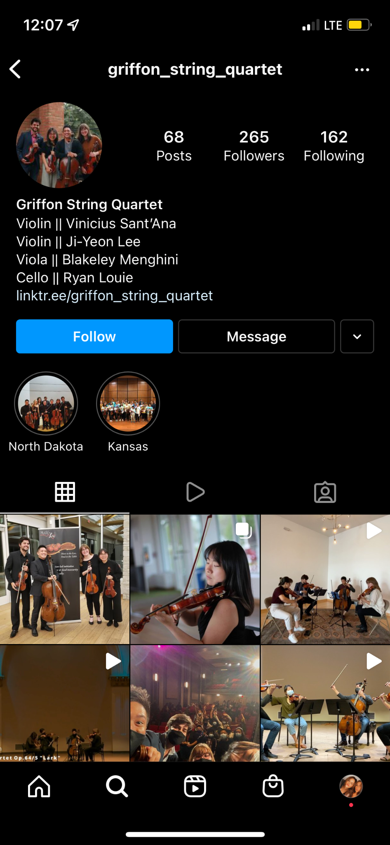
Current Social Media Presence
YouTube - 64 subscribers - zero links
Instagram - 265 followers - links to Midsummer’s website & linktree
Linktree - on Instagram only. Links to proper locations listed.
Notes:
Angela

Slide 16
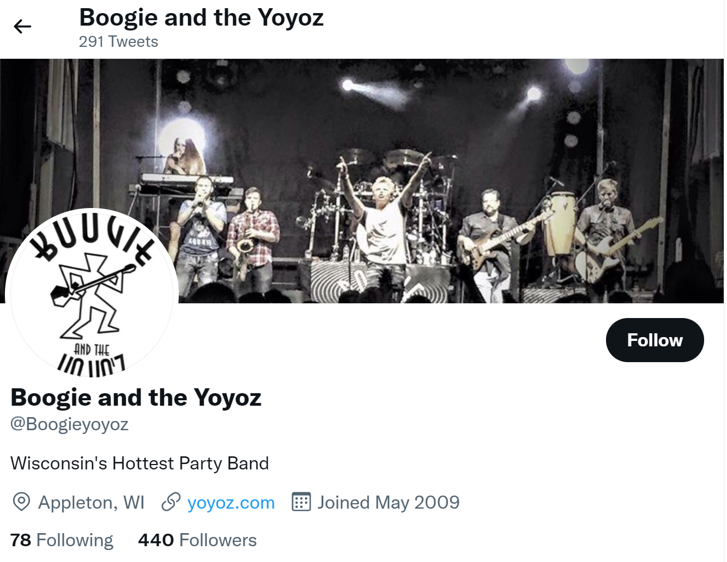
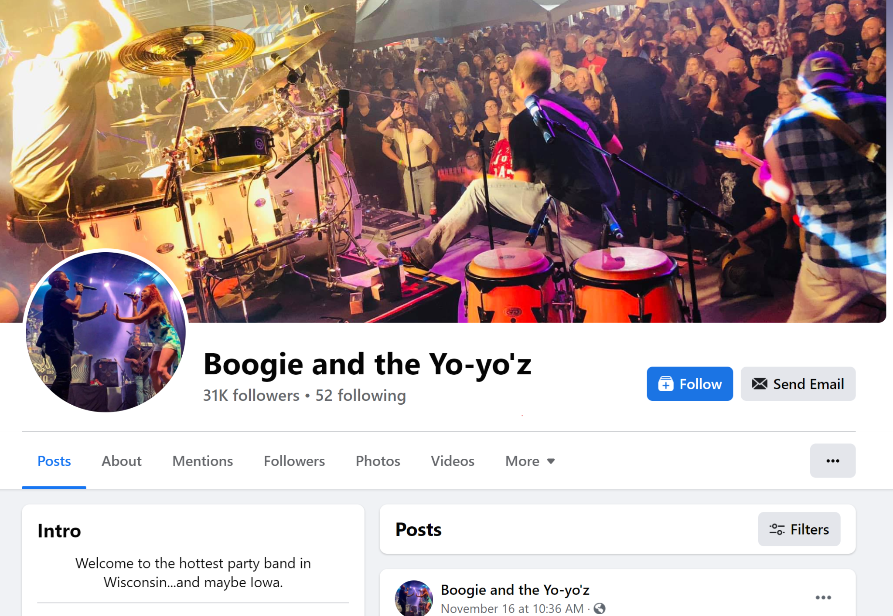
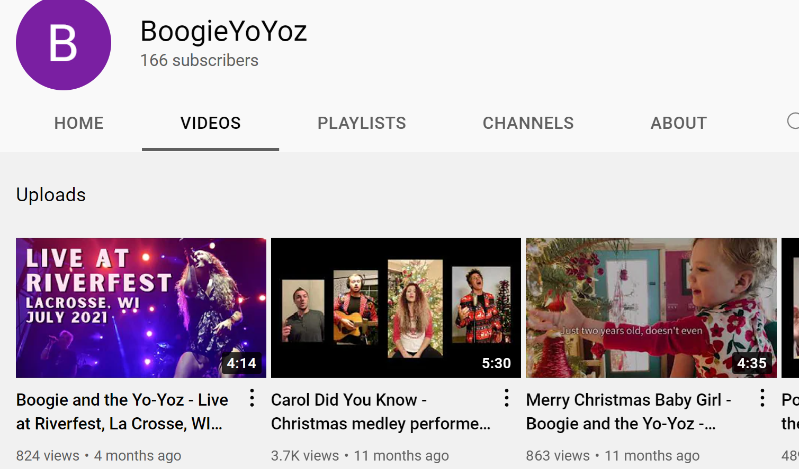
Social Media Uses of Other Music Group
They also have several social medias: (all of which are linked on their website)
Twitter
Used to tweet locations and share quick information with fans.
Website is linked.
Used mostly when touring and playing shows.
Facebook
Used heavily to post photos, events, and keep the public and their fans updated.
Updated every few days even when they are not playing shows.
Includes all of their contact information and website.
Most used platform.
Youtube
Used to post fun videos about the band and some clips of past performances.
Passively managed.
Notes:
Angela

Slide 17
What Social Media would be most Effective?
Facebook - active
Parents - kids music lessons/ events
Donors - stay up to date on events
Ages 26-35 - (71%)
Ages 46-55 - (67%)
Instagram - active
Ages 18-24 - (31%)
Ages 25-34 - (31.2%)
Public - updates and see the quartet music
Parents- kids music lessons
YouTube - active
Kids (parents)- To see lessons and how to’s.
Public- To see the quartet music and examples of past concerts
Ages 15-35 (77%)
Twitter - passive
Public - quick updates for event information
Donors - would like to stay frequently updated for events
(76.3%) of Twitter users are 24 to 50+
LinkedIn - passive
Ages 25-34
(59.3%)
Ages 18-24
(20.3%)
Young adults - to get information about events and who they are as a group
Notes:
Caitlyn

Slide 18
So What Should be Done?
Create a website that encapsulates everything that the Griffon Quartet wants to display.
Create and promote on Facebook
Events, photos, videos, updates
Use Instagram more for videos and photos
Reels, photos, videos
Change up the YouTube style
Different types of videos of their content
Can be shared on other social platforms
Create a Twitter for event updates and quirky amusement
LinkedIn for professional networking
Notes:
Caitlyn

Slide 19
So How Should this be Implemented?
Hire a Social Media Manager:
Hire someone that can be there with the group updating their social media as events go on.
Hire an Intern:
Hire a lightly paid intern to be there with the group part time and update their social media as events go on.
Uphold the Social Media Themselves: Have a Content Checker
Have the group update their media as events go on and as they have time
Have someone well versed in social media check posts over and give tips to the group as time goes on (e.g.: intern).
Send out brief surveys to donors and students to check interest and effectives of socials and contact methods
Notes:
Emily

Slide 20
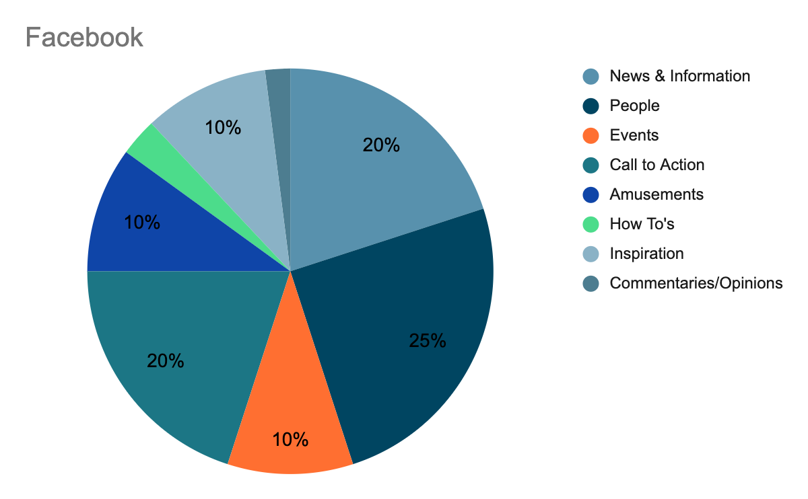
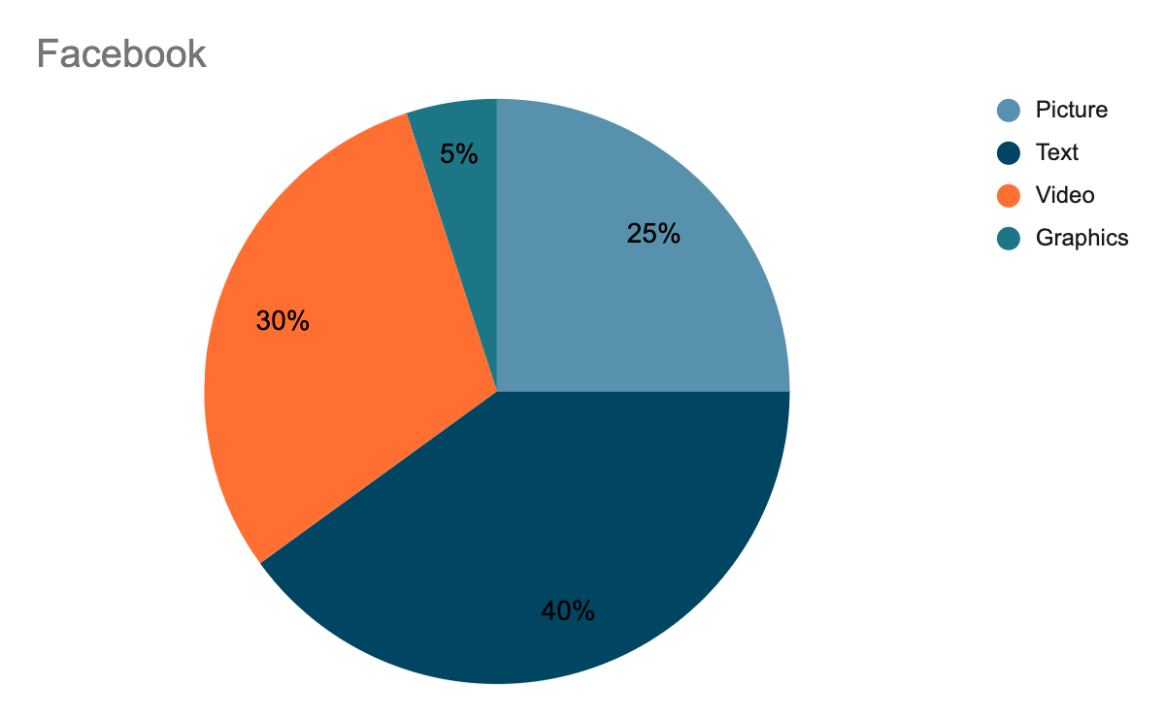
Facebook
Substance Mix
Form Mix
Notes:
Angela
Picture: Lots of personal photos of the quartet and pictures of the members engaging with their community.
Text: Explaining events and shows that are going on, as well as updating the page with what the quartet is doing “recently”.
Video: Video of performances and maybe some behind the scenes; link some of the youtube videos.
Graphics: Educational posters of music lessons, upcoming special events.

Slide 21
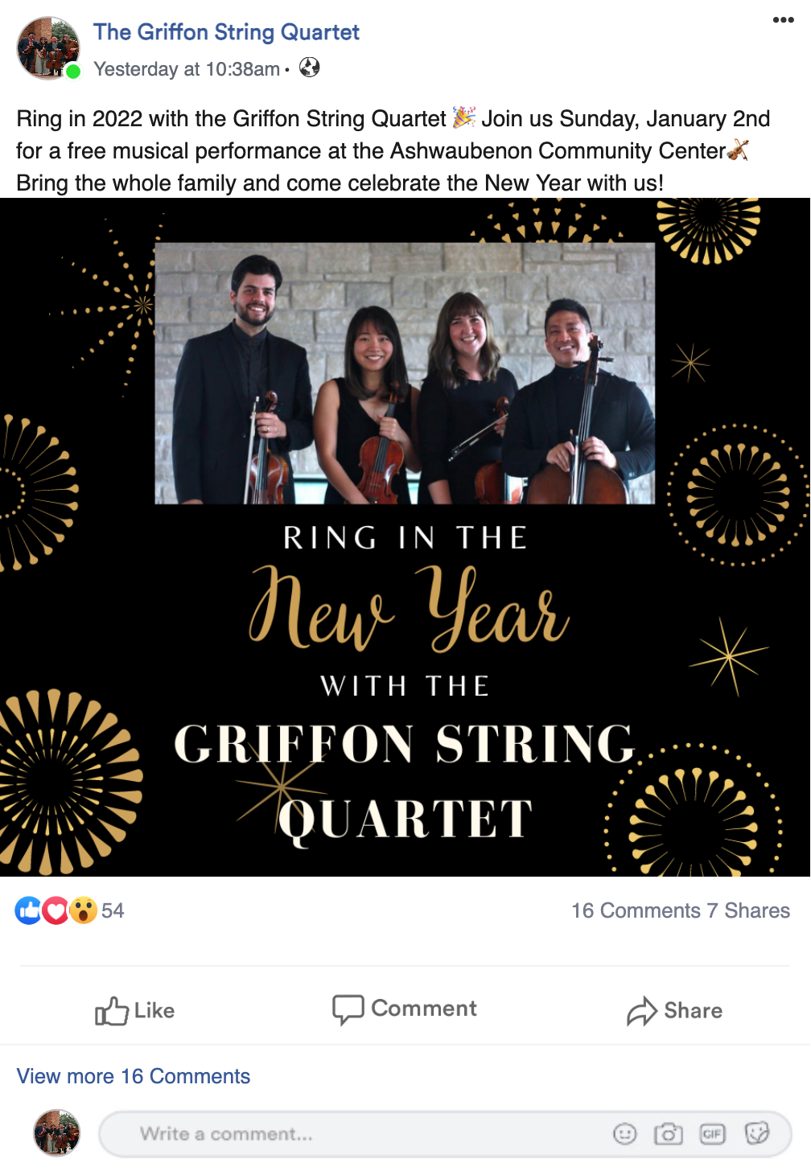
Example
Facebook Post
Notes:
Angela

Slide 22
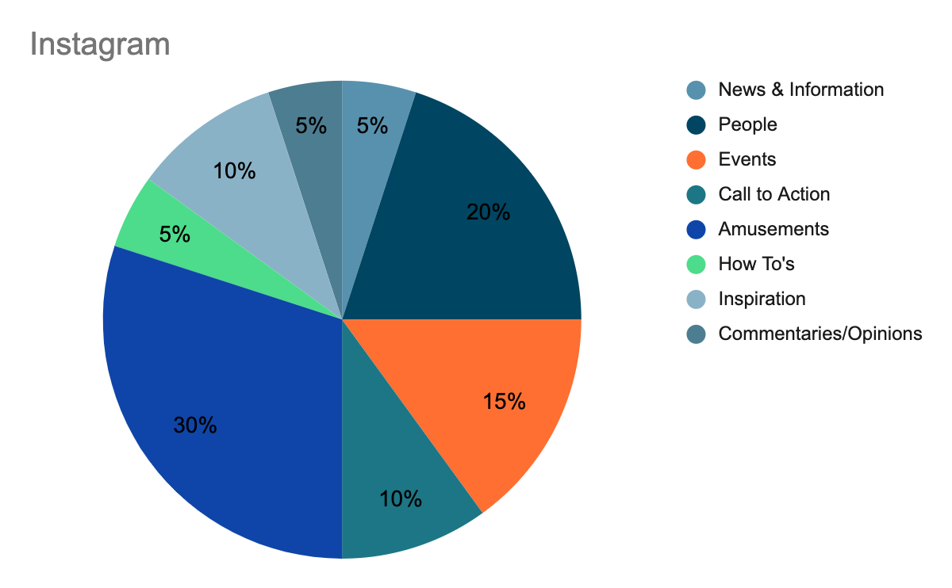
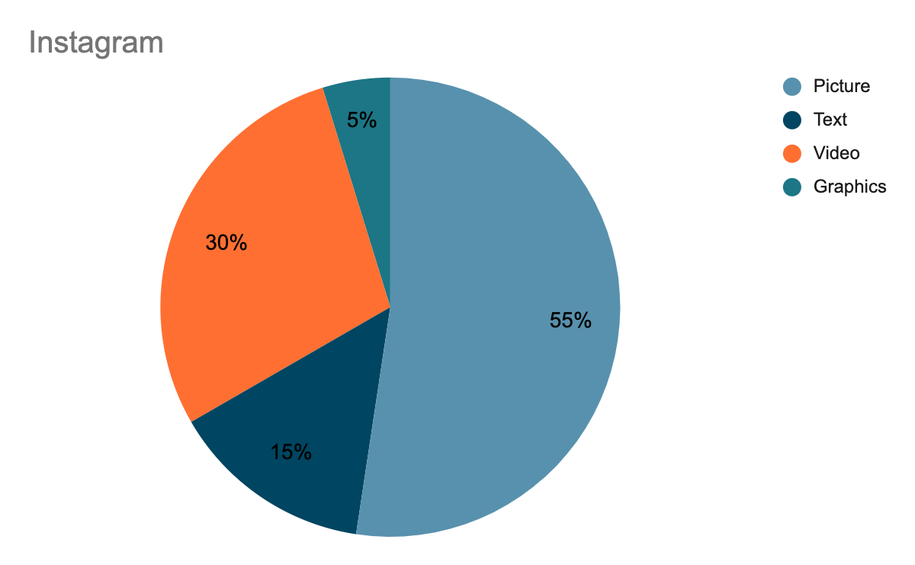
Instagram
Substance Mix
Form Mix
Notes:
Caitlyn
Picture: Lots of pictures of themselves and the group. Engaging in their community and what they do. Even their performance.
Text: Explaining what is going on in the picture or where to find the event.
Video: Little clips of their performance that can be linked to the website or YouTube,
Graphics: Just like Facebook it has educational posters of music lessons, special events that are upcoming.

Slide 23
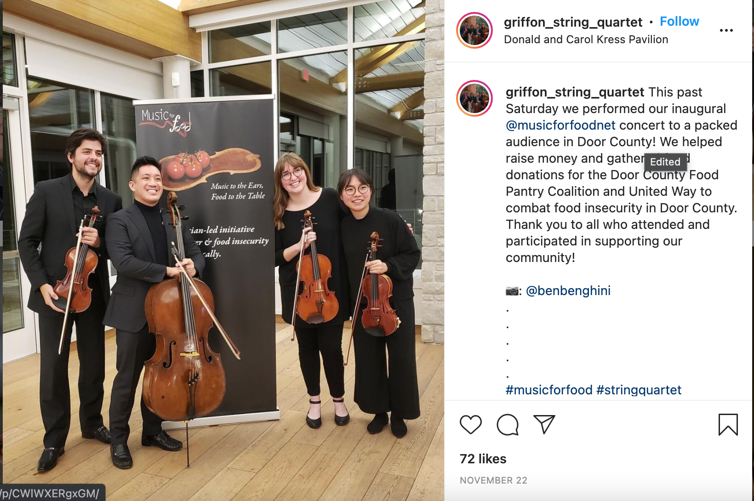
Example Instagram Post
Notes:
Caitlyn

Slide 24
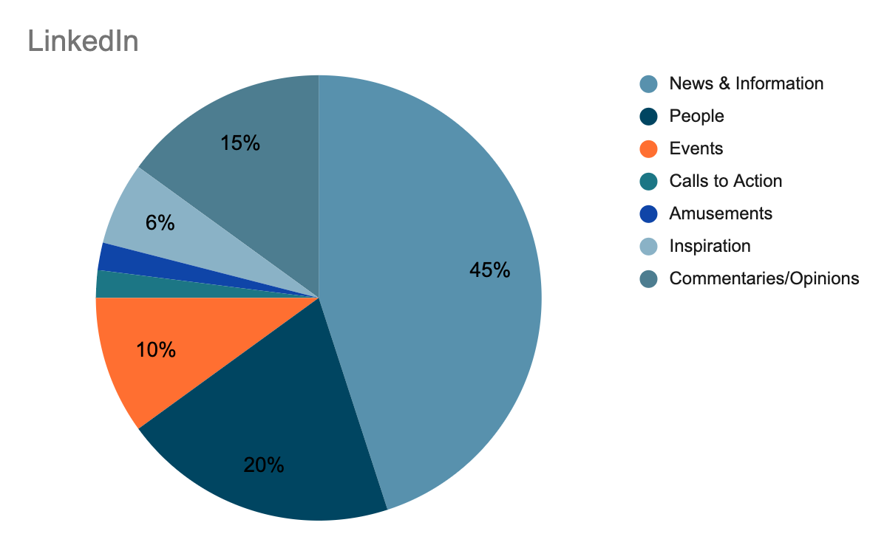
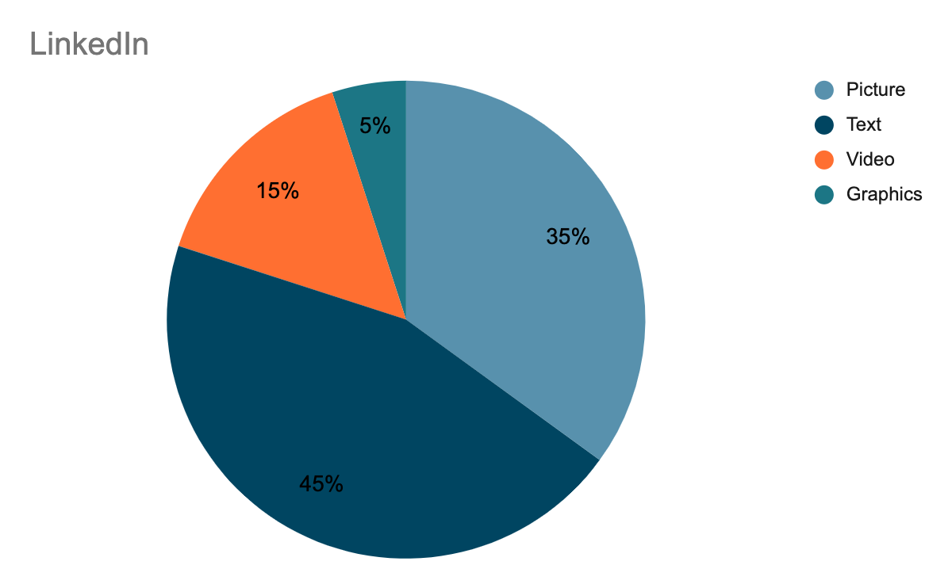
LinkedIn
Substance Mix
Form Mix
Notes:
Abby
Picture: Have pictures of the quartet members or an event.
Text: Bio-style paragraphs/sentences of who the members are or about events.
Video:Highlight an event with a clip.
Graphics: Poster for an upcoming event or how-to get connected with them.
Abby

Slide 25
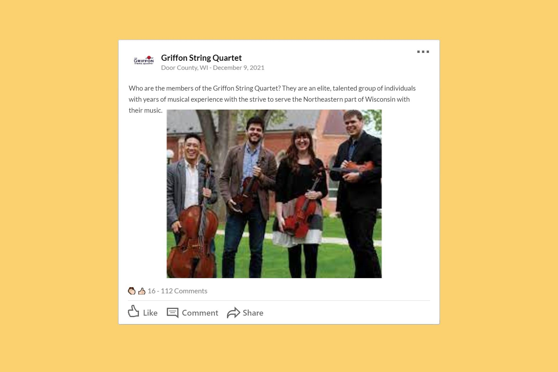
Example LinkedIn Post
Notes:
Abby

Slide 26
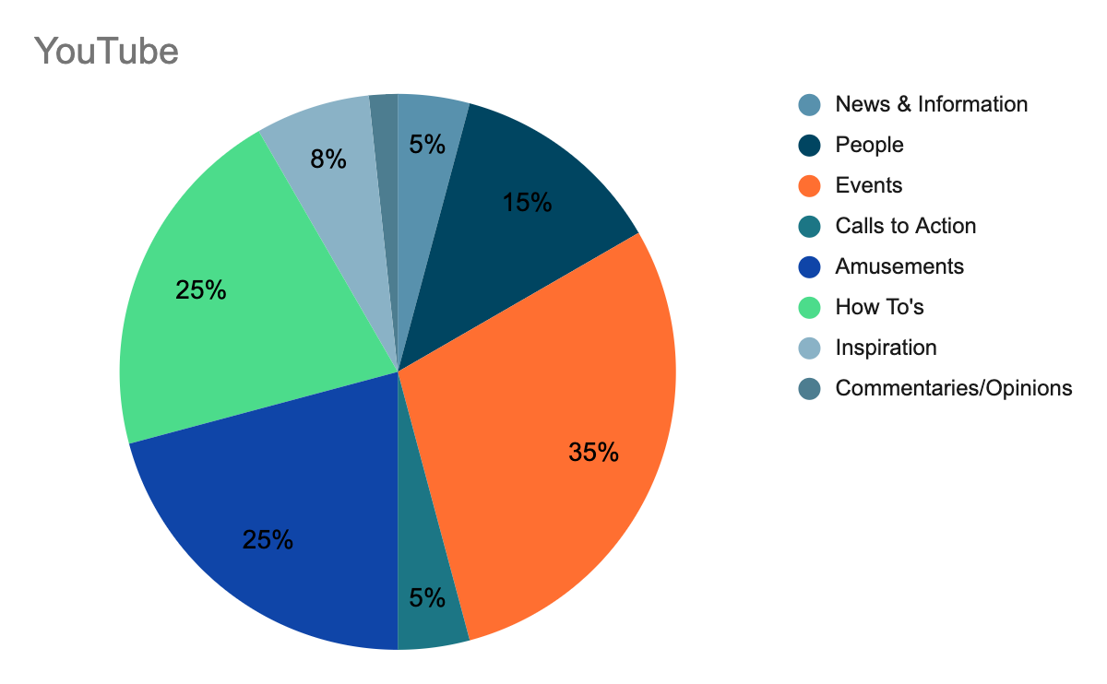
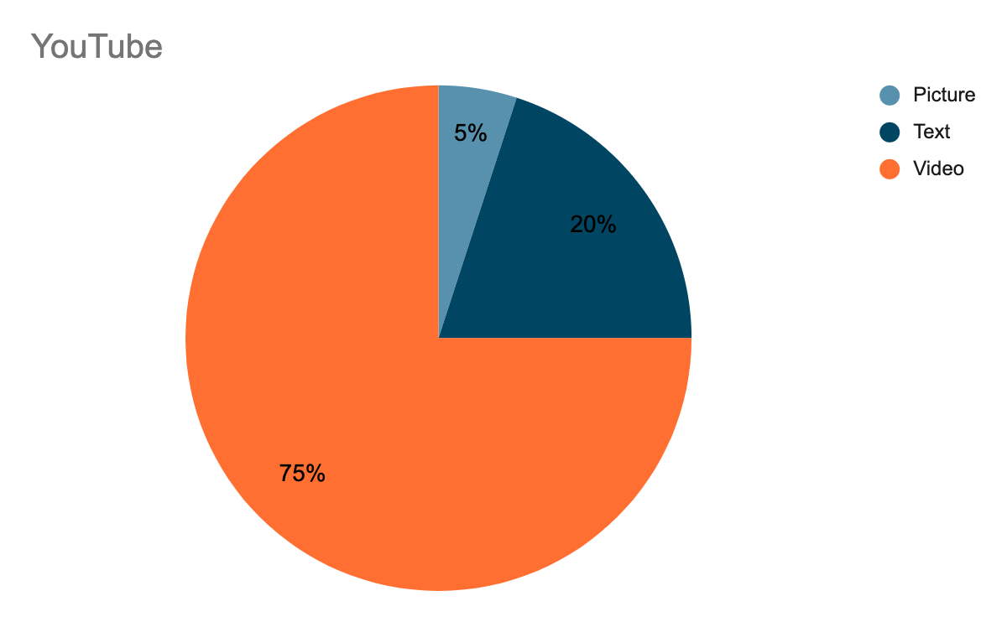
YouTube
Substance Mix
Form Mix
Notes:
Picture: pictures will mostly be thumbnails for the videos, otherwise photos could be shared during the videos depending on the content and editing.
Text: Text will be mostly captions for the videos or video descriptions. Text could also come in the form of comments.
Video: Most of the videos can be of past performances they have done. Some of their videos can also be an instrument lessor for kids, and maybe some how to’s revolving around music.

Slide 27
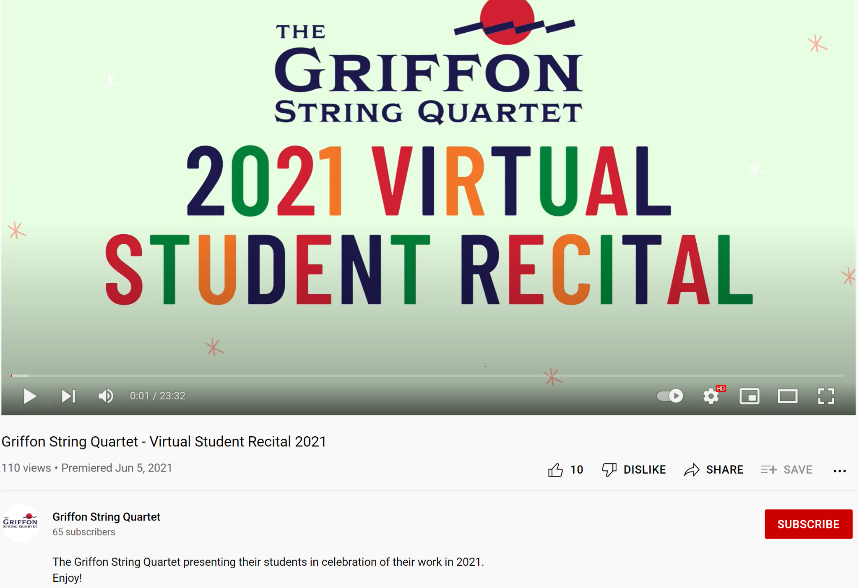
Example YouTube Video

Slide 28
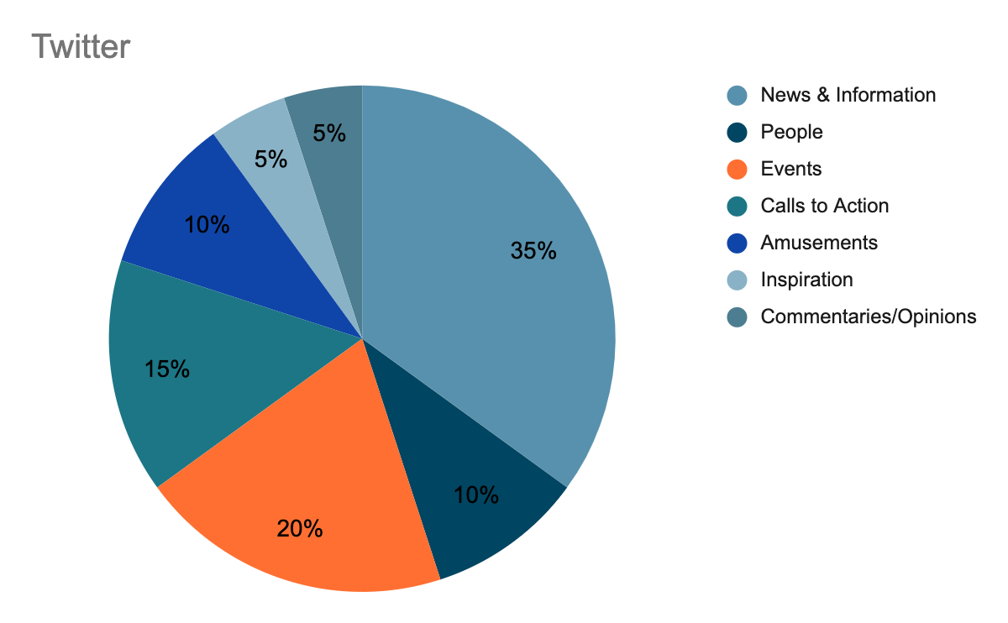
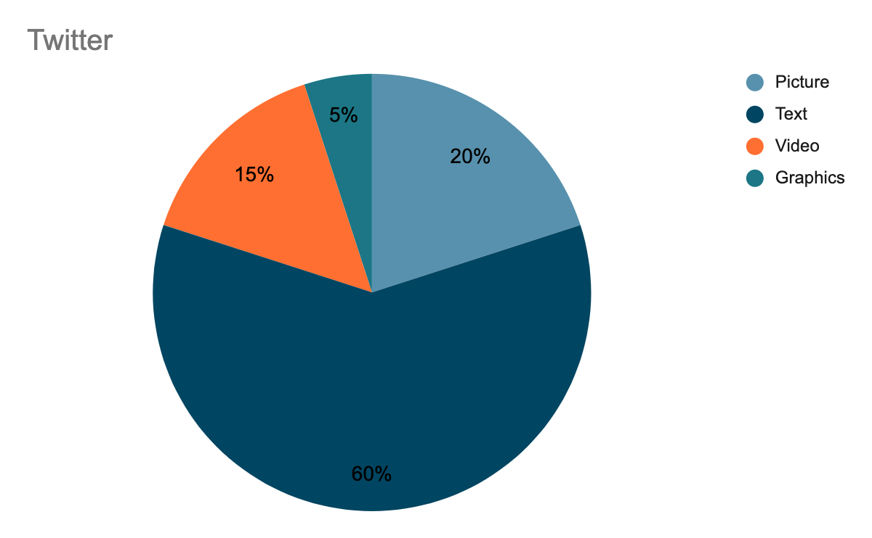
Twitter
Substance Mix
Form Mix
Notes:
Picture: Pictures of band members, pictures of prior events, pictures of patrons?
Text: Engaging with people (@ patrons), event updates, live updates.
Video: Must be brief videos. Small clips of previous events, small less than a minute clips from lessons.
Graphics: Quick graphics of events (Canva works well), curated graphics of music lessons.
ELSIE :D

Slide 29
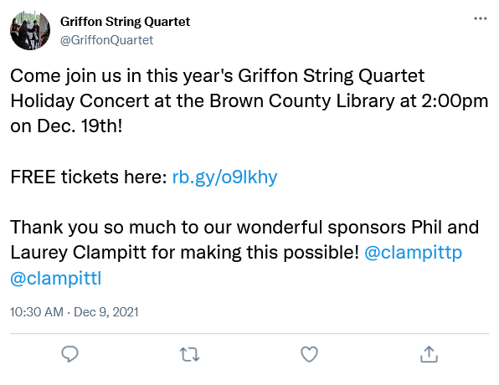
Example Tweet Mockup
Notes:
Elsie

Slide 30
Ideal Links and Nodes
Key:
Links one way
Links two ways Links to website
Notes:
Caitlyn
Hyperlinks can link to these websites.
Twitter, facebook, instagram only have the hyperlinked to the website.
The gold one are the ones that only connect to the website.
The gray ones are the ones that connect to other sites.

Slide 31
Coordinates
Enrich. Educate. Excite. Guided all decisions.
Content
Channels
All content will be guided by trying to achieve the coordinates. Ensure content matches with Coordinates.
All suggested platforms support target demographics.
The 5 C’s
Connections
Corrections
Corrections guided by feedback from content and audiences. Ex. Surveys & monitoring
Achieved through linking on social media on website and other platforms.
Notes:
Coordinates: Essentially, this affects everything.
Content: All content is influenced by the overall mission goals/coordinates. The channels selected dictate the type of content being created. The content reinforces itself by the connections, such as the cross-promotion that would be happening between the platforms. You can easily make corrections based on the reaction of the target audience to content.
Channels: To ensure that you are doing the right channels for your target demographic, it might be wise to send out a survey to test to see what your demographics are using. Link the channels together for maximum.
Corrections: Feedback driven, utilize surveys and use monitoring team to check for errors that fall outside of the general mission.
Connections: This was shown primarily through our links and nodes slide, but it is about how the griffon website will connect to all of their social medias accordingly.
ELSIE :D

Slide 32
Lessons Learned
That all organizations need to have a strong social media that meets the needs that they want to share with their intended audience.
There must be a fundamental “stronghold,” that connects various nodes and platforms.
It is important to align your strategic insights and the research you use to help resolve a social media challenge.
Notes:
Emily

Slide 33
References
Albert, D. J. (2015). Social Media in Music Education: Extending Learning to Where Students "Live."
Global Linkedin User age distribution 2021 https://www.statista.com.statistics/273505/global-linkedin-age-group/ statista December 08, 2021
Midsummer's Music (@midsummersmusic) • instagram photos ... (n.d.). Retrieved November 30, 2021, from https://www.instagram.com/midsummersmusic/
Music Educators Journal, 102(2), 31-38. https://www.jstor.org/stable/
Retrieved December 7, 2021, from https://www.crazyegg.com/blog/why-users-leave-a-website/
The griffon string quartet BIOS. (2021, July 02). Retrieved November 30, 2021, from https://www.midsummersmusic.com/the-griffon-string-quartet/string-quartet-bios/’
The griffon string quartet. (2021, September 27). Retrieved November 30, 2021, from https://www.midsummersmusic.com/the-griffon-string-quartet/
YouTube by the numbers: stats, Demographics & fun facts https://www.omnicoreagency.com/youtube-statistics/ December 08, 2021
Zheng, D. (2020, May 14). The 15 Second Rule: 3 Reasons Why Users Leave a Website. The Daily Egg. 24755658?seq=1#metadata_info_tab_contents

Slide 34
Thank you!
Any Questions?

