Slide 1
TikTok
Social Media Strategies
By: The Alpha Wolf Squadron
Notes:
Tanner

Slide 2
Agenda
TikTok Background Information
Costs & Benefits
TikTok Fail
ML +- Chart
Evaluation
Infographic
So What?
References
Questions?
Notes:
Tanner

Slide 3
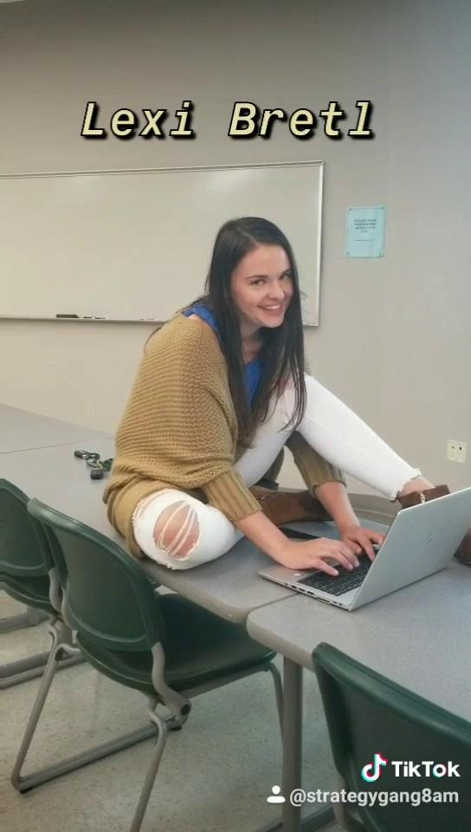
Notes:
Tanner

Slide 4
Origins of Tik Tok
Owned by Bytedance (Acquired 2017)
Formerly known as Musical.ly
Merged with TikTok in August 2018
Can create “lip-sync” videos of 15 seconds
Full-Length looping videos of up to 60 seconds
Shared across other platforms
Currently the world’s most valuable startup
Notes:
Tanner

Slide 5
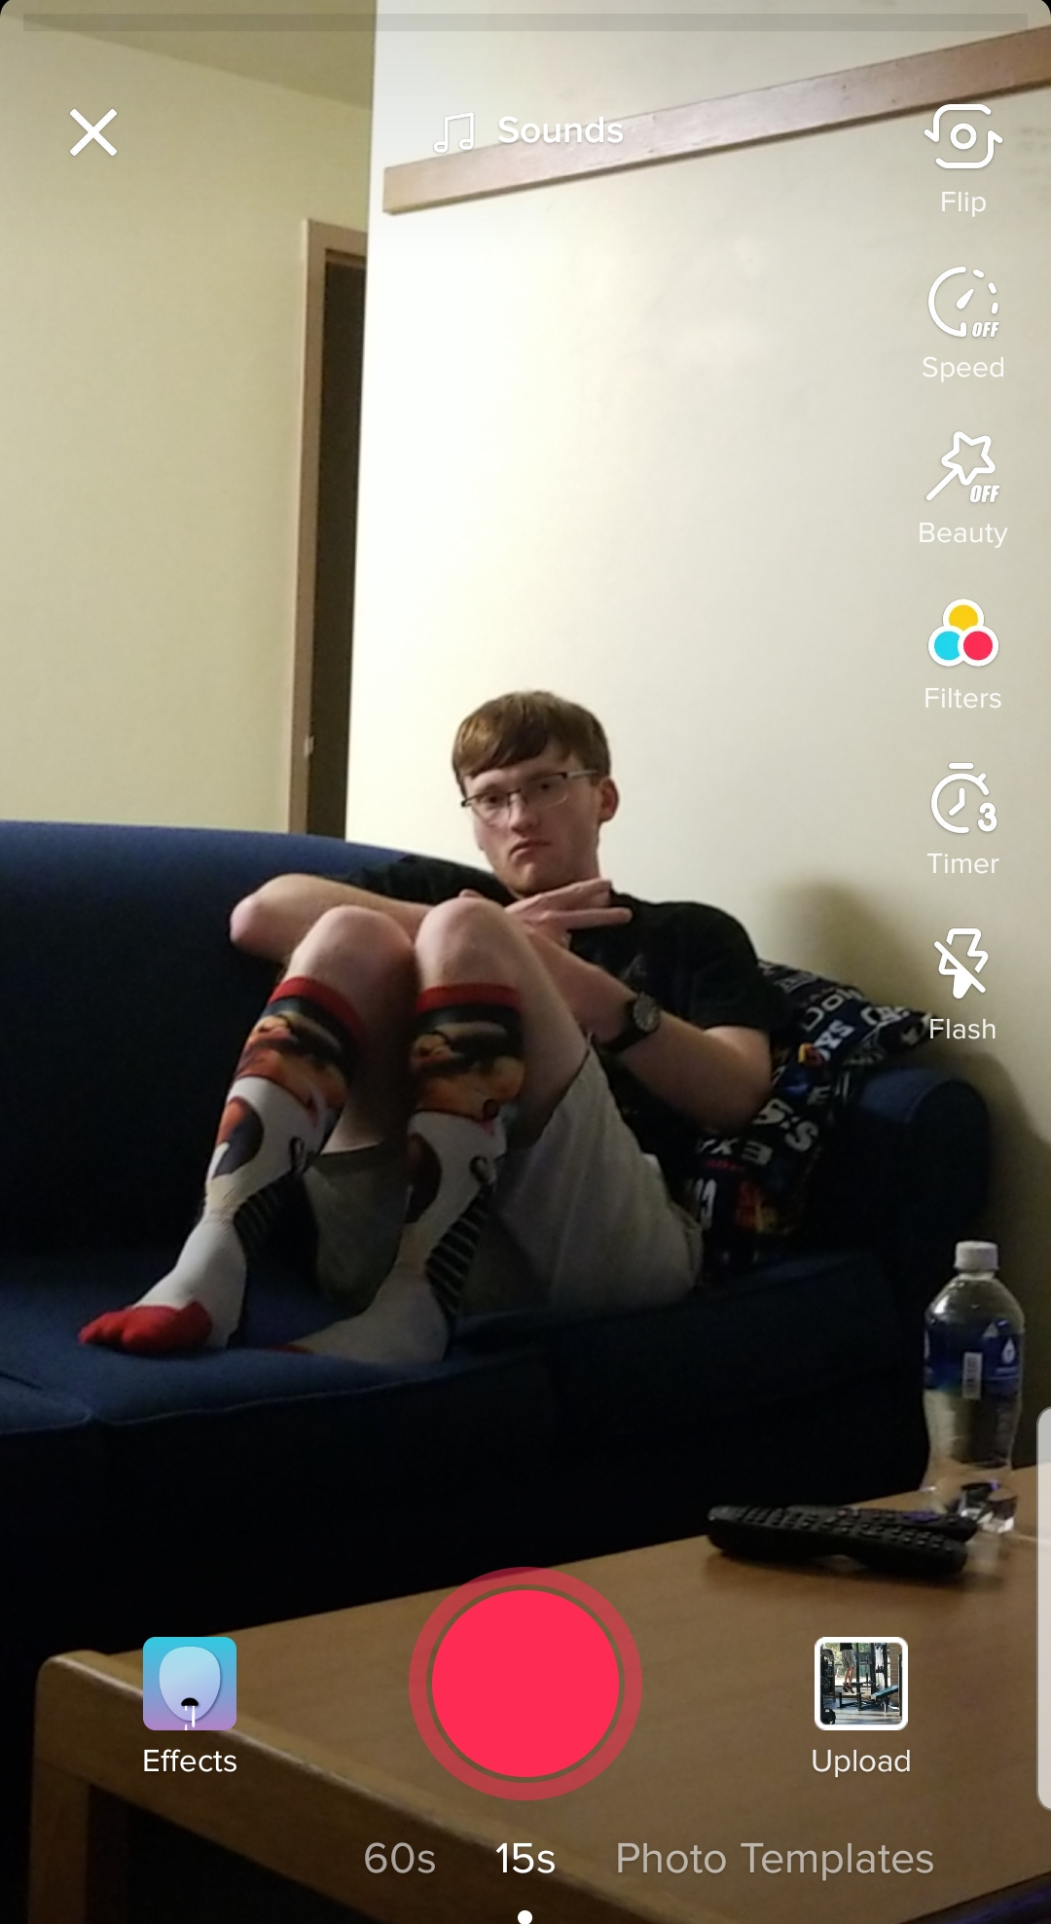
How TikTok Works
Choose sounds
Upload pre-existing clips or record from the app
Filters
Many Camera options
Effects
Flash
Timer
Clip Editing
Can trim uploaded clips
Notes:
Tanner

Slide 6
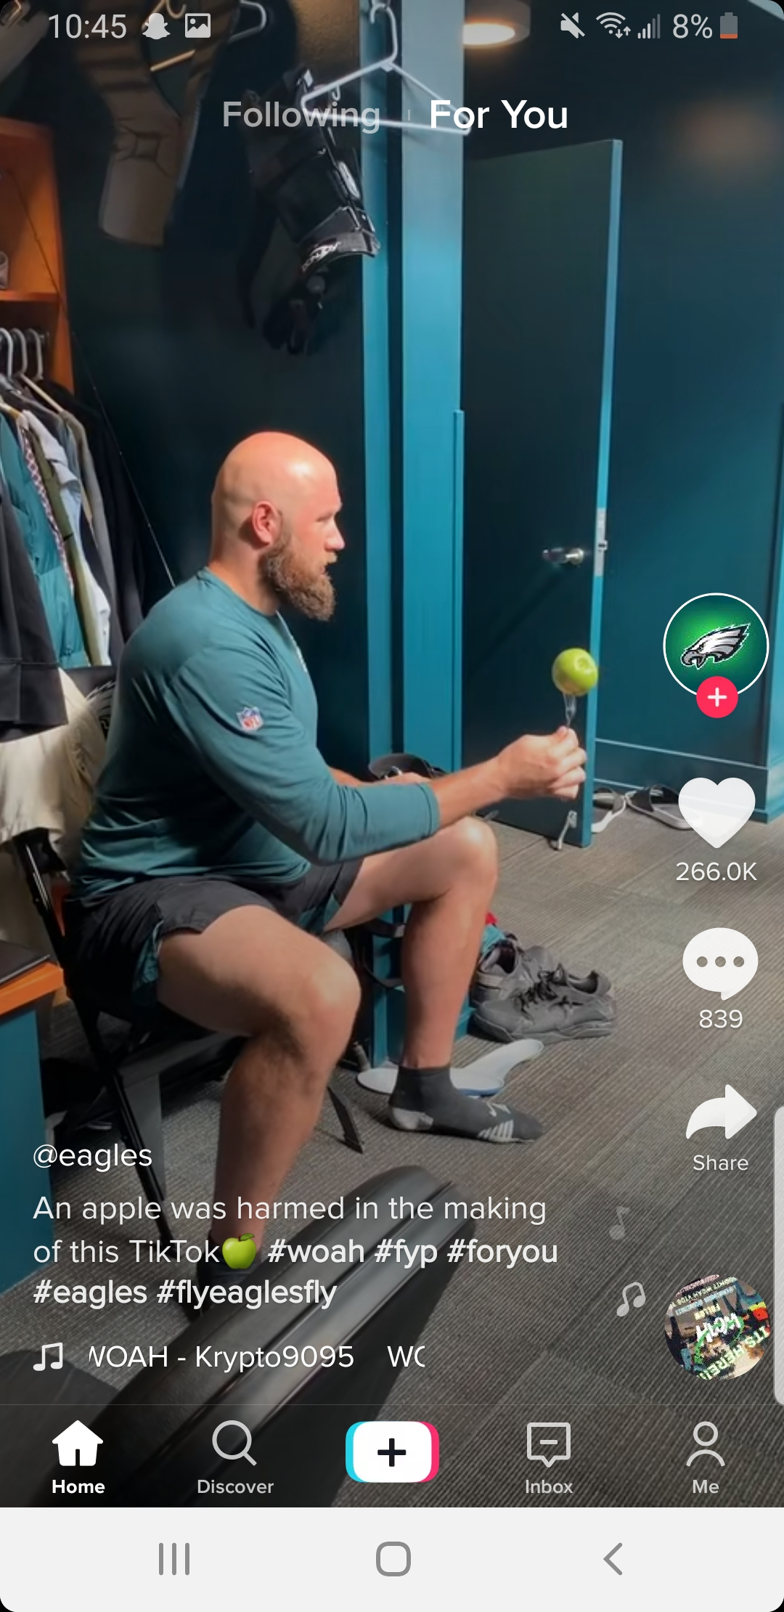
TikTok usage
Posts are uploaded to individual profile
Shown to profile’s followers
Can also be featured on the “For You” page
Users can also “Duet” existing posts
Can even Duet other Duets.
Users can find various information on sounds used
“Trends“ are often formed
Often based on audio or memes
Many various uses
Humor, art, cosplay, etc.
Notes:
Tanner

Slide 7
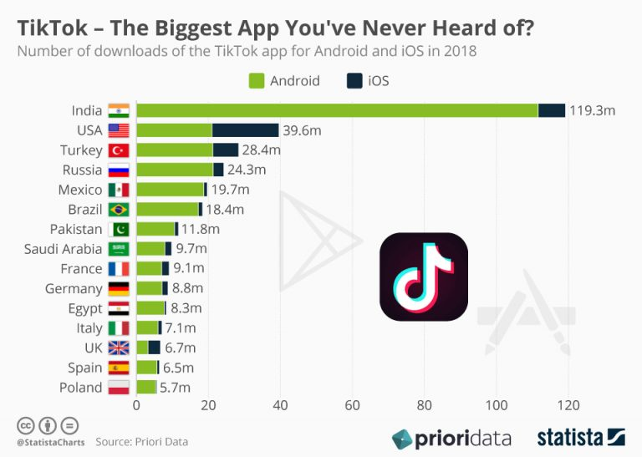
Tik Tok Usage Across the World
Most of the downloads of Tik Tok are coming from Southeast Asia
The country with the most downloads in Southeast Asia is Indonesia
40% of users come from outside of China
25% of the apps users come from India
26.5 Million users come from America

Slide 8
How TikTok makes money
Coin Currency System
$0.99 = 100 coins
Selling Ad Revenue
Brand Takeover Ads
In-Feed Video Ads
Hashtag Challenges
Guaranteed International Reach
Notes:
Tanner

Slide 9
Effective/Ineffective Uses
Effective Uses
Appealing to a younger (generally teenage) audience
Using trends and hashtag challenges
Utilizing Popular Audios
Keeping an active presence (approximately 1 post per day is recommended) to gain a larger reach
Ineffective Uses
Paying no attention to popular trends
Creating content that can be considered highly offensive
Not staying active enough to keep followers’ interest
Notes:
Tanner

Slide 10
Costs/Benefits for Users
User | Costs | Benefits
CEOs | Free to make an account, provide e-mail address, expensive advertising, time spent creating/editing content | high reach platform, ability to showcase new products, keep up with trends
Teens | Free to create an account, provide e-mail address, bullying, predator accounts, time spent creating/editing content | stay-up-to-date on trends, high reach platform, potential for fame, sponsorships
Entertainers | Free to make account, provide e-mail address, expensive advertising, time spent creating/editing content | stream of income (sponsorships), stay relevant, keep up with trends, grow following globally, exercise creativity
Athletes | Free to make account, provide e-mail address, time spent creating/editing content | stream of income (sponsorships), stay relevant, keep up with trends, grow following globally, show fans a new perspective of you, promote your team
Entrepreneurs | Free to make account, provide e-mail address, expensive advertising, time spent creating/editing content | great for product demo videos, join in on trends, high reach platform
Notes:
Drew

Slide 11
Cost/Benefits for Organizations
Organizations | Costs | Benefits
Restaurants | Free to make an account, time management, social media strategist, expense on advertising | Able to show products and the inside of their business, help get more consumers
Manufacturers | Free to make an account, time management, social media strategist, expense on advertising | Able to show how products work, able to show new ideas for products, help get more consumers
Professional Sports Leagues/Teams | Free to make an account, time management, social media strategist | High reach platform, able to showcase the teams and athletes, keep up with trends, help get more fans
News Media | Free to make an account, time management, social media strategist, expense on advertising | High reach platform, able to show how they are different from other news media sources, able to show news that is going on, keep up with trends, help get more viewers
Automobile | Free to make an account, time management, social media strategist, expense on advertising | Able to show the products features, show improvements made, how the product works, help get more consumers
Technological | Free to make an account, time management, social media strategist, expense on advertising | Able to show how products work, able to show new ideas of products, high platform reach, help get more consumers
Notes:
Drew

Slide 12
TikTok Fail
The platform is in its infancy
Not a lot of organizational fails
Challenges are common
Some have been successful
Others have failed
A Star Is Born Challenge
Jimmy Fallon
875k views on original
1.6m on all posts
Notes:
Drew

Slide 13
ML+- Platform Thinking
Platform | Most Like (ML) | Plus (+) | Minus (-) | “Sexy” Statement
TikTok | Singing in the shower Lip sync battle | Visually entertaining Challenge friendly Combines music and video Countless content | Time spent making the perfect video Meaningless content Lack of personification | Mini music video Timely trailer Modern multimedia

Slide 14
Discussing Strategy For An Organization
+ | -
Captivates younger audiences that you may want to target | Will not reach middle-aged and older audiences
2. Growing rapidly, just like you want your company to | 2. Major brand interaction is in its infancy
3. Intended to broaden your reach/impressions | 3. Growing pains are foreseeable
Notes:
Derek

Slide 15
Evaluation
Channels
Does TikTok align with your business goals?
Does TikTok align with your target audiences?
Do you have the resources to support TikTok?
Coordinates
Do you have SMART goals?
Do your coordinates enrich each other?
Do your communication goals support your business goals?
Content
Is your content type compatible with TikTok?
Are you generating effective content?
Are you creating content that allows for customer interaction?
Connections
Does TikTok allow you to connect back to your website?
Does TikTok provide you the versatility to share on other platforms?
Is it competitively advantageous to use TikTok?
Notes:
Lexi

Slide 16
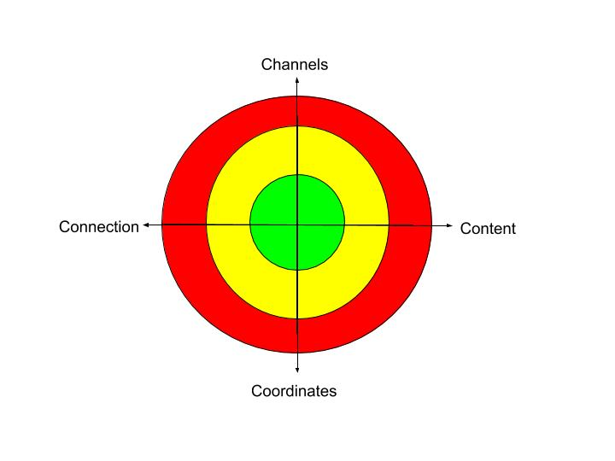
Evaluation
Tool: Target Analysis
CHANNELS | YES | NO
Question 1 | X
Question 2 |  | X
Question 3 | X
 | TOTAL | 2
Notes:
Lexi

Slide 17
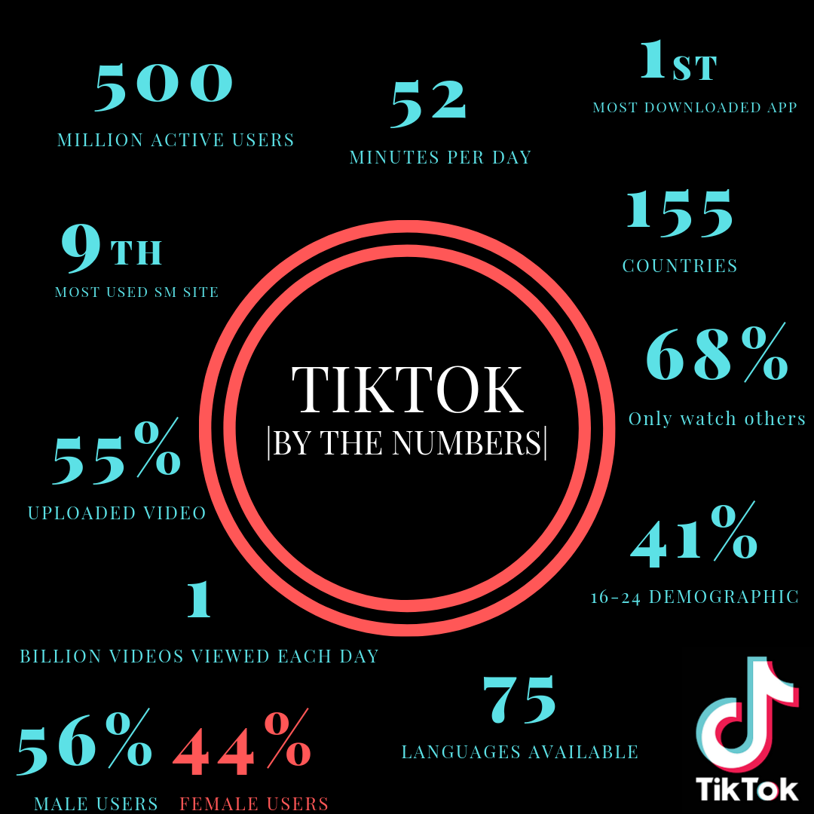
Infographic
Notes:
Lexi

Slide 18
So What?
Ideally, an evaluation tool could evaluate all platforms.
However, it’s most effective to create a tool for each specific platform.
Universal platform is essential to comparatively analyze
There is a lot of potential marketing value in TikTok as a platform.
TikTok may not be growing as fast as it initially was, but it will remain relevant for quite some time.
Notes:
Lexi

Slide 19
References
Garyvee, & Garyvee. (2019, April 17). Why the TikTok (formerly Musical.ly) App is So Important. Retrieved from
https://www.garyvaynerchuk.com/why-tiktok-formerly-musical-ly-app-is-important/.
Herrman, J. (2019, March 10). How TikTok Is Rewriting the World. Retrieved from
https://www.nytimes.com/2019/03/10/style/what-is-tik-tok.html.
Kuligowski, K. (2019, April 21). How to Use TikTok for Business. Retrieved from
https://www.businessnewsdaily.com/12020-tiktok-business-features.html.
Tolentino, J. (2019, September 24). How TikTok Holds Our Attention. Retrieved from
https://www.newyorker.com/magazine/2019/09/30/how-tiktok-holds-our-attention/amp.

Slide 20
Questions?

