Slide 1
Records Management
This training applies to all areas of the UW Green Bay community regardless of their location.

Slide 2
Session Agenda
Understand Wisconsin State law relating to records
Learn the two components to Records Management
Know when and how to dispose of a record through record retention
Recognize methods for managing records
Know where your department Record Management Plan is located

Slide 3
What’s the Law?
The State of Wisconsin Public Records Law requires that all public records shall be open to the public because people must be informed about the workings of their government. Therefore, every record here at the University is presumed to be available to the public per Statutory authority at Wis. Stat. Sec. 16.61.
This statute gives the State Public Record Board (PRB) authority to oversee how agencies store and dispose of records through Record Management.
Wisconsin Executive Order #189 requires public records training for all employees and regular training for all supervisors. This training will ensure our University meets these standards and preserves the publics records.
Because all documents – or records – essentially belong to the public – every agency is required to have a Records Management program. Records Management is the official term for controlling all the documents we create AND STORE during the course of our daily work.
Notes:
It starts with you. Because we are state employees, our records are considered a state public record and must be made available.
We cannot discard any records that may be deemed of administrative or historical value according to an established Record Schedule. Have you ever peaked in an office and seen an explosion of paper everywhere? Or moved to a new department and become overwhelmed by the sheer volume and disorganization of computer files on the department’s shared drive? This person might need a Record Management refresher course!
Because we are mandated for our records to be available to the public doesn’t mean we have to keep them forever.
In fact, the State Public Records Board establishes set Record Schedules that define what a record is, how long it must be kept, and how it is to be disposed of.

Slide 4
Functional Records Management
When we refer to records, we are speaking of all the records used and created in the course of our business. A record is a document created, received, scanned, or copied, by offices or employees that allows them to conduct University business. The format of a record doesn’t matter, the CONTENT does. Therefore, records that fall within the state statute can be paper, a scanned document, a computer file, social media blog, video, or email.
If a record helps you perform your job description or documents the history and/or administration of your office, it should be handled through Records Management. Here at the University, we divide Records Management into two categories.
Comply with Record Retention. The PRB sets and approves Record Schedules that determine a records retention period and the legal authorization to dispose of records eligible for disposition. There is an record schedule for every record at the University. Agencies such as the University of Wisconsin have adopted many RDA’s to account for multiple functionalities and operational area records on our campus. In some cases, we use the State Public Records Board schedules so we don’t have to develop our own. The record schedule dictates retention and disposal of records.
Manage Records. Part two of records management is managing the documents that either come across your desk or that your department uses or creates. Public record requests continue to rise and without organization or control over these records, we cannot serve the public in an efficient and cost effective manner. Records include paper, computer files, email, instant messages and even social media!

Slide 5
Part 1 – Comply with Record Retention
Every record in your office is governed by an record schedule that has been approved by the State Public Records Board.
By abiding by the approved Record Schedules, we know specifically what records must be kept in our files, for how long, and how to dispose of them. It is essentially illegal to dispose of a record without following the record schedule.
Each Record Schedule is assigned a unique number, description, the length of time it is required to be kept, and what to do with it after that time has passed.
A Record Schedule will tell you WHEN you can dispose a record and HOW it is to be disposed.
Don’t use old department logs or lists regarding retention
ALWAYS use an approved record schedule from the Record Schedule List
Notes:
By abiding by the approved Record Schedules, we know specifically what must be kept in our files and for how long; what should be transferred to the Archives for permanent retention, and what is OK to dispose of.
It is illegal for any UW-Green Bay employee to destroy a public record in their office without an approval from the Public Records Board. This means we must follow the retention period in a Record Schedule.
All Record Schedules are listed on the UWGB Record Management website using the Record Schedules List.

Slide 6
Using the Record Schedule List
To comply with record retention, use the Record Schedules List. An excel spreadsheet on the webpage.
Search for a Record Schedule
Locate a schedule that matches the record you have. Use the TITLE and RECORD DESCRIPTION
Determine Retention Period
View the EVENT that must occur before time can start in the RETENTION PERIOD
Determine Disposal Method
Verify the date on your document; once retention period has passed, the DISPOSAL METHOD determines the method for disposing of the record.

Slide 7
Example: find retention period and disposal method for MEETING MINUTES
Search | 2. Determine Retention | 3. Determine Disposal
Search for a record schedule that matches your document using the Title or Record Description | Determine if the date of your document is passed the Retention Period and EVENT | Confirm the disposal method
1
[ ]
2
[ ]
3
[ ]
ADMIN301 gives you the authority to dispose of meeting minutes AFTER 5 years AND the approval of the minutes. Once the retention period has passed, you are directed to dispose of these documents by Transferring to the Archives. This is your ONLY option.

Slide 8
Options for Disposal
There are only two options for disposing a record when it passes the retention period:
OR
Example: A record is being considered for disposal and the retention is: EVT (date of creation) + 6 Years The Disposal Method is Transfer to Archives. The record is dated 2019. It’s now 2023.
Because the document was created in 2019 and must be retained for 6 years, it is NOT ready for disposal.
TRANSFER TO ARCHIVES
DESTROY
(Recycle or Confidential)

Slide 9
Exceptions to the Rule
Disposable Records
We’ve learned the two options for disposing of a record. However, the State has built in an exception for those records that are considered disposable. This means that any “disposable” record can be destroyed immediately and has no set record schedule to follow. Examples of disposable records include:
Duplicate copies of records
Drafts and notes
Routing Slips
Forms that are blank and unused
The original record or master would be the document that must be retained according to a record schedule. If you have a copy of a record, and you know another office is maintaining the master record, then your copy becomes “disposable”.
Records Involved in Litigation, Claims, Audits, Open Public Record Requests
A state record may not be destroyed if any litigation, claim, negotiation, audit, open records request, administrative review, or action involving the record is initiated before the retention period expiration. The record must be retained until completion of the action and the resolution of all issues that arise from it, or until retention period expiration, whichever is later. Any record subject to federal audit must be retained until the expiration of the audit period or the retention period expiration, whichever is later.
Your office would most likely be aware if a record, or set of records, was in litigation or an open public records request. Although the retention period may have passed, any records in this category must not be disposed of. If in doubt, contact your Supervisor.

Slide 10
Transferring to Archives
You will only transfer to Archives those records that are deemed “Transfer to Archives” from a Record Schedule, unless they have historical value. This only includes ORIGINAL records (paper or electronic), no copies.
Retention: 5 Years after the approval of the document
Disposition: Transfer to Archives
Example: Your meeting minutes records are being reviewed and the retention is: EVT (approval of the minutes) + 5 Years. The records are dated 2014. It’s now 2022. Is it ready to be transferred to the Archives? The answer would be Yes as over 5 years has lapsed.

Slide 11
Transfer to Archives Process
Note – all Electronic Records you can skip to Step #5
Go through the records.
Remove items from 3-ring binders and transfer them into regular (non-hanging) file folders
Remove items from hanging file folders and transfer them to regular file folders
Maintain the original order and file folder labels used in your office
Box your records in standard storage boxes (10” x 12” x 15”).
The correct boxes may be purchased through the standard state office supplier. You should not transfer the records to the archives in paper boxes, file cabinets, plastic storage bins, etc. Boxes must be able to be properly labeled and must fit on standard archives shelving.
3. Leave files in file folders as you had them originally labeled in your office.
4. Clearly label boxes with permanent marker, including this information:
Name of the creating department or academic unit
Name/title of the records series
Date span of the records series
5. Fill out the Transfer Records to Archives form. This can be found on the Records Management website.
You will need to provide:
Department Name
Any pertinent details Archives should know about (e.g. Electronic records will include a flash drive)
Number of Boxes (only for paper)
Date span of records within each box
The Archives will follow up with you to coordinate the date/time of records transfer. You may contact Archives directly at archives@uwgb.edu.

Slide 12
Destroying Records
You will only destroy records that are deemed “Destroy” from a Record Schedule. HOW you destroy a record is determined by the “confidential” or “PII” descriptor.
Recycle: Records marked for “Destroy” where the Confidential descriptor is “No” can be recycled AFTER the retention period. In this example the time period is 3 months.
These records can be placed in a recycle bin.
Confidential Destruction: Records marked for “Destroy Confidentially” or where the Confidential descriptor is “YES” must be shredded or deleted AFTER the retention period. In this example, the time period is 3 years.
These records can be disposed of during the Confidential Destruction process and must be reported.

Slide 13
Confidential Destruction Process
Confirm Records are Ready for Disposal
Records that may be destroyed include:
CONVENIENCE COPIES that are no longer needed by the department, or
OFFICIAL RECORDS (paper, email, electronic) past their retention period date, and
The record has no pending record requests, audits, or lawsuits that would require retention, and
The Record Schedule Retention is: Destroy Confidentially.
Document Record Disposition
Using a Confidential Disposal Form (CDF), list the record dates, approved record schedule (RDA) number, description of records, retention disposal method, and if record is an Original or Copy. You should use the Record Schedule List to quickly search for a record schedule that matches the description of the document. Example of CDF entry that must match one of the Record Schedules for retention and disposal:
Obtain Departmental Approval
Obtain approval signature from your Department Supervisor and email this form back to Records Management at maines@uwgb.edu. Once the records have been confirmed, you will be sent a calendar appointment as a placeholder with directions to bring your records to the Mail Room Loading Dock on that day for collection if you submitted a CDF for paper records.
4. Prepare Records for Disposal
Electronic Records. If you are preparing electronic records, you may delete these records at this time.
Paper Records. You do not need to remove staples or paper clips before placing records in boxes. DO NOT purchase new boxes for this process as they will be destroyed. Binders or hanging folders are not allowed and should be removed before placing in the disposal box.
5. Bring Records to the Mail Room Loading Dock on Scheduled Date
On the designated date and time, take your records to the Lab Sciences Mail Room Delivery Dock. These will be disposed of for you. The Records Officer (or designee) will be available should questions arise. You must stay with your records until they are loaded onto the shredder truck.
Before you get rid of a record, make sure there are no pending records requests, audits, or lawsuits that require you to hold on to it.
A state record may not be destroyed if any litigation, claim, negotiation, audit, open records request, administrative review, or action involving the record is initiated before the retention period expiration. The record must be retained until completion of the action and the resolution of all issues that arise from it, or until retention period expiration, whichever is later. Any record subject to federal audit must be retained until the expiration of the audit period or the retention period expiration, whichever is later.

Slide 14
Part 2 – Manage Office Records
Part two of records management is MANAGING the records that either come across your desk or that your department uses. Our agency, and you as an employee, are required by law to account for the documents we use and create. Managing records properly saves time and allows us to be efficient in locating and disposing of records.
A typical situation: Your predecessor Amy worked in the department for 5 years. When you start your new job, you receive a flash drive with all of her files. You look through them enough to find the important stuff. You start saving records to your own drive and also use a department SharePoint.
Soon, you’ve been at your role for over a year and Amy’s files are a thing of the past.
You’ve been asked to look at the Syllabi records. We know that Syllabi need to be retained in the department for 10 years, and then transferred to the Archives.
When it’s time to think about verifying where all the Syllabi for the last 10 years are – how is this managed? Remember Amy’s flash drive?
You’re responsible for these records. What do you do?
Notes:
By abiding by the approved Record Schedules, we know specifically what must be kept in our files and for how long; what should be transferred to the Archives for permanent retention, and what is OK to dispose of.
It is illegal for any UW-Green Bay employee to destroy a public record in their office without an approval from the Public Records Board. This means we must follow the retention period in a Record Schedule.
All Record Schedules are listed on the UWGB Record Management website using the Record Schedules List.

Slide 15
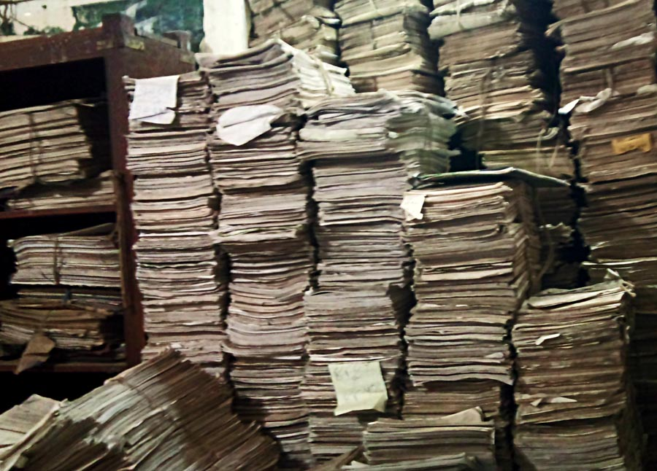
Take Control!
If your office hasn’t already, it’s time to take control of all records in your area – paper, email, and computer files! Don’t let this mess become your reality!

Slide 16
Ensure Records are Easily Retrievable
All documents must be easily retrieved and located. In the event of a public record request – or litigation – departments have a responsibility to locate any document. This means that employees are accountable for the records they create and save.
Examples of poor record keeping include:
Storing records indefinitely, including your email and work computer
Saving records from emails or other sources onto a work computer outside of the department record or storage system
Deleting emails every 6 months without accounting for the content
Scanning records and destroying the paper copy without a quality control check that verifies the document is an accurate representative of the paper copy (e.g. is it cut off, slanted, or image not clear?) See Wis. Stat. ch Admin 12.
In order to have retrievable records, every department should set standards for WHERE records are located within an operational area, and HOW they are named.

Slide 17
Safeguard Records
Stop and evaluate if the record you are handling contains any private information. Since most of our work is electronic these days, you may need to consider removing restricted information before forwarding.
Be cognizant of your surroundings when you are working on your computer with sensitive information
ALWAYS lock your computer before stepping away from your desk
Be aware your email is not considered safe if sharing documents outside of the University to another server
Always follow the University’s Information Security Policy
Send secure emails. As part of safely storing records, emails containing sensitive information sent outside of the UW-Green Bay server, should either have PII removed or sent through an encrypted system like LiquidFiles. Contact Information Technology for additional information.

Slide 18
Set Office Standards
Remember Amy’s flash drive from a couple slides ago? Setting office standards ensures we meet state requirements and are actually managing our department records.
File Naming Conventions
Pick a file structure that suits the needs of your office and consistently use that structure. Everyone in the department should be aware of, and use, the identified naming conventions the department sets up. This avoids confusion in locating records, and for new employees will maintain a consistent style. Using a shared operational unit network drive makes sense as people come and go. The goal of naming records is to find them later! Specifically, if someone is looking for this record 5 years from now, would they know what to search for or is it only understandable to you and those in your department?
Email Standards
Did you know email is kept forever on Outlook, including the “deleted” emails? The practices you develop now will help manage this volume. Create Good Subject Lines When sending emails, think about how you can best locate this email later. The subject line is the most critical component. Email subject line examples: FYI: Bellin Contract Proposal Request Review: GRC Minutes 01252018 Invoice Payment Smith Factory #15530 Create Email Folders Once an email is received, users may save the email into a folder to review or recall at a later date. Setting up email folders will be beneficial in locating an email or when you are needing to transfer records to the archives. These saved email records most likely do not fall into a transitory schedule and should be reviewed before arbitrarily deleting. The content will factor into a record schedule.

Slide 19
Locate Unit Record Management Plan
Finally, your unit is required to have a Record Management Plan. This plan is essentially an inventory of department records that employees may reference and learn the types of records used by the department and where they are located. It is recommended that departments use the Inventory Management Worksheet. The Worksheet lists department documents, their dates, and the associated record schedule that governs them. Departments are encouraged to review the list annually or at least during the Confidential Destruction process.
Here are four types of record formats to consider:
Paper Documents
Paper documents are the easiest records to inventory in the department. Most are already filed according to department standards and can be easily listed within the Inventory Worksheet.
Computer Files
This category consists of departmental shared files as well as those files that are stored on every employee’s work computer. Listing these documents on an Inventory Worksheet will take the most time initially, but annually you will only need to consider adding date ranges.
Emails
Every employee should be aware of the emails they have within Outlook and have created file folders or other standards in which to save important emails. When adding emails to the Inventory Worksheet, be concerned with the email content to match with a record schedule.
Database Records
The systems and databases we use convey multiple documents within them. A system may have 100 GB of storage capacity, but records within a database or system also fall under records management. Don’t wait until storage capacity is an issue before your department looks at the data/records contained within to determine what should be appropriately disposed of. Your department will want to list the records stored and work with your Business or IT Analyst to determine the best method for disposing of data once a retention period has been met.

Slide 20
Inventory Records Process
If your department has not already done so, establish a Record Management Plan by completing the following steps:
Locate your records and evaluate the content
Open a blank Inventory Management Worksheet
This worksheet mirrors the Confidential Disposal Form so you can easily copy and paste records set for destruction onto the CDF for records that will be disposed of in a confidential shred.
Complete the Worksheet
Enter records to be inventoried: Record Media, Record Description, Dates
Locate a record schedule related to these records
Use the Record Schedules List to locate a record schedule that matches the document you have by searching within the List. You will need the TITLE and RECORDS DESCRIPTION to match the document you have.
Record Description: emails on purchasing Record Schedule: External Communications ADMIN351
Enter the RDA Number, Title Description, Retention Period, and Disposal Method within the Worksheet
d. Continue adding records
Once the Worksheet has been completed, you can now determine which records in the office are past the retention period and can follow steps for disposal. Save the Worksheet where everyone in the department would have access.

Slide 21
Congratulations!
You have completed the basics of Records Management.
We encourage you to become familiar with the Record Schedules List that relate to the documents within your work area or utilize the Records Management Handbook. Should you have additional questions on Records Management, locate information or forms on the UWGB Record Management website or contact:
Records Officer
Sandi Maine-Delepierre
maines@uwgb.edu
920-465-2781

