Slide 1
EQ: Making It Work For You
Notes:
Ralph Rothacker
Beth Bechtel
Stevens PTA
Christine Goss
Elementary years are Best time to learn about Bullying
Studies show it is worst in the middle school years 6-8

Slide 2
Emotions
They aren’t good or bad
They can control you, or you can control them
They give you data to make good or bad choices
They can certainly change your path, if you let them!
For instance:
Anger can lead to regret
Anxiety can lead to worrying
Frustration or fear can lead to giving up
Excitement can lead to underestimating risk
Notes:
Source: https://www.psychologytoday.com/blog/what-mentally-strong-people-dont-do/201510/7-surprising-ways-your-emotions-can-get-the-best-you

Slide 3
Questions to Ask Yourself
What makes a good leader?
What makes a bad leader?
Most likely, your answers will bring out your feelings

Slide 4
Do You Know Yourself?
On a scale of 1 (low) to 10 (high), rank your confidence level
What are your weaknesses?
How do your words and actions affect others most often?
Do you make situations better: most of the time, sometimes, or rarely?
Would others say the same about you?

Slide 5
Ultimate Question:
What is YOUR contribution to a conflict?
Over personalizing?
Unrealistic expectations?
Lack of trust?
Over reacting?
Unhappy with the difference in styles?

Slide 6
The Journey Begins
Four Primary Emotions
Happiness
Sadness
Fear
Anger
Look for facial cues in yourself and others:
Eye rolling
Smirking
Furrowed brow
Notes:
Source: https://www.spring.org.uk/2021/06/how-many-emotions-are-there.php
https://www.bbc.com/news/uk-scotland-glasgow-west-26019586
Discuss facial expression associated with the primary emotions

Slide 7
“Anyone can become angry – that is easy. But to be angry with the right person, to the right degree, at the right time, for the right purpose, and in the right way – that is not easy.”
- Aristotle

Slide 8
Exercise
Pick a person who challenges you emotionally
How do you feel about this person?
How do you manage those feelings?
How do you leverage those feelings?
What choices can you make to improve the relationship?
How can you view this person from a new perspective to feel better?

Slide 9
Best Practices
Mindfulness: paying “ultimate” attention
Breathing
Visualization
Guided Imagery
Centering
What works for you?

Slide 10
Today…
Wake up in the morning
You create the mood: happy, serene, joyful, calm...
What will get you there?
Choice of clothes
Choice of food
Your commute
Prioritizing your work
Notes:
Ex: when my dad dies if I could get from despondent to sad I would be happy

Slide 11
Leveraging…
Making your emotions work for you:
Lucky rabbit’s foot
Favorite colors
Favorite theme songs
Painting your room
Food choices
Accomplishments

Slide 12
THOUGHTS = FEELINGS = ACTIONS
Formula to Managing Emotions

Slide 13
It’s All About the Party
Knowing others: not judging others
Consider past baggage
Meet a lot of people who are different from you
Walk a mile in their shoes
It’s just as important to know when to leave the party

Slide 14
Your Kepro EAPur Kepro EAP
EAP Services available to employees, any household members and dependents
Confidential
EAP Counselors available 24/7/365 via 833-539-7285
Up to 6 in person counseling sessions, per issue, per year, per household member
Management Consultations
Financial/Legal Consultation and Referral Service
Work/Life & Convenience Services
https://sowi.mylifeexpert.com Company code: SOWI

Slide 15
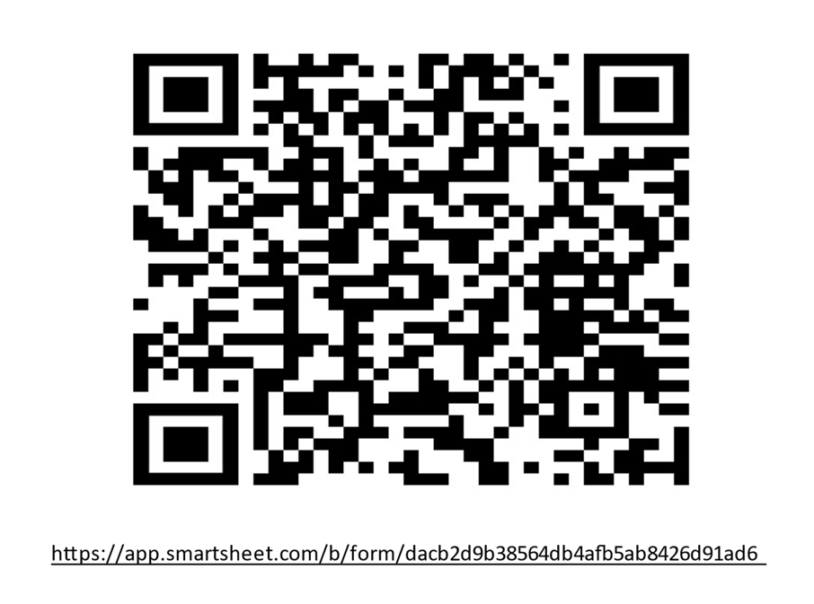
Please complete a training evaluation. Thank you!

Slide 16
Questions & Answer
Embracing Happiness

