Slide 1

Emotional Intelligence:
A Guide to How it Works

Slide 2

Agenda
Introduction/Overview
Emotions, Moods, Feelings
The Science behind Emotional Intelligence
Using Emotional Intelligence
Closing/Action Plan
Notes:
Review the agenda, providing a brief preview of each item. Throughout the training, discuss how Emotional Intelligence applies to both their personal and professional lives and give examples from both. Let participants know they will have an opportunity to apply what they have learned to one of their own situations through an activity. They will also have an opportunity to reflect on their learning and think about how they will incorporate Emotional Intelligence into their lives.

Slide 3
Learning Objectives
After completing this training, you will be able to:
Explain what Emotional Intelligence is and is not
Identify your own primary and secondary emotions
Describe the connection between the brain and emotional responses
Understand how a higher Emotional Intelligence can help you manage your emotions
Discover how to start increasing your emotional management.
Notes:
Review the learning objectives. Ask participants what their expectations are for this training. Explain that if there’s time at the end, there may be room to discuss some of the expectations that weren’t addressed during the presentation.

Slide 4
Did you ever know anyone who…
Just didn’t get it?
Said the wrong thing?
Did the wrong thing?
Couldn’t get along with anyone? Or everyone?
Missed cues at meetings/parties?
Had a high IQ but was awkward while interacting with others?
Had no common sense?
You just couldn’t be around?
Drove you crazy!
Notes:
This topic really opens up a whole new world. So, for some people that have a high IQ they need to understand how important people skills are. Ask the audience their experience with people who have little or no common sense.

Slide 5

PEOPLE SKILLS MATTER!

Slide 6
EI Facts
Emotions FUEL performance
$40B Training & Development
1998 Harvard Business Review’s most popular publication of all time!
EI is 58% of a leader’s performance
90% of top high performers have high EI
EI: needed at all work levels, in all industries and in all aspects of life: personal & professional

Slide 7
Emotional Intelligence is NOT……
  Being smart
  IQ
  Controlling others’ emotions
  Manipulating others
  Extroversion/Introversion
Notes:
Review the lists, give examples of each alternating between work and personal examples. Provide background on leaders in the field and their contributions: Salovoy, Mayer and Caruso; Goleman.

Slide 8
What is Emotional Intelligence
Recognizing, understanding, expressing and managing your emotions and the emotions of others.
  Examples of high EI:
  Understanding your own emotions
  Picking up on others’ cues
  Managing your responses/reactions to others
  Being appropriate in social situations
  Developing relationships
  Treating others well
  Helping others manage their emotions
Notes:
Review the lists, give examples of each alternating between work and personal examples. Provide background on leaders in the field and their contributions: Salovoy, Mayer and Caruso; Goleman.

Slide 9
“Anyone can become angry - that is easy, but to be angry with the right person at the right time, and for the right purpose and in the right way - that is not within everyone’s power and that is not easy”
- Aristotle, Ancient Greek Philosopher
Notes:
Read and discuss the quote. Ask participants if they can relate to the quote. While it is not in everyone’s power and not easy, Emotional Intelligence can be learned.

Slide 10
Emotions, Moods, Feelings
What is an emotion?
Why is it valuable to understand what you are feeling?
Why is it important?
How do feelings affect your mood?
Our emotions and moods are contagious
Notes:
We all need to be more comfortable talking about how we feel. Ask participants to share different emotions.
Ask people to show what it looks like when they are happy! Sad! Angry! Confused! The point being, some of us express our emotions more clearly than others. Emotional Intelligence gives us a vocabulary to express our emotions, moods and feelings. All of which effect our actions, interactions and connections.
Remind everyone that in this one hour training we are “introducing” Emotional Intelligence. Our goal is to familiarize participants with the topic and it’s importance.
Definitions:
Emotion: a mental state that arises spontaneously rather than through conscious effort and is often accompanied by physiological and behavioral changes in the body.
Mood: a particular state of mind or outlook at a particular time.
Feeling: an emotional state or reaction; an awareness by your body.

Slide 11
Primary and Secondary Emotions
Primary emotions happen in the moment/real time; they move us to action.
Joy
Happiness
Fulfillment
Contentment
Peace
Fear
Shame
Sadness
Hurt
Guilt
Frustration
Dissatisfaction
Disappointment
Secondary emotions are complicated and built up; they hinder us
Disapproval
Disdain
Hatred
Coldness
Hostility
Persecution complex
Paranoia
Distrust
Worry
Anxiety
Insecurity
Low self-esteem
Self-hatred
Depression
Anger/Rage
Jealousy
Notes:
Primary Emotions are our immediate reactions, they are advantageous and have great value. They motivate us. Secondary emotions hinder us. When we experience a secondary emotion, we need to figure out why we feel that way and what we can do to do away with them.
Source: Personalitycafe.com
Primary emotions are in- the- moment emotional responses to a pleasant or unpleasant stimulus. They happen as a direct result of an external cue that affects us emotionally. That is, they occur in close proximity to the event that brought them on. Primary emotions are important because they provide us with information about our current situation and get us ready or motivated to act in some way.
Primary emotions can be extremely pleasant and they can also be extremely unpleasant. Crucial to understanding our emotional reactions and how we behave, either in a healthy and self-actualising way, or conversely in an unhealthy detrimental way, is being aware of our primary emotions and that they all have value. They are important cues to our humanity and growth on a personal level as well as interpersonally and socially.
We can look at our primary emotions as a human survival mechanism. If we do not allow ourselves the expression of our primary emotions, we at best fail to thrive and live a meagre detached existence, and at worst, when the primary emotions become secondary emotions (which they inevitably do), we cause damage to ourselves and others.
Understanding Secondary Emotions
Let's look at the above statements. These statement do not help us to achieve. They do not make us better people. They disguise themselves by making us think we'll be better if we listen to the voice. But, in fact what they do is destroy our sense of self and demoralise us.
If that were not bad enough, in the long term, we get into a pattern of not even recognising the primary emotion anymore because the dysfunctional voice has infiltrated completely. What happens then? Not a pretty picture. Because the primary emotion never goes away. It gets buried, but we need it to survive. It makes us human.
This brings us to our secondary emotions. These are very familiar. We might mistake them for primary emotions if we're not self aware. For example, anxiety is often due to fear. We may not be aware that we're afraid, or even what we are fearing (it could be many things), so it becomes expressed as general anxiety. The thing about secondary emotions that will be a tip off is if you can't alleviate it without digging deeper.
Secondary emotions are not there to help us. They hinder us. They are the emotions we have in response to a primary emotion not being recognised or expressed. Secondary emotions can be analysed by listening to our inner dialogue. When we feel uncomfortable with the expression of a primary emotion, our inner judgemental voice kicks in. What does it say? Whatever that voice is saying will be a cue as to how we our turning our primary emotion into a secondary one.
A secondary emotion is what occurs when we don't value, listen to respond to our primary emotions. If we do not express the primary emotion it does not go away. We may not express it for a variety of reasons. It may be because of habit from our past (emotional blocks from childhood, family, school, society or relationships and past hurts), or it may be because we are in a social or work situation in which it is not acceptable or safe to express the primary emotion, or it could be because our current situation blocks us from expressing it (ie. it is not accepted by a partner).

Slide 12
Next…
We know how we feel…
What does it mean?
Keep a journal of your emotions and your behaviors…
When I am angry, I yell
When I am sad, I cry
When I am hurt, I shut down
When I am overwhelmed, I make mistakes
Notes:
We are now going to transition into how to use emotional intelligence. Keeping a journal is a way to help us understand the variety of emotions we have and how they affect us. It is important to know how we feel, what triggered the emotion, what emotion is driving our behavior; once identified we can figure out what to do about it, and how to fix it, if needed.
There is a sampling of emotion and behavior, for example: anger leads to yelling, sadness leads to crying. Trying to understand our emotions and behaviors is what ultimately makes us more successful.

Slide 13
Understanding Emotions
Learn how to be the best listener
Watch others’ body language
  What are they are really feeling?
  What emotion is their tone conveying?
  Do their tones and their emotions match?
Become more comfortable sharing your emotions
Notes:
The vast majority of us are not comfortable sharing how we feel. Therefore, we need to be attuned to other signs and signals. By picking up on verbal and non verbal cues we can get insight into others’ emotions. Ask if anyone is a good people watcher? If this is an area you want to improve upon, take a day and go sit in a coffee house.
Even watching foreign films or traveling to new and different areas can help to better understand human behavior and actions
The more comfortable we become being open about our feelings the more likely we are to get along with others. Emotional Intelligence helps us to build social skills and connect with people.

Slide 14
Understanding the Brain
Thalamus
Relay center between our conscious and subconscious
Helps us to react appropriately
Cortex
Thinking center
Helps us make sense & sends messages
Amygdala
Regulates emotional responses
Here is our chance to change behavior
Notes:
The Thalamus is in the center of the brain, a sort of relay center where our thoughts from the “higher” parts of the brain are integrated with sensory and motor information from our “lower” brain.
The Cortex is what you see on the outside of the brain, and it is where our conscious thoughts occur.
The Amygdala is connected along the pathway between the thalamus and cortex, you can think of it as where some of our gut reactions happen.

Slide 15
How does Emotional Intelligence really work?

Slide 16
Our Response to Triggers
Traffic
Awakened by a scary noise
Yelling at work
Worrying email/phone call
Impending deadline
Bad news
TRIGGER
Activation of “lower” brain regions
Irrational, kneejerk reaction , entirely emotional
“Scream and Yell”
Activation of “higher” brain regions
Calm response, combination of emotion and logic
“Work to fix it”
Notes:
The response to a trigger or stress is complex, and we still aren’t sure how exactly it works. One major obstacle in understanding it is how many regions of the brain are involved, only a few of which are mentioned here. What we do understand is that in each stressful situation, the involvement of our “higher” brain regions (cortex) give us more reasonable responses. It is the part of the brain that calms ourselves. Whereas when our “lower” brain regions become more involved, we get more rash, irrational responses to triggers and stress. The lower brain region produces more knee jerk reactions.
In this situation, imagine that your teenage son or daughter came to you and said “I crashed the car”.
Since this isn’t actually happening right now, we can all appreciate that the more important thing is that they’re okay.
In the moment, you may be overwhelmed and freak out, forgetting the important facts

Slide 17
The Key Ingredient: Empathy
Ask questions to understand how others are feeling
How do your words/actions affect others?
Anticipate how others are feeling
Notes:
Introduce empathy. Insert a story here that demonstrates the importance of seeing and understanding someone else's view point and talk about employing empathy. Looking at things from the others’ perspective and what they may be experiencing as a result.
In a personal relationship its easy to understand why we would want to know what's going on in the other persons life. It is equally important in business relationships.
When we yell at someone, how does it make that person feel. When we shut down and tune out, how does that make someone feel. What do OUR actions do to others…… something to think about!

Slide 18
Changing your Emotions
How does a lucky rabbit foot make you feel?
Has music ever changed your mood?
A picture of your family?
The smell of coffee?
Listening to a story about someone who did something amazing?
Reprogram or rewire your brain: What works for you?
Notes:
It is empowering to remember that we choose our responses… how do you want to feel. What makes you feel good? Once we know, we can use to reprogram our mood.
A story one instruction shares is: The holiday season after my dad died I wanted to have a calm holiday and family get together. I picked the mood and then I asked myself what makes me feel that way… less parties, less presents, calm music. I orchestrate and dictate the mood and emotions that I am going for.

Slide 19
Controlling your Emotions
Identify how you feel and then…
Pause
Walk away
Take a deep breath
Do a crossword puzzle, Sudoku, etc.
Laugh
Relax
Paint, draw, cook
Notes:
While these are some quick, simple ideas, they are effective. They help us to decompress and be able to handle a task or situation in a positive way. Ask the audience to share what works for them.

Slide 20
The Benefits of Emotional Intelligence at Work
On the job, people with higher emotional intelligence excel at:
  Staying calm under pressure
  Resolving conflict effectively
  Behaving with empathy
  Leading by example
Those with high levels of Emotional Intelligence delegate more effectively and more emphatically
Increasing our Emotional Intelligence makes us better employees, leaders, colleagues and teammates
Notes:
There is plenty of research supporting the benefits of Emotional Intelligence at work, below is a sampling:
EQ is a driving force in the $40 billion training and development industry.
The 1998 Harvard Business Review article on emotional intelligence is their most popular piece of
all time.
TalentSmart®studies show the link between EQ and job performance:
 EQ alone explains 58% of a leader’s job performance.
 90% of top performers are high in EQ.
 Just 20% of low performers are high in EQ.
EQ is linked to job performance for employees at all levels, in virtually every industry.
In Working With Emotional Intelligence, Daniel Goleman reported that 80-90% of the competencies that differentiate top performers are in the domain of emotional intelligence.
In a study, when asked what sets superior performers apart, participants identified emotionally intelligent competencies 44% of the time and cognitively intelligent competencies 19% of the time.

Slide 21

Emotionally Intelligent People are…
Empathetic…care how others feel
Willing to change…and open to it
Positive people, that others want to be around
Focused on achieving goals while motivating others
More productive
Notes:
If time allows, have people share stories of role models in their life. Who is the most EI person they know?
Or share someone you know! And what makes them emotionally intelligent?

Slide 22
Activity
Think about an interaction or situation at home or at work that caused an emotional response in you, that didn’t go well.
Who was involved?
What triggered your response?
What was the outcome?
Based on what you learned today, what could you have done differently?
Notes:
Participants will now have an opportunity to apply what they have learned to one of their own situations.

Slide 23
Most Important Point
Reflect back on the information presented today.
What is the most important thing you learned?
What is one thing you will do to become more Emotionally Intelligent?
Notes:
Ask participants to reflect back on what they learned, what they want to be sure to remember and what they want to apply from the training. Walking them through these 3 bullets will help them to do so. In bringing the session to a close, if time allows, ask participants to share one new thing they learned from this presentation, one thing that closed a circle for them, one thing they now see from a new angle, or one thing they will do differently.

Slide 24
Your Kepro EAPur Kepro EAP
EAP Services available to employees, any household members and dependents
Confidential
EAP Counselors available 24/7/365 via 833-539-7285
Up to 6 in person counseling sessions, per issue, per year, per household member
Management Consultations
Financial/Legal Consultation and Referral Service
Work/Life & Convenience Services
https://sowi.mylifeexpert.com Company code: SOWI

Slide 25
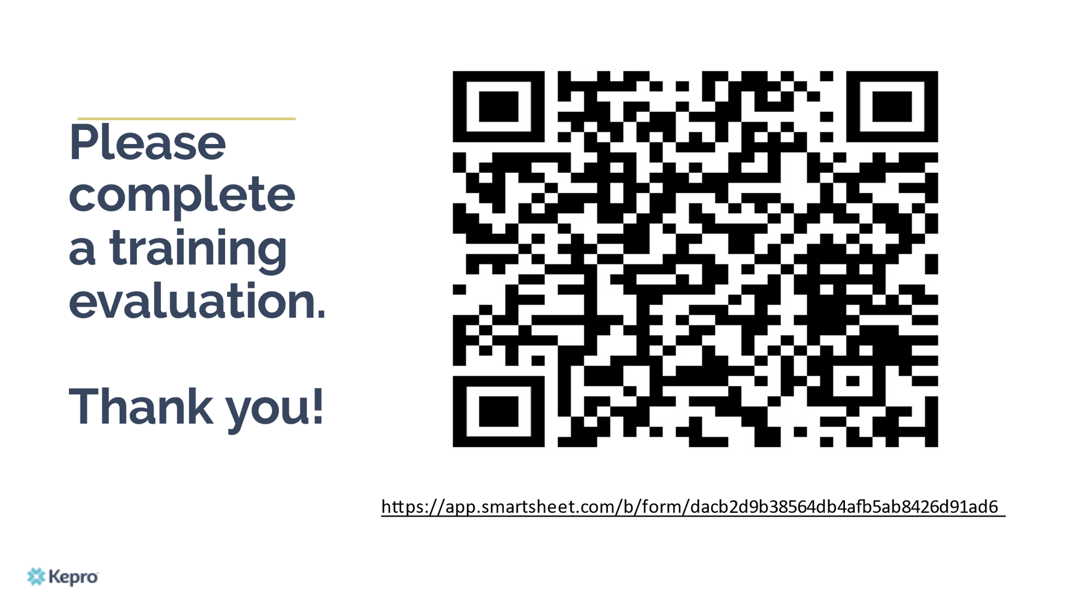
Session Evaluation

Slide 26

Questions & Answer
Emotional Intelligence:
A Guide to How it Works

