Slide 1
Onboarding & Engagement of
Student Employees
Student Employee Supervisor Training – Part 2
August 16, 2023
Presented by:
Allen Voelker, Kay Voss, Bev Pence, Julie Stanelle & Rachel Wautier
Notes:
Good afternoon and welcome to part 2 of our 4 part Student Employee Supervisor Training series. We are very excited that you decided to take time out of your day to spend with us. We are looking forward to having a great conversation with you all today about Onboarding and Engaging our Student Employees.

Slide 2
Part 1 – Recruitment & Hiring of Student Employees
Financial Side of Hiring a Student
Creating a Job Description
Handshake Overview
Career Services Resources
Interview Tips & Recruitment Best Practices
BP Logix – NEW Electronic Hiring Form
Notes:
For those you who were unable to participate in Part 1, I wanted to just take a moment and highlight what we discussed.
We talked about the financial side of hiring a student including understanding what your departments budget is for student workers and how work study plays into that.
We talked about writing your job description, how to make that engaging and really helping the student understand what the job is about as well as the steps to post it in Handshake.
We talked about some recruitment and interviewing tips and best practices.
We wrapped up this session with our official launch of our new BP Logix Electronic Hiring Forms for student employees.
Now if you missed all of that fun, you can go to the Student Employment website, within the Supervisor Toolkit and find the recording and the slide deck.

Slide 3
Agenda
Onboarding
Training Best Practices
Student Employee’s Time
Understanding Federal Work-Study
Effective Communication
Employee Engagement
Career Readiness for our Students
Notes:
So today, we are going to talk about what happens in those days leading up to and beyond that start day.
I am going to talk about onboarding and training your new student. Rachel will share with you how they will enter their time. Allen will share with you information on how to monitor a work study award. Bev is going to have a conversation with you on effective communication and engagement. And Kay is going to share with you how the skills they are learning in your on campus job translate to their resume and into their future professions.

Slide 4
Onboarding
Onboarding Checklist
Welcome environment
  Meet and greets
Allow time for My UW Portal entry
  Direct Deposit
  W-4 Withholding
  Self ID
I-9 verifications with Human Resources
Setting Expectations
Notes:
So you hired a student employee, you have a start date...now what?
The first thing I would do is go out to the Student Employment website and get myself an onboarding checklist. This checklist will guide you through the preparation and first few days of the onboarding experience.
Before the student starts, think about the work space you have for them. Is it clean? Is it stocked with the supplies they need in order to do the job and meet the expectations you have for them?
Make sure that your department knows that a new student is starting. Share with them things like their work hours and any specific projects they might be working on, a small bit of personal information like where they are from and what their major is.
On the students first day, make sure you or someone else are there to greet and welcome them into the office. Give them a tour and do introductions. If the new student will be working closely with others, perhaps you want to work with the student to set up one-on-one meetings so the student can better understand what everyone does and how their roles will interact.
On their first day or two, you should also allow for some computer time. Is a trip to the IT Help Desk needed to get Duo access? You certainly want to allow the new student a few minutes to work through their My UW Portal to complete their Direct Deposit, W-4 Withholding, and Self ID. And you'll also need to make a trip to HR so that we can complete Section 2 of their I-9. As we announced in the first session and as part of the Chancellor's missions alignment exercise, all I-9s will be 100% processed within the HR office and we will no longer have departmental representative processing these forms. Remember it is required by law to have this document completed within 3 business days of the new employees start date. For those of you that may hire students for the additional location campuses, we will be working with representatives on the campus to complete the I-9 so that a trip to Green Bay is not needed.
Another thing you will want to do at the start of employment is set expectations. What are their work hours going to be? Who do they contact if they have an emergency and can't make it to work? Who should they go to with questions if you are unavailable or out of the office? Are they able to work on coursework in this role? Can they listen to music with their ear buds? Have the conversation around flexibility when it comes to their course work and your department's policies and practices. Remember, they are a student first so you may need to work with them if they need to adjust their schedule to work on a group project or study for a big exam.
What did I miss? What do you all do as part of onboarding a student employee? Folks joining us online, throw something in the chat so we know you're out there.
Please keep in mind that onboarding doesn't end after their first few shifts. To onboard and orient someone to a new role takes time and it is possible that this is the first job our students have had. Therefore, we need to provide them with a little bit of grace as they navigate this new challenge.

Slide 5
Training Best Practices
Training plans/schedules
  LinkedIn Learning
Mandatory Trainings
Opportunities to job shadow if applicable
Check In/Workload Meetings
Be transparent
Notes:
Starting a new job always comes with training and learning. We would recommend putting together a training plan. In that plan, you will want to lay out what tasks/projects the new student will be working on? Who is going to train them? What materials do they need access to? Who do they ask questions to? And how long you expect them to working on that. We would recommend that you share this training plan with others in your department so that everyone is on the same page. We would also encourage you to provide status updates with your team if that is appropriate.
You are welcome and encouraged to supplement your training with training lessons from LinkedIn Learning. For example, in our HR Office, we have had our students watch videos on telephone and email etiquette. That is certainly a resource that is available not only to employees but also students. If you have a training need, you are welcome to reach out to me. I am happy to look for trainings or work with my LinkedIn Learning Customer Success Manager to find a great training for you.
In general, students do have 2 mandatory trainings that they are enrolled in and are expected to take – Mandated Reporter which only needs to be completed once upon hire and then Information Security training which is done annually. Students are enrolled in these trainings by UW- Shared Services and we do get audited on their completion. Please make sure that as you are setting up their training plan, you are allowing time for them to complete these two important trainings.
If your student employee has interest in pursuing a career in your area, for example HR in the HR Office, or computer programming and working in IT, perhaps you can set up an opportunity for the student to job shadow or provide some assistance with specialized projects. Helping the student not only get work done for you and your department but also helping build some skills that can translate to their resume.
Trainings is another topic that doesn't end after the first few days. We would encourage you to have regular check in or workload meetings with your student on their work. Do they have enough to do? Do they have a solid understanding of their role and how their works impacts your office. You might also want to check in on how their semester is going? How are they doing with all of their coursework? You can use these meetings to discuss any issues or concerns you have with their performance in the role and also to give them praise on a job well done. The biggest thing in these meetings and throughout their time with you is to be transparent. It is our job as their on-campus employer to help them build skills and work habits that will carry with them as they start in their desired career field.
At this time, I am going to pass the presentation over to Rachel to talk about student time entry.

Slide 6
Student Employee's Time
Must be in compliance with the Affordable Care Act(ACA) and state legislation students can work max of 25 hours per week during academic year
Can work up to a max of 40 hours per week during designated break periods
If a student will be working over, please contact HR before they work
If students have multiple positions, please communicate how many hours they are working within the different positions
Flexible Hours – need to go to class
Let know who their backup approver
Payroll website with additional resources on ACA
Notes:
Rachel

Slide 7
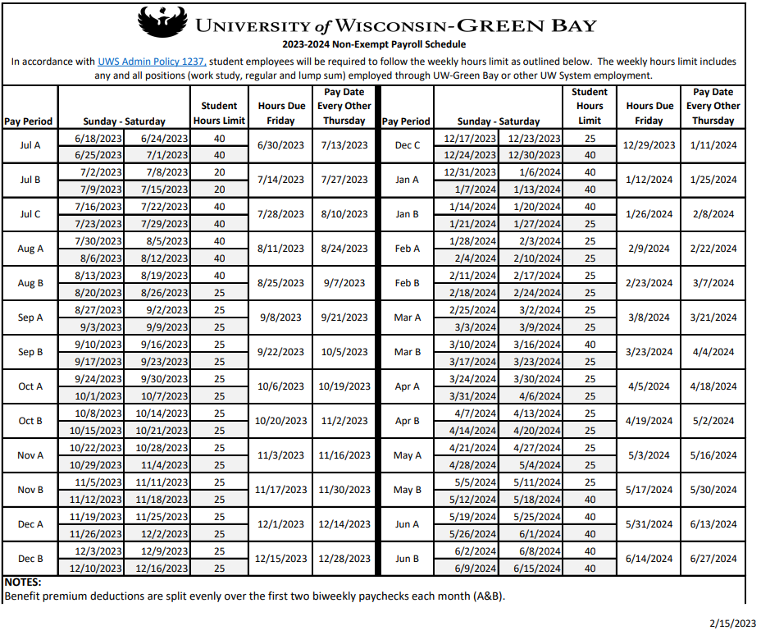
Payroll Schedule:https://www.uwgb.edu/human-resources/payroll/payroll-information/
Notes:
Rachel

Slide 8
Types of Time Entry
Webclock – entry should be utilized for student employees who are able to punch "in" and "out" each day
  Will need access to computer to punch "in" and "out"
  Ex: Attendants
Timesheet – Students are not able to immediately enter time. Able to login during bi-weekly pay period and enter in "in" and "out" times
  Ex: Research Assistant
Notes:
Rachel

Slide 9
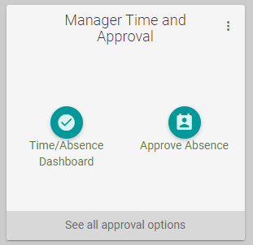
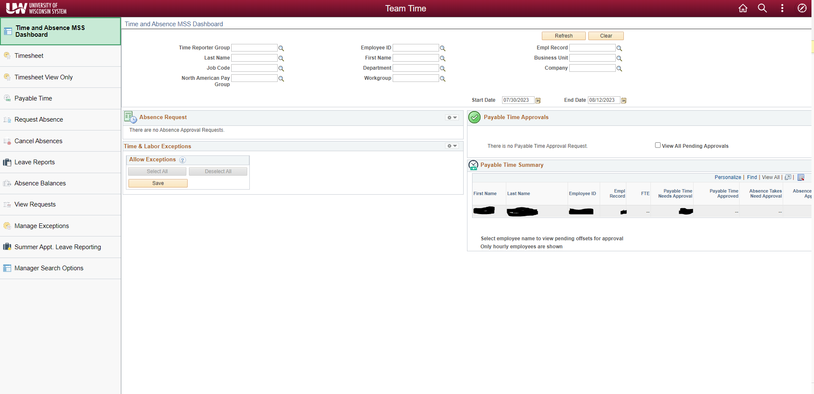
Approving Time
Notes:
Rachel

Slide 10
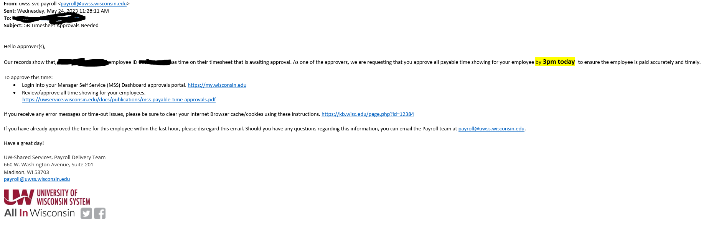
Hour Reminders
UW-Shared Services will send out email Monday morning that pay hours are due
Recommend setting up recurring calendar reminder bi-weekly to get time approved by Wednesday at 3:00 pm at the latest
Notes:
Rachel

Slide 11
Financial Aid Resources
Student Employment
Federal Work-Study (FWS)
General
Free Application for Federal Student Aid (FAFSA)
Scholarships
Notes:
Allen

Slide 12
FWS: Basics
Need-based program
Students submit the FAFSA each year to determine eligibility
May not displace or replace other workers
May not schedule students during class periods
Federal funds cover 75% of qualifying wages
Notes:
Allen

Slide 13
FWS: Scheduling
In general, FWS eligibility will not directly impact whether it is permissible to hire a student
Budget drives what is possible for the department to afford
No special HR paperwork required to initiate or continue employment
Notes:
Allen

Slide 14
FWS: Monitor Spending
WISER line item represents budget for departmental share
  FWS Hourly: Acct 1781
  Regular Hourly: Acct 1771
Ask students to share biweekly balance reports during academic year
  Figures are as of the last date of a previous pay period
  Amounts may change (e.g., receipt of outside aid, less than half-time enrollment)
  All eligible positions pull from FWS balance by default
Notes:
Allen

Slide 15
FWS: Projecting Hours
FWS Balance ÷ Hourly Wage = Total number of hours
2000 ÷ 12 = 166.7
Total hours / Number of Earning Weeks = Number of hours per week
166.7 ÷ 28 = 5.95
Notes:
Allen

Slide 16
FWS: Waitlist
You may ask continuing or prospective student employees to add themselves to the FWS Waitlist.
  Explain how the program impacts your budget (and scheduling, if applicable)
  Encourage students to contact with Financial Aid with further questions
It is possible for a supervisor to submit a request for the student, but
  Add comments indicating you are the supervisor
  Do not consent to loan adjustments on the student's behalf
Financial Aid will review and follow up with the student via campus email if we are able to assign funds
  First batch for the academic year is typically in July
  Periodic review during academic year depending on aggregate earnings
  We can typically accommodate most, if not all requests for eligible students
Notes:
Allen

Slide 17
FWS: Exhausted Balance
Student will receive a final biweekly balance report via campus email during the academic year
  Keep in mind there is a delay due to payroll processing timelines
The department may continue scheduling the employee
Financial Aid completes periodic reviews and may increase FWS offers to meet aggregate spending targets
Notes:
Allen

Slide 18
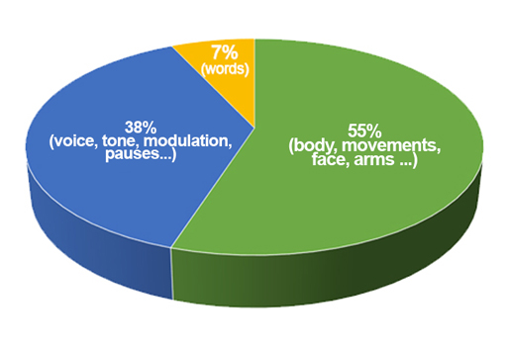
Effective Communication
Clear Communication
Body language and tone
Difficult conversations
Continuous feedback
https://www.open.edu/openlearn/mod/oucontent/view.php?id=98509&section=_unit4.1
Notes:
Bev
I'd like to start with a short video.
Video ends – what are some takeaways we heard in that video?
-focus on evaluating ideas, not the person
-empathy through conflict
-acknowledgement of your role during conflict
-don't be afraid to speak up
We always want to make sure we are trying to provide clear communication which helps to eliminate any misinterpretation. Sometimes this may take a little more thought and time, but is usually worth it if it leads to a clear understanding from all. For example, when sending an email with instructions/information, it's okay to provide that extra piece of clarification if you are not sure if they might need it or not.
Before training new employees, ask about their learning styles/personality styles – asking them how they learn best? Is it better to watch someone else do it or is it easier for them to have that hands-on experience in learning? If they aren't sure, give them time and opportunity to discover what might work best for them moving forward. As we know, sometimes this is a student's first job, so they might not be sure what their preferred learning style is when it comes to work tasks/duties.
We need to be sure that we create an environment where everyone feels safe to express ideas, opinions, and feelings, or plan and problem solve in creative ways.
Let's move on and talk a little bit about body language and tone: It's important not only to be aware of your own nonverbals, but also the nonverbals that are displayed by the person you may be communicating with. 55% of communication is physical body language, 38% is related to tone, and only 7% is the actual words.
Some examples of nonverbal communications?:
-Facial Signals
-Head tilts
-Eyes
-Eyebrows and forehead
-Mouth
-Gestures (using body and arms)
Regular feedback on employee performance can be helpful. If the student does not know they are doing something well, they may not seem confident in continuing to do the task. In turn if they do not know if they are following a process correctly, they could continue to do it that way and cause errors along the way that would need go to back and fix. It is important to acknowledge both the good and improvement opportunities throughout their employment. We will go more in to details on managing performance and addressing performance concerns in the next session of this series.
Essentially, we want to be sure to have open communications throughout employment so their experience during that time is rewarding to both them and you as a supervisor and for your department.

Slide 19
Employee Engagement
Remind students how the work they do fits into the overall operations and success of the area
Plan opportunities throughout whole year
Provide similar opportunities for student workers as areas do for permanent staff and faculty members
Specific Recognition
  Student Employee Recognition Posters
  Student Employee Appreciation Week – Career Services Coordinate
  Open to ideas!
Notes:
Bev/Kay
So, what are some opportunities for engagement and recognition? We have some ideas out on the Student Employment website many of which are at a zero to low cost. (Pull up website) - You can see here a list of some ideas such as:
Certificates to award your workers
Photo recognitions
Treat week
"You rock" traveling award to pass around
Another great idea is social media shout-outs or even just recognizing your new student employees online and welcoming them
Simply saying "thank you for all you do" regularly can go a long way
Does anyone have any other ideas that they do in their departments that have been well received and could be implemented in other areas?
Ok, so we want to remember that it is important that we are engaging and recognizing throughout the whole year and not just a one and done item to mark off of a checklist. The more engaged and valued the employee feels, the more likely they will be to stay and feel part of the team. They may even remember how great their time was during their student employment, that they look at continuing to work with the university after they graduate as well – which we see quite a bit!
I'll pass it over to Kay to go over some more specific student recognition efforts that Career Services is working on.
Student employee appreciation week and student employee of the year? - Kay
Every week or two – highlight student workers on the wall to union throughout year - photos. - Kay
Treat student employee as part of team, include them, etc.

Slide 20
Helping Students to Build their Resume and Career Readiness

Slide 21
Career Readiness for Our Students
According to the National Assocation of Colleges and Employers (NACE), career readiness is a foundation from which to demonstrate requisite core competencies that broadly prepare the college educated for success in the workplace and lifelong career management.
More info: https://www.naceweb.org/career-readiness/competencies/career-readiness-defined/
Notes:
Kay

Slide 22
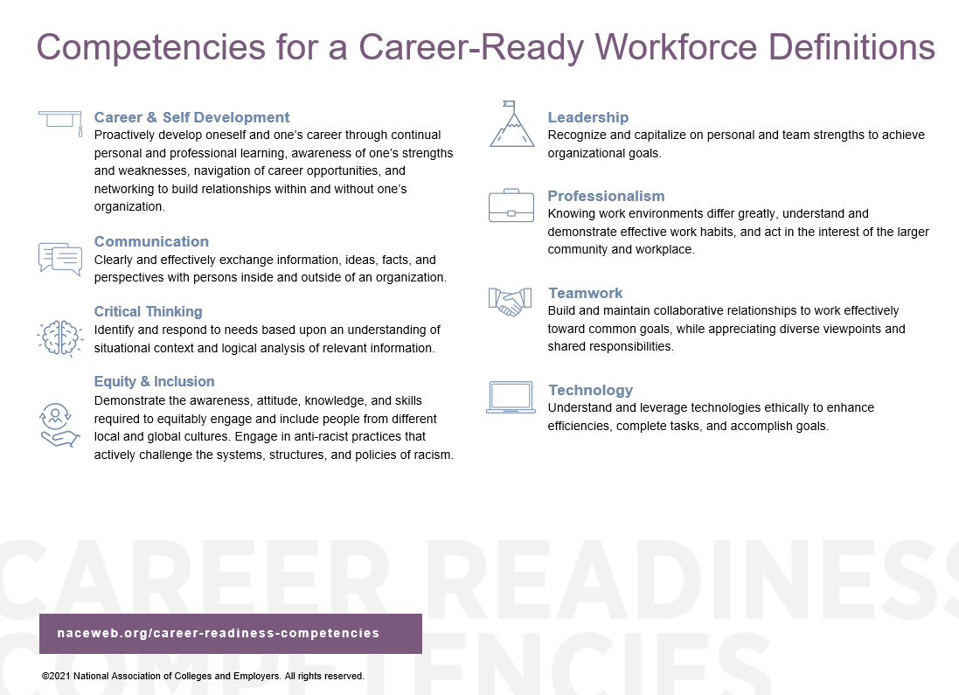
Notes:
Kay

Slide 23
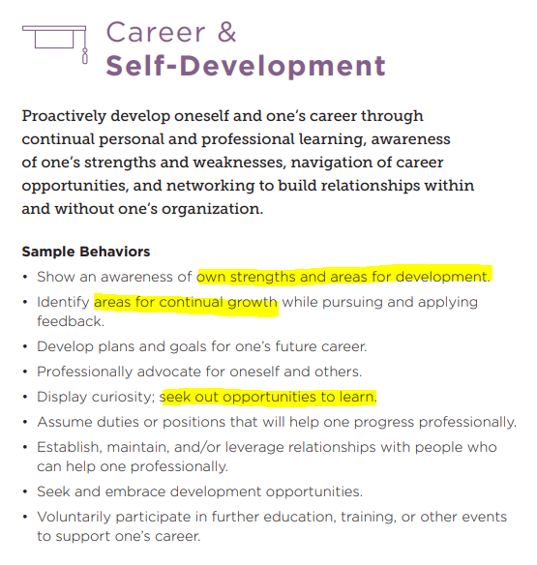
Notes:
Kay

Slide 24
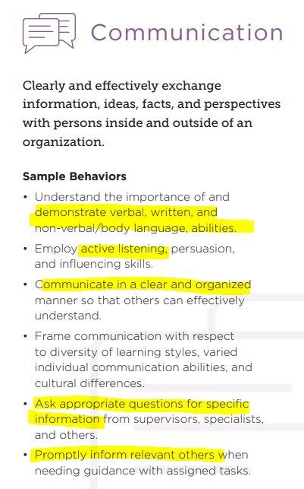
Notes:
Kay

Slide 25
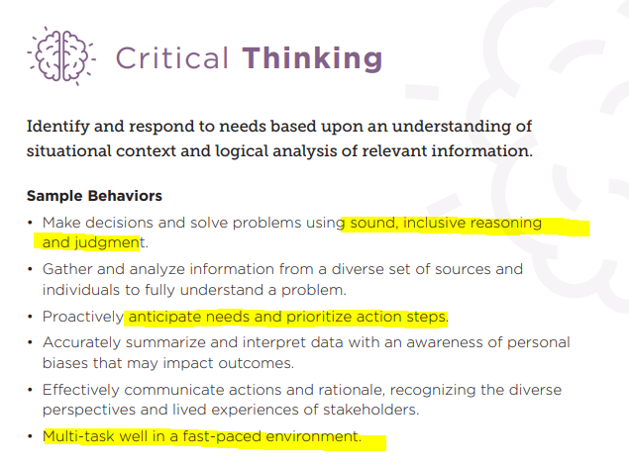
Notes:
Kay

Slide 26
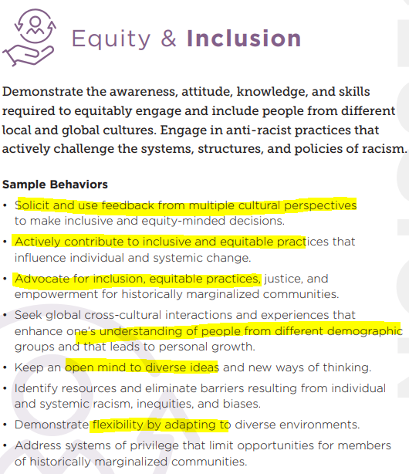
Notes:
Kay

Slide 27
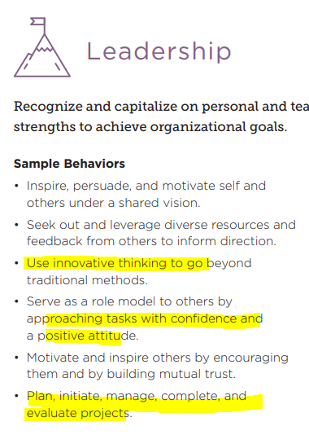
Notes:
Kay

Slide 28
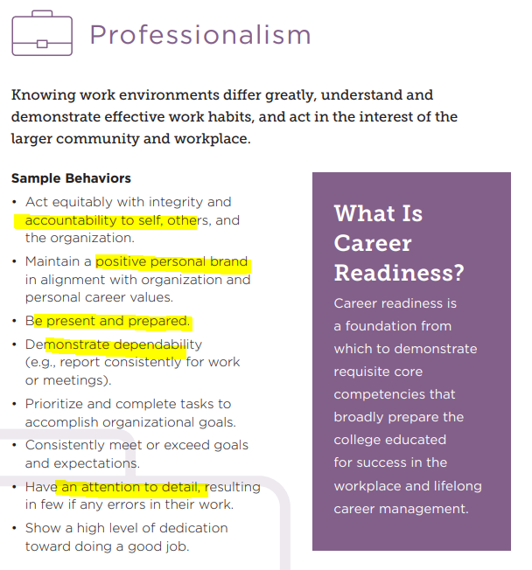
Notes:
Kay

Slide 29
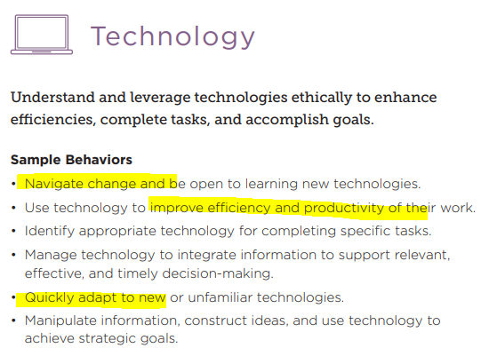
Notes:
Kay

Slide 30
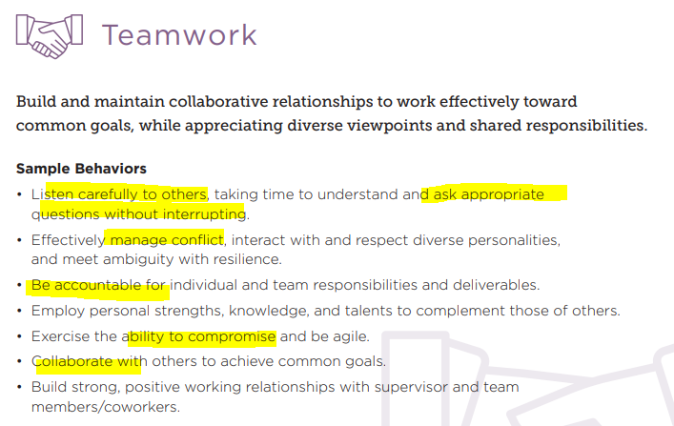
Notes:
Kay

Slide 31
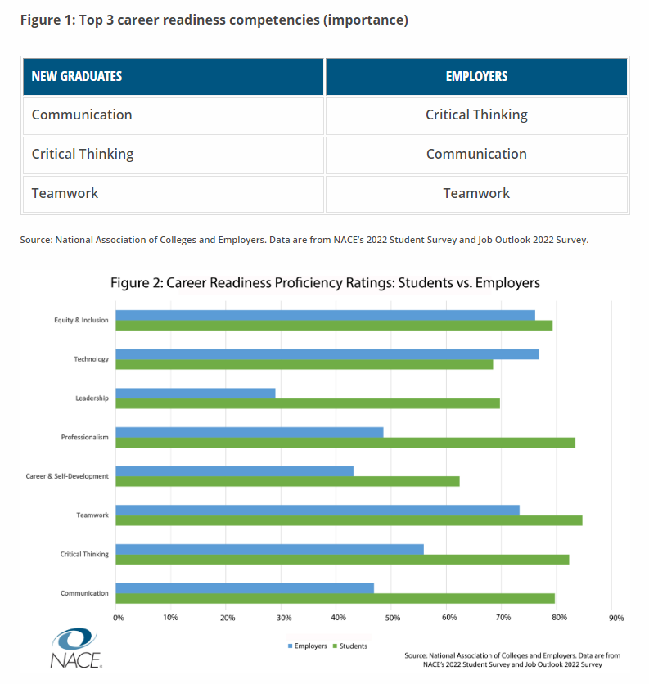
Notes:
Kay

Slide 32
Questions?
Ensure open positions are posted in Handshake!
Please fill out our feedback survey
Next Session October 17 from
  Feedback, Expectations & Performance Management of Student Employees
Notes:
Kay

