Slide 1
UW-Green Bay
Non-Instructional Staff Performance Evaluations
Supervisor Training
January 11, 2023

Slide 2
Agenda
Overview of the Past, Present and Future state of the Performance Evaluation process
NEW 2023 Performance Review Form
Modified Non-Instructional Academic Staff and Limited Performance Evaluation Form
Managing & Evaluating Employee Performance Best Practices
Notes:
Understanding that with any change there is a feeling of uncertainty, my goal for today is that as supervisors you leave this training comfortable with the modified form and what is expected from you as the supervisor in the performance evaluation process. Keeping that in mind between each of the sections in the training I will pause for questions. Julie Flenz from our office will be assisting me in keeping an eye on the chat for those individuals you are joining us virtually today. We will be compiling all the questions we receive in both the Supervisor Trainings as well as the Employee Trainings and creating a FAQ for employees to reference back on after the training.

Slide 3
Past State
University Staff Evaluation
Academic Staff/Limited and University Staff Non-Exempt
Review Period: Calendar Year (January - December) with evaluations due end of March
Structured Format, with self-evaluation in form of R.A.P Sheet
Review Period: Fiscal Year (July – June) with evaluations due end of August
Narrative format, with self-evaluation in form of a list of accomplishments
Notes:
Before we talk through current and future state, lets have a quick refresher on our past process.
Talk through slide
With approval from Cabinet in Spring of 2022, all evaluations for Non-Instructional staff transitioned to one review period. Calendar Year was chosen with the understanding that the first full review cycle would occur in January 2023 for the 2022 year. To accommodate this transition, Academic Staff/Limited were not required to have an evaluation completed in July/August of 2022 making their evaluation period for this year from July 1, 2021 to December 31, 2022.

Slide 4
Why change?
The AS/LI form had to change for this upcoming review period
UW-Green Bay is one of only a couple of schools that has different performance review forms for University Staff and Academic Staff
UW-Green Bay is one of only a couple of schools that has a full narrative format for AS reviews (UW-Milwaukee is the only other one that we have found)
UW-Green Bay is one of only a few institutions that are not already on a standardized Electronic Performance Review tool.
Notes:
The AS/LI form had to change for this upcoming review period:
Remove information about career progression
Revise assessment criteria (bullet points) to align with approved and signed position descriptions post-TTC.
Better describe “overall level of performance” to align with UW System policy.
UW-Green Bay is one of only a couple of schools that has different performance review forms for University Staff and Academic Staff
These differences exacerbate institutional silos
Creates difficulty for supervisors, especially when they have employees that are doing similar jobs with different classifications (due to UPS and TTC). Now that we are on one calendar for all reviews, if supervisors have employees doing similar jobs but different classification (both AS & US), they would be responsible for two different forms for their employees at the same time.
UW-Green Bay is one of only a couple of schools that has a full narrative format for AS/LI reviews (UW-Milwaukee is the only other one that we have found)
Narrative format naturally encourages an inconsistent (and potentially inequitable) review process across supervisors/departments/divisions
Other institutions, even if they are still using paper, have a check-box format with ratings for individual responsibilities to provide consistency (i.e. Whitewater and Superior)
UW-Green Bay is one of only a few institutions that are not already on a standardized Electronic Performance Review tool.
We were originally slated to go-live with ePerformance through HRS in July, 2020 (and had already started conversations with governance), but UW System put that on hold due to COVID.
Both the HRS ePerformance tool and the upcoming Workday tool have a similar format, and we were prepared to move to this more structured format a couple of years ago prior to being put on hold.

Slide 5
Looking to the future
UW System’s Administrative Transformation Program (ATP)
Workday scheduled implementation in July, 2024
Inability to customize for individual institutions
Changes to current Human Resources business process are being informed what the future state may look like.
Notes:
UW-System’s Administrative Transformation Program (ATP) is intended to reduce the complexity of the current administrative environment, streamline business processes, and refocus staff time on mission-critical activities.
The cornerstone to ATP is the implementation of Workday, which will replace the current Peoplesoft HRS and Shared Financial System (SFS). Workday is currently scheduled to be implemented in July, 2024.
There will not be the ability to customize Workday for individual institutions. All institutions (including Madison), will utilize the same business processes.
Workday will have incredible benefits for both subject-matter staff (HR & Controller’s Office) as well as end users. However, we recognize that there will be a lot of transition all at one time. Every aspect of HR will be impacted with this new System. For end users, that will mean that business processes such as recruiting, time & absence, learning/training, onboarding, offboarding, self-service, and performance reviews will all look different as of July, 2024.
Right now, we have the smallest HR team of any UW institution (outside of Superior), so we must remain aware of our training capacity now and especially in the future with the upcoming Workday transition.
Because of this, as we move towards Workday implementation, any change that we have to make in a current business process is being informed by what the future state may look like. We do a disservice to our institutional employees and HR if we don’t consider ways in which we can lessen the transition that will happen in 2024. So, as we are working through needed process adjustments, we are being informed by the ongoing design of Workday.

Slide 6
NEW 2023 Performance Evaluation Template
Performance Review Form (Non-Instructional Staff)
*Form should be utilized for all University Staff (Exempt & Non-Exempt)
Notes:
With that in mind the form we are about to see was created with what we anticipate will be the final Workday product (without actually be electronic)
Navigation: Form can be found by navigating to the Human Resources webpage, clicking on Employee Relations from the side bar menu and under Performance Management or on the Forms page
One of the biggest changes this year, is that the employee will no longer complete a separate RAP sheet as their self-evaluation. With the new form, employees will have the opportunity to answer similar questions in addition to providing ratings and comments on all sections of the review. This further encourages employee input into the evaluation process, provides ability to incorporates suggestions and will assist with fostering meaningful conversations about reviews and job expectations between the supervisor and employee.
First Section: Similar questions to what was asked on the RAP sheet have been incorporated within the review form as part of the Job Engagement Section. In the past we had heard from employees that the RAP sheet felt very separate from the evaluation completed by the supervisor and in some cases made the employee feel unheard. The new format allows the opportunity for the manager to make comments or notes to prepare for the evaluation meeting by anticipating what may come up.
Employee: What are the achievements you’ve accomplished in this review period that you would like highlighted?
Manager: What have you observed?
Employee: What would help you achieve higher performance in your role? Please mention any barriers that may be impacting your progress.
Manager: What support can you offer?
Employee: What new knowledge or skills are you interested in pursuing to help advance your work performance?
Manager: What knowledge and skills would you suggest that would advance performance in this role? Provide tangible resources
Second Section: Job Responsibilities should come directly from the employees UW-Green Bay Standard Job description. This will mean that not all responsibilities will have something filled in and that is ok, if an employee’s SJD only has 4 responsibilities than it is only expected that Responsibility 1-4 are completed on the form. The additional 6 responsibilities can remain blank. The Manager evaluation section for each responsibility should provide both areas where the employee may be doing well and areas where improvement may be needed. It is important to detail the performance results and incorporate any feedback received if necessary. Most importantly, be specific it is important that you are not giving mixed messaging and that the rating accurately reflects the information provided.
Third Section: An item to note is this section does not require either the supervisor or the employee provide a rating. There are few reasons the decision was made not to include it. The first being length, we acknowledge the time and effort it takes for both the employee and supervisor to complete the performance evaluation process. By adding ratings and a comments section for each of the eight (8) organizational competencies would require significant amount of time. However, we also did not feel an overall rating for this section would provide a fair assessment in instances where an employee may excel in a few but struggle in others. The second reason was what we know currently at the time of go live when Performance Evaluations transition to the electronic format in ATP organizational competencies will not be included. This allows additional time and an additional workgroup to focus on the creation of a organizational competency library that will meet the needs for 13 institutions across the UW System. Organizational competencies are an integral part of both the standard job description and the performance evaluation that further speaks to expectations of an employee. Therefore, we felt very strongly that although a rating is not required for the section an employees performance in those areas are taken in to account when the supervisor selects an overall rating.
Fourth Section: We will talk more about Goals

Slide 7
Rating Model
Not Meeting Expectations: Performance generally fails to meet job expectations or requires frequent, close supervision of employee
Partially Meeting Expectations: Performance meets some job expectations, but does not fully meet remainder.
Meeting Expectations: Performance meets all essential job expectations. Occasionally exceeds expectations. Employee demonstrates good knowledge of job expectations, and assignments are accomplished effectively with normal supervisory guidance.
Exceeds Expectations: On a regular basis and/or consistently produces high quality work that exceeds position requirements.. Employee demonstrates outstanding skills and abilities, and assignments are accomplished with limited guidance and direction.
*Job expectations takes in to account essential job functions/responsibilities and organizational competencies identified on the standard job description

Slide 8
Performance Review Process
Employee and manager review position description and make updates as needed.
Manager builds Performance Review Form by adding in Responsibilities (from position description) and sends via email to the employee.
Employee completes employee evaluation, suggests goals, and sends to manager via email.
Manager completes manager evaluation (assessments and ratings to include overall performance rating), and goals and sends back to employee at least three business days prior to meeting.
Employee and manager meet to discuss the performance review.
After meeting, manager sends the review through DocuSign to the employee for signature.
Employee acknowledges review and adds comments (as applicable) in DocuSign
Manager reviews comments and signs in DocuSign. Completed form is forwarded to Human Resources and next level supervisor (if overall performance rating is ‘not meeting expectations’ or ‘partially meeting expectations’) through DocuSign.
Notes:
This process is also outlined on front page of the form and is very similar to prior process. However, I wanted to highlight the few changes that were made.
Previously the first step was the employee completed the RAP worksheet and submits to their supervisor for review. Process now starts with the manager building the Performance evaluation by completing the Performance Review Information and adding job responsibilities.
As we continue to strive towards digital transformation as part of one of the six institutional priorities and allow flexibility for remote workers performance evaluations should be signed and sent to HR as an electronic document vs. paper copy.
No longer require second level signature. If an employee’s overall performance rating is marked as ‘not meeting expectations’ or ‘partially meeting expectations’ the completed performance evaluation should be forwarded to the Next Level Supervisor at the same time it is submitted to Human Resources.

Slide 9
Non-Instructional Academic Staff & Limited Performance Evaluation
Performance Evaluation (Non-Instructional Academic Staff, Limited)
*For the 2023 year, all Non-Instructional Academic Staff and Limited Employees (contingent upon agreement between the employee and supervisor) may elect to utilize the Non-Instructional Performance Review Form or the Non-Exempt Evaluation Narrative Form.

Slide 10
Electronic Submission
Option 1:
Utilize DocuSign to capture signatures and email to HR
  https://account.docusign.com/
*DocuSign accounts need to be set up by GB IT before use. If your account has not been created yet, please contact the IT Service Desk before proceeding.
Option 2:
Add signature (electronically or print physical copy and scan), combine all relevant documents in to one PDF file and email to HR at hr@uwgb.edu

Slide 11
Managing & Evaluating Employee Performance

Slide 12
Why are Evaluations Important?
Allows an employee to see how their work fits into the departmental goals and why their work is important.
Allows employees to know how they are performing, what they can improve, and in what areas they have good performance.
Allows both employees and supervisors to communicate goals, expectations, and achievements.
Identifies potential problems early.
Evaluations are a key piece of the puzzle for future personnel issues, including discipline, compensation, and promotion.
Aids in employee retention.
Identifies training and development needs for the department.

Slide 13
Performance Management Cycle
Plan
Monitor
Evaluate
Provide Feedback/Praise
Notes:
It is important to remember that Performance Evaluations are not just once a year… but is looked at as a continuous cycle.
Plan: Supervisors kick off the cycle by clearly communicating expectations, departmental initiatives and collaboratively discussing/identifying individual goals.
Monitor: Consistent ongoing feedback should be provided to the employee to let them know how things are going. This can be done in variety of ways such as regularly scheduled 1-1 meetings, mid-year check-ins, etc. During these meetings goals should be reviewed to check-in on progress, make adjustments, talk through barriers that may be preventing the employee from being able to meet performance expectations and and/or offer support/resources.
Evaluate: The annual evaluation should be used as a comprehensive look back at the work down during the last review period and not just recent items. Making notes on items discussed during the scheduled 1-1 meetings/ mid-year checks will assist when completing the annual evaluation. Remember to focus on what was achieved and not how it was achieved.
Provide Feedback/Praise: Remember to provide recognition for employee’s efforts and success. This is an important step that can often be overlooked or may not be done enough. It is a crucial piece to promote employee engagement and motivation.

Slide 14
Performance Evaluation Form Reminders
Addresses accomplishments and areas for improvement and provides a framework for collaboration on realistic expectations and goals.
Evaluations should be:
  Based upon job-related factors (directly tied to the position description)
  Objective
  Accurate
  Drafted by the supervisor, NOT the employee
  Written with integrity
  Solution oriented and constructive

Slide 15
Performance Standards and Goals
Quantitative – goal is measured by a metric or statistic
Qualitative – goal is measured by observation
Timeliness
Rate
Volume
Accuracy
Amount of work accomplished within a specific timeframe
Comprehension
Professional judgment
Opinion ratings from customers/clients
Work results
Creativity

Slide 16
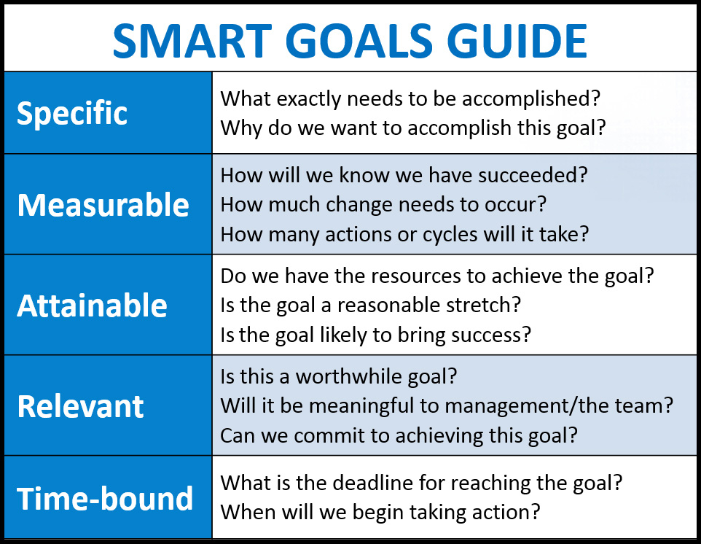

Slide 17
Performance Evaluation Meeting
  Schedule the meeting well in advance.
  Be prepared.
  Choose a quiet place for meeting and limit interruptions.
  Watch your body language.
  Do not delay the meeting – timeliness shows importance of feedback and that performance is important.
  Don’t waste time in the meeting – keep on topic.
  Allow for two-way communication. Listen.
  Focus on the job responsibilities. Should not be a time for discipline.
  Discuss goals and future development. Encourage success and address ways to improve performance and success.
  Inform employee that they may document their comments or disagreement regarding the evaluation.
Notes:
To ensure

Slide 18

Performance Concerns?
Ignoring the performance concerns will NOT make them change (i.e., in a few more weeks, things will improve)
Supervisors MUST feel that honest evaluations are allowed, expected, and encouraged – don’t give a stellar evaluation for an average or below-average performer.
Performance deficiencies impact all staff, not just the employee demonstrating poor performance.
Employees need to be held accountable for their actions.

Slide 19
Performance Concerns?
Communication is a critical key to employee success!
Questions? Call Human Resources if you have any questions or concerns (x2390)

Slide 20
Additional Training Opportunities
Supervisor Training Sessions
  Tuesday, January 17, from 9:00 – 10:00am in the University Union, 1965 Room. For Teams link click here
Employee Training / Open Lab Sessions
  Wednesday, January 25, from 10:00 – 11:00am in GAC Lab A (1129A) For Teams link click here
  Thursday, February 2, from 11:00 – 12:00pm in GAC Lab A (1129A) For Teams link click here
  Wednesday, February 15, from 2:30 – 3:30pm in GAC Lab A (1129A) For Teams link click here

Slide 21

Questions

