Slide 1
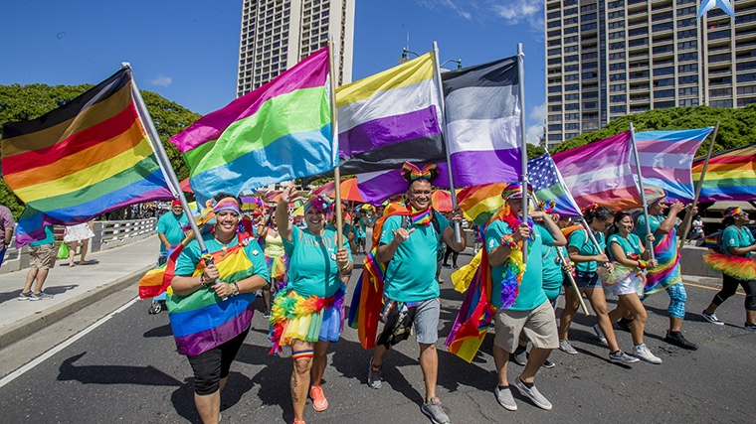
What in the Pride Flag does this mean?
History and Meaning of Pride Flags

Slide 2
First Pride Flag - 1978
Gilbert Baker created the gay pride flag in 1978
Originally had eight stripes:
Hot pink to represent sexuality
Red for healing
Yellow for sun
Green for serenity with nature
Turquoise for art
Indigo for harmony
Violet for spirit

Slide 3
Pride Flag 2.0 - 1979
The flag has been reduced to six colors:
Because of production issues, the pink and turquoise stripes were removed
Indigo was replaced by basic blue, which resulted in the contemporary six-striped flag

Slide 4
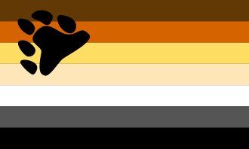
Bear Pride Flag - 1995
Created by Craig Byrnes
The gay bear culture celebrates secondary sex characteristics such as growth of body hair and facial hair, which is typically considered a "bear" trait.
The colors represent the fur colors and nationalities of bears throughout the world and the flag was designed with inclusivity in mind.

Slide 5
Bisexual Pride Flag - 1998
Created by Michael Page
The pink is intended to represent attraction to the same sex only
The royal blue to the opposite sex only
The purple attraction to all genders / more than one.

Slide 6
Labrys Lesbian Flag - 1999
Created by Sean Campbell
The flag is a symbol for the lesbian feminist community.
The labrys was adopted in the 1970s by lesbian feminists as a symbol representing strength, empowerment, and female divinity
The color violet became associated with lesbians through the representation of the violet flower as a symbol of lesbian love, which originates from a poem by Sappho
The inverted black triangle originated in Nazi Germany. Similar to the pink triangle design, the black triangle was used in concentration camps to designate prisoners with “anti-social” behavior, which included lesbians.
Some lesbians reclaimed this symbol as gay men reclaimed the pink triangle

Slide 7
Trans Pride Flag - 1999
Created by Monica Helms, an openly transgender American woman
The light blue and pink are the traditional colors for baby girls and baby boys
The white represents intersex, transitioning, or a neutral or undefined gender.
The flag is symmetrical so “no matter which way you fly it, it is always correct, signifying us finding correctness in our lives.”

Slide 8
Lipstick Lesbian Flag - 2010
Created by Natalie McCray
The term "lipstick lesbian" has been met with controversy. Some authors have commented that the term lipstick lesbian is commonly used broadly to refer to feminine bisexual women or to heterosexual women who temporarily show romantic or sexual interest in other women to impress men

Slide 9
Lesbian Pride Flag - 2010
Created by Emily Gwen
“A Lesbian Flag for Everyone”
This flag retained the seven stripes from the lipstick flag, but changed the top set to orange shades.
Dark Orange - Represent gender non-conformity
Orange - independence
Light Orange - community
White - unique relationships to womanhood
Pink - serenity and peace
Dusty Pink - love and sex
Dark Rose - femininity

Slide 10
Pansexual Pride Flag - 2010
Created by unknown
According to most definitions,
The pink represents attraction to people who are female identified
The blue represents attraction to people who are male identified
The yellow represents nonbinary attraction

Slide 11
Asexual Pride Flag - 2010
Created by The flag was created by Asexual Visibility and Education Network
The black stripe represents asexuality
The grey stripe represents the grey-area between sexual and asexual
The white stripe represents sexuality
The purple stripe represents community.

Slide 12
Genderqueer Pride Flag - 2011
This flag was designed by Marilyn Roxie, a genderqueer writer and advocate
The lavender stripe is a mix of blue and pink—colors traditionally associated with men and women—and represents androgyny as well as queer identities.
The white stripe, like in the transgender pride flag, represent agender or gender-neutral identities.
The chartreuse stripe is the inverse of lavender and represents third gender identities and identities outside the gender binary.

Slide 13
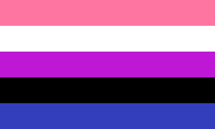
Genderfluid Pride Flag - 2012
JJ Poole created this flag
Pink for femininity
Blue for masculinity
Purple for both masculinity and femininity
Black for the lack of gender
White for all genders.

Slide 14
Intersex Pride Flag - 2013
Created by Morgan Carpenter.
The color yellow has long been regarded as an intersex color, neither blue nor pink. Purple, too, has been used for the same purpose.
“The circle is unbroken and unornamented, symbolizing wholeness and completeness, and our potentialities. We are still fighting for bodily autonomy and genital integrity, and this symbolizes the right to be who and how we want to be.”

Slide 15
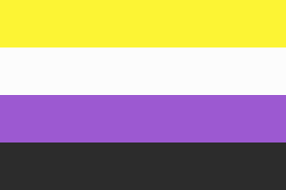
Nonbinary Pride Flag - 2014
Kye Rowan created the nonbinary pride flag
It is intended to represent nonbinary people who did not feel that the genderqueer flag represents them
The yellow stripe represents people whose gender exists outside of the binary
The white stripe represents people with many or all genders
The purple stripe represents people with genders considered a mix of male and female
The black strip represents people who identify as not having a gender.

Slide 16
Agender Pride Flag - 2014
Created by Salem X
The black and white stripes represent an absence of gender
The gray stripes represent semi-genderlessness
The central green stripe represents nonbinary genders.

Slide 17
Aromatic Pride Flag - 2014
This flag was designed by Cameron Whimsy
Dark Green: Represents aromanticism.
Light Green: Represents the aromantic spectrum.
White: Represents platonic and aesthetic attraction, as well as queer/quasi platonic relationships.
Grey: Represents grey-aromantic and demiromantic people.
Black: Represents the sexuality spectrum.

Slide 18
Pride Flag 3.0 - 2018
This is a rebooted pride flag by Daniel Quasar.
Representation matters — especially for the most marginalized communities.
The reboot is meant to be inclusive of queer people of color and trans people.

Slide 19
Why a Flag?
Baker, creater of the first Gay Pride Flag, later revealed that he was urged by Harvey Milk, one of the first openly gay elected officials in the U.S., to create a symbol of pride for the gay community.
Baker decided to make that symbol a flag because he saw flags as the most powerful symbol of pride.
“Our job as gay people was to come out, to be visible, to live in the truth, as I say, to get out of the lie. A flag really fit that mission, because that’s a way of proclaiming your visibility or saying, ‘This is who I am!’”

Slide 20
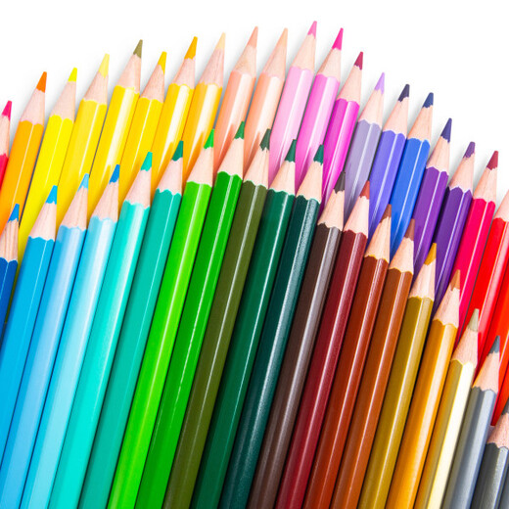
Design your own Flag!
Apologies if you didn’t see a flag that you know should be here!
Please let us know what we should add!
Pull out a piece of paper and some coloring tools and design a flag.
Use colors that represent your gender identity, sexuality, values, and anything else!
No paper? No problem!
Try out this website to make a virtual flag
https://tennessine.co.uk/flags/

Slide 21
Example Flag
Incorporated colors of the Bisexual, Asexual, and Pansexual Pride Flags
Blue to represent attraction to males
Pink to represent attraction to females
Yellow to represent attraction to nonbinary
Black to represent sexuality spectrum
Green to represent serenity with nature
Purple stripe to represent community.
Moon phases to show that sexuality is fluid
Wave to reinforce fluidity

