Slide 1
Dealing with
Disruption

Slide 2
OBJECTIVES
Communication barriers
What can we do to identify disruptive behaviors
What to do – what not to do
Campus response to disruption
When to call and who to call
What to do in an active situation
Time for questions
Notes:
Psychological crisis exists when an individual is out of touch with reality.
Uncontrollable behavior and/or hallucinations could be manifested.
Provide the following information:
Your name
Precise location (building, floor, floor room number)
Observed behavior
Individual's name, if known
Until help arrives, be pleasant, considerate and understanding to avoid aggravating the situation.
Do not argue with the individual.
Try to determine and accept the individual's point of view. Do not confront/detain the individual if violent/combative.
Have someone meet Public Safety at the entrance to the building and provide up-to-date information.
NOTE: Contact the University Counseling Services for further information.

Slide 3
FERPA…a barrier?
You CAN share concerns about observed behavior to those who need to know.
    Department Chairs
    Academic Deans
    Public Safety
    Dean of Students Office
    Individuals who may be at risk
    www.uwgb.edu/FERPA

Slide 4
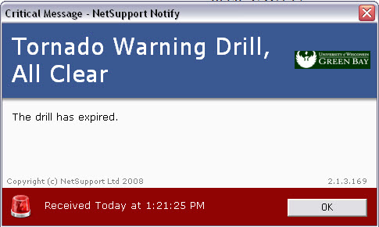
Clery Reporting Requirements
Crime Log
Crime Statistics
Emergency Notifications w/ Confirmation
  GB Alert
  NetNotify
  PA system
Timely Warnings (Collaborative Decision)
  Nature of Crime
  Continuing Danger
  Risk of Compromising Law Enforcement Efforts

Slide 5
Nobody Just Snaps!
We should be aware and alert, but not alarmed
“I have studied thousands of shootings that have taken place in the United States. Please remember that nobody snaps – that this is a process and if you know what to look for, you can see it coming. The good news about that is if you see it coming, you can stop it.”
Susan Riseling
Former UW-Madison Police Chief
Sept. 17, 2013 in response to Sept. 16, 2013 navy yard shooting in Washington D.C.

Slide 6
Student review team
Team Approach to behaviors of concern
Our Job: Assess & Respond
  Public Safety
  Dean of Students
  Counseling Services
  Residence Life
  Associate Dean of L & S
  Disabilities Services
  Athletics
  Others as needed

Slide 7
Student Review Team
Give us your puzzle pieces
How to Contact
  Dean of Students Office (x2152)
  Public Safety (x2300)
Follow-up Response
  Bi-weekly meetings
  Emergency meetings as needed
  Additional resources brought in as needed.
  Continuous and collaborative response
Notes:
Bi-weekly meetings
Emergency meetings as needed

Slide 8
See something, say something
“Creating a culture of shared responsibility for a safe campus must be a top priority. An engaged community, armed with a shared mindset, access to information and effective mechanisms to respond to threats before violence occurs is a formidable force and one that will have an immediate impact on improving the overall safety of our colleges and universities”
Governor’s Task Force on Campus Safety 2007

Slide 9
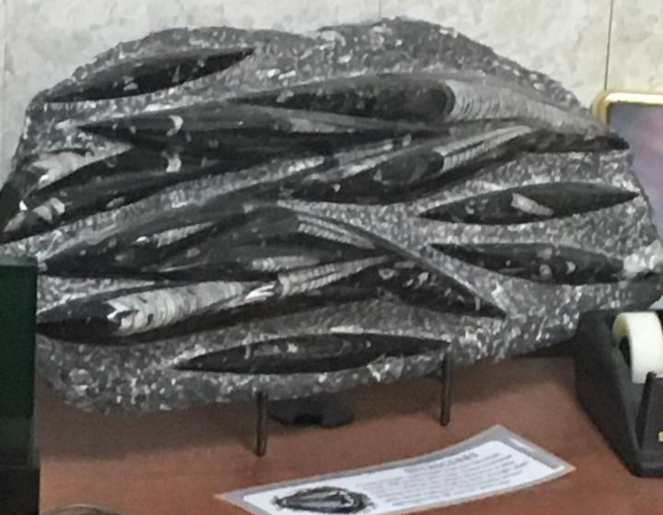
Before Something Happens
Be aware of behaviors of concern
Early intervention is essential
Report the behaviors to the right people (Dean of Students, Human Resources, Public Safety, etc)
  SRT may be consulted for students only.
Know your surroundings, preplan for an emergency
Don’t assume disruptive behaviors will stop on there own
Always be prepared to call 911or 9-911
Notes:
Psychological crisis exists when an individual is out of touch with reality.
Uncontrollable behavior and/or hallucinations could be manifested.
Provide the following information:
Your name
Precise location (building, floor, floor room number)
Observed behavior
Individual's name, if known
Until help arrives, be pleasant, considerate and understanding to avoid aggravating the situation.
Do not argue with the individual.
Try to determine and accept the individual's point of view. Do not confront/detain the individual if violent/combative.
Have someone meet Public Safety at the entrance to the building and provide up-to-date information.
NOTE: Contact the University Counseling Services for further information.

Slide 10
Office Safety
Pre-plan an escape route and play “what if…”.
Avoid any physical contact, finger-pointing or long periods of fixed eye contact. Do not touch the person.
Position a barrier between you and the person. If no barrier is present, just slowly back away to add distance.
Avoid invading the individual’s personal space. 3’ to 6’ between you
Notes:
Still working to get room numbers
Reinforce room number importance
Brown County cell proximity:
In regards to calling 911 using a cell phone.
It is possible to get to about 300 ft of someone’s location, but this is dependent upon conditions.
First the person would need to be outside and not in a building.
Then depending on weather conditions, buildings around the person, trees around the person they may get to within 300 feet.
If in a building this will not work and they may not even be able to tell what building the person is in.
Example: You’re in a house but you have 3 other houses within 300 – 500 feet, they will not be able to tell you what house.
Critical that you still provide the dispatcher with as much information as possible so they can get you the right help and get the help to you
Phone stickers w/ building name, address & room to write in room number
IF YOU DO NOT HAVE THEM WE RECOMMEND YOU GET THEM
Our office has the stickers available

Slide 11
Is disruptive Behavior a disability
All students must adhere to the student code of conduct and reasonable behavior standards
We do not need to tolerate or excuse disruptive, dangerous or violent behavior, even if connected to a disability
Such behavior cannot interfere with the educational opportunities of others
Setting/Enforcing standards may encourage needed therapy/prescribed medications
Notes:
Psychological crisis exists when an individual is out of touch with reality.
Uncontrollable behavior and/or hallucinations could be manifested.
Provide the following information:
Your name
Precise location (building, floor, floor room number)
Observed behavior
Individual's name, if known
Until help arrives, be pleasant, considerate and understanding to avoid aggravating the situation.
Do not argue with the individual.
Try to determine and accept the individual's point of view. Do not confront/detain the individual if violent/combative.
Have someone meet Public Safety at the entrance to the building and provide up-to-date information.
NOTE: Contact the University Counseling Services for further information.

Slide 12
Behaviors of concern
Loss of control
Threats/Acts of violence
Fixation on violence
Perceived injustice, hostility, blaming
Substance abuse
Isolating behavior
Strained relationships
Chronic depression/mood swings
Low self-esteem
Reduced motivation
Changes in health, hygiene, or behavior
Notes:
Psychological crisis exists when an individual is out of touch with reality.
Uncontrollable behavior and/or hallucinations could be manifested.
Provide the following information:
Your name
Precise location (building, floor, floor room number)
Observed behavior
Individual's name, if known
Until help arrives, be pleasant, considerate and understanding to avoid aggravating the situation.
Do not argue with the individual.
Try to determine and accept the individual's point of view. Do not confront/detain the individual if violent/combative.
Have someone meet Public Safety at the entrance to the building and provide up-to-date information.
NOTE: Contact the University Counseling Services for further information.

Slide 13
What You Might Do
You are not expected to provide therapy or counseling
However, you are often in a good position to help individuals start to deal with concerns by:
  Expressing clearly your willingness to help
  Providing the essential first supportive contact
  Taking time to listen
  Assisting the individual in locating resources
  Contacting appropriate resources to make them aware of your concern.

Slide 14
Talking with a Disruptive Person or Someone in Crisis
Identify boundaries
  Respectful conversation
  Appropriate time and place
  Time restraints
Assess Threat
  Refusal to leave area
  Body language
  Tone/Volume
  Content of speech
  Statements made

Slide 15
Talking with a Disruptive Person or Someone in Crisis
Do
Do NOT
Project calmness; move and speak slowly, quietly and confidently.
Be an empathetic listener
Use “I” language, such as: “I see.”, “How can I help.”
Have another employee present
Set clear boundaries, physical barriers
Challenge or interrupt the person while they are talking
Use threatening or derogatory words, such as: “You are wrong” “You shouldn’t feel that way”
Make false statements or promises you cannot keep
  Unless you need to do so to keep yourself safe

Slide 16
Planning Ahead
If you anticipate an issue may develop
Make a Safety Plan
  Consult with Public Safety or DOS
  Talk with co-workers in area
  Agree on code word
  When in doubt, call Public Safety and let them evaluate the situation
Notes:
Psychological crisis exists when an individual is out of touch with reality.
Uncontrollable behavior and/or hallucinations could be manifested.
Provide the following information:
Your name
Precise location (building, floor, floor room number)
Observed behavior
Individual's name, if known
Until help arrives, be pleasant, considerate and understanding to avoid aggravating the situation.
Do not argue with the individual.
Try to determine and accept the individual's point of view. Do not confront/detain the individual if violent/combative.
Have someone meet Public Safety at the entrance to the building and provide up-to-date information.
NOTE: Contact the University Counseling Services for further information.

Slide 17

Calling 911
  New phone system does not require 9-911
  Your exact location does not appear and you must provide it
  Contact Public Safety for phone sticker
  Stay on line with dispatcher if safe
  Describe situation and individual
Notes:
Still working to get room numbers
Reinforce room number importance
Brown County cell proximity:
In regards to calling 911 using a cell phone.
It is possible to get to about 300 ft of someone’s location, but this is dependent upon conditions.
First the person would need to be outside and not in a building.
Then depending on weather conditions, buildings around the person, trees around the person they may get to within 300 feet.
If in a building this will not work and they may not even be able to tell what building the person is in.
Example: You’re in a house but you have 3 other houses within 300 – 500 feet, they will not be able to tell you what house.
Critical that you still provide the dispatcher with as much information as possible so they can get you the right help and get the help to you
Phone stickers w/ building name, address & room to write in room number
IF YOU DO NOT HAVE THEM WE RECOMMEND YOU GET THEM
Our office has the stickers available

Slide 18
When to Call Public Safety?
IF IT GOES BEYOND WHAT YOU CAN HANDLE OR IF THE PERSON BECOMES THREATENING OR VIOLENT CALL 9-1-1
If the agitated person is standing next to the phone or will not let you get to the phone, call out to a co-worker
Have supervisor or co-worker come out to assist you
If the suspect leaves, be prepared to give a complete description
Awareness of Surroundings – If you see someone dealing with a disruptive person, make contact with that co-worker or call Public Safety
Notes:
Use the CAMPUS EMERGENCY ACTION PROCEDURES as a guideline
WEBSITE:
Safety tips and plans
Crime prevention tips
Policies on Violence and threats

Slide 19
Active Shooter Situations
  Actively engaged in killing or attempting to kill – Situations are unpredictable and evolve quickly
  Law enforcement action is required to stop the killing and mitigate harm to victims
  We must be prepared both mentally and physically to deal with an active situation

Slide 20
Strategies for Survival of a Violent Incident
Strategies you can use anywhere
5 Out’s
ALICE
Run – Hide – Fight
Get Off the X

Slide 21
Police Response
Law enforcement’s purpose is to stop the active shooter-will proceed directly to the area in which the last shots were heard -Will not stop to help injured
  Officers - patrol uniforms or external bulletproof vests, Kevlar helmets, tactical equipment
  Officers armed with rifles, shotguns, handguns
  Officers may shout commands, and may push individuals to the ground for their safety

Slide 22
Police Response
What Should I do????
Remain calm, and follow officers’ instructions
Put down any items in your hands
Immediately raise hands and spread fingers
Keep hands visible at all times
Avoid quick movements toward officers – don’t grab them
Avoid pointing, screaming and/or yelling
Don’t stop officers for help or direction when evacuating- proceed in the direction from which officers are entering
Once you have reached a safe location/assembly point. Do not leave until law enforcement authorities have instructed you to do so -need to ID witnesses/Suspects

Slide 23
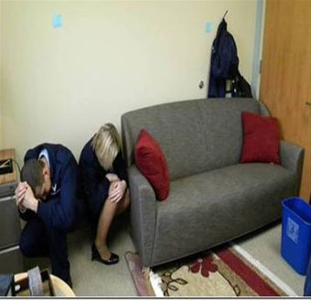

The 5 Outs
Hide Out – Keep Out
Notes:
If you’re not able to get out, find a safe place to hide.
If there’s no way to get out or hide, playing dead could save your life.
If you are hiding when the police come, realize that they will not know if you’re a victim or a shooter.
A shooter might pose as a hiding victim
Follow their instructions!

Slide 24

Call Out
Dial 911!
Notes:
If possible, take care of your safety first.
Run first, hide first, barricade or lock the door first, then call 911.
If it’s safe, stay on the line and give the police the best information you can.

Slide 25
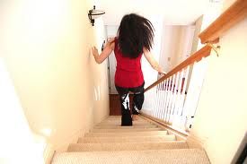
Get Out
Run!
Notes:
Your best option is ALWAYS to run, get out, get away.
Think in advance about how you’d get out, including the possibility of jumping from the windows.
Know your area and how to get out.

Slide 26
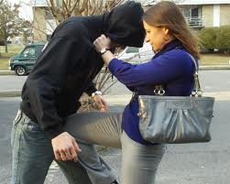
Take Out
If there’s no way out,
FIGHT!
Notes:
Fight or Flight?
Flight, running, getting out, is always your best option.
But if flight is removed as an option, your only choice may be to fight.
If you MUST “Take Out”, remember you are fighting for your life
Why did students at Virginia Tech and others not try to “Take Out”
Theory – 18-23 year olds were 9 – 14 in 1999 when Columbine occurred.
Grew up w/school shootings
Teacher locks door, turns off lights, call 911, hide, you dive under desk
Did what they were taught

Slide 27

RUN> HIDE> FIGHT

Slide 28
Bottom line…
You are not trained to assess threats and are not expected to do so.
When in doubt about a behavior or concern, ask for advice or help.
  Contact Public Safety, Dean of Students, Supervisor
If violence or threats are involved, call the police!
If You See Something, You Must Say Something
Plan ahead
Get off the X

Slide 29
Recent Efforts
Phoenix Cares Website
  New Incident Report Forms
Stop The Hate Training
Cameras
PA System
License Plate Recognition
Electronic Doors
Emergency Operations Center
Public Safety Staffing

Slide 30

Additional information available
  www.uwgb.edu/phoenix-cares
  www.uwgb.edu/publicsafety
  www.uwgb.edu/dean-of-students
  www.uwgb.edu/counseling-health/
Notes:
Use the CAMPUS EMERGENCY ACTION PROCEDURES as a guideline
WEBSITE:
Safety tips and plans
Crime prevention tips
Policies on Violence and threats

Slide 31
QUESTIONS?

