Slide 1
Hazardous Materials Transport Awareness Training
for
UW – Green Bay Airline Passengers
February 15, 2012

Slide 2
Hazardous Materials Transport Awareness Training
Purpose of training:
To provide UW – Green Bay airline passengers with a general awareness of the requirements of air transport of hazardous materials

Slide 3
Hazardous Materials Transport Awareness Training
What are hazardous materials?
Overview of hazardous materials transportation legislation and regulations
How to identify hazardous materials
The requirements for hazardous materials transport
How to determine if a material is allowable for passenger transport
Notes:
Training objectives:
What are hazardous materials?
Overview of hazardous materials transportation legislation and regulations
How to identify hazardous materials
The requirements for hazardous materials transport
How to determine if a material is allowable for passenger transport

Slide 4
What are hazardous materials?
Title 49 of the Code of Federal Regulations (CFR), Part 171, Section 8
49 CFR 171.8
The definition of HAZARDOUS MATERIALS includes those materials designated by the Secretary of the Department of Transportation (DOT) as posing an unreasonable threat to the public and the environment. The term "Hazardous Materials" includes all of the following: (1) Materials identified in 49 CFR 172.101, (2) Materials meeting the definitions contained in 49 CFR Part 173, (3) Hazardous Wastes, (4) Marine Pollutants, (5) Elevated Temperature Material (6) Hazardous Substances.
Notes:
What are hazardous materials?
Many agencies regulate hazardous materials depending upon status of material:
In workplace: OSHA
As waste: EPA
In transportation: DOT
For public employees Dept of Safety & Professional Services has adopted and enforces OSHA
U.S.DOT definition of hazardous material
Background:
U.N. Model Regulations

Slide 5
Examples of hazardous materials
Household goods:
Oven cleaner
Paint
Turpentine
Alcoholic beverages
Lighter fluid
Nail polish remover
Shoe polish
Weed killer
Batteries

Slide 6
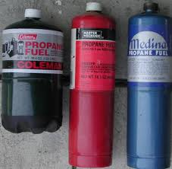
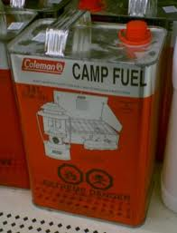
Examples of hazardous materials
Sporting equipment:
Camp stove fuel (kerosene, propane, etc.)
Ammunition
Scuba diving tanks
Lighter fluid
Insecticides (most mosquito repellants, DEET)
Self-inflating life rafts
Charcoal briquettes

Slide 7
Examples of hazardous materials
Scientific/teaching equipment:
Most laboratory chemicals
Dry ice
Biological samples
Acids

Slide 8
The Hazardous Materials Transportation Act of 1974
The HMTA created regulations to govern:
Packaging of hazardous materials
Marking of hazardous materials containers
Labeling of hazardous materials containers
Transportation of hazardous materials in commerce
Placarding of transport vehicles
Several additional issues

Slide 9
Regulations for the Transport of Hazardous Material...
Written by the U.S. Department of Transportation (DOT)
Found in Title 49 of the Code of Federal Regulations (CFR)
For air transport, also see:
International Civil Aviation Organization (ICAO) Technical Instructions
International Air Transport Association (IATA) Dangerous Goods Regulations

Slide 10
Hazardous Materials Regulations
Subchapter C (49 CFR Parts 171 – 179)
Part 175: Carriage by Aircraft
175.10: Exceptions for passengers, crewmembers, and air operators

Slide 11
How to identify hazardous materials
Hazardous materials identification systems: Labels
Consumer Product Safety Commission (CPSC) labels
National Fire Protection Association (NFPA) 704 rating system
Hazardous Materials Identification System (HMIS)
DOT Hazard Classifications System
UN #
There are others…..
Notes:
How to identify hazardous materials?
Methods to identify a hazardous material:
By a label
By looking it up in a table (or MSDS)
Some common labeling systems
NFPA 704 rating system
HMIS
DOT classification system
UN number

Slide 12
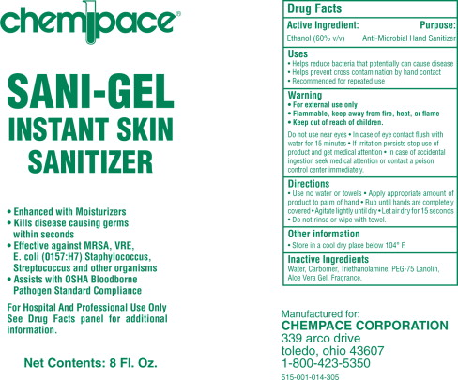
How to identify hazardous materials
Hazardous materials identification systems: Labels
CPSC signal words:
Danger
Warning
Caution
Poison
Notes:
Another way to identify potentially hazardous materials:
CPSC signal words
Danger
Warning
Caution
Mr. Yuck or skull & crossbones

Slide 13
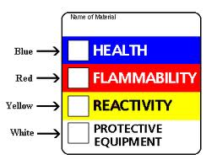
How to identify hazardous materials Two of the most common hazardous materials labeling systems:
NFPA 704 rating system
HMIS®
Notes:
Two common labeling systems:
NFPA
Developed by National Fire Protection Association
Numerical and color rating system
Diamond shaped
Designed to provide rapid & clear information to emergency responders and fire fighters
HMIS (Hazardous Materials Identification System)
Developed by National Paint & Coatings Association
Numerical and color rating system
Horizontal bar shaped
Designed to convey health and hazard warning information to employees

Slide 14
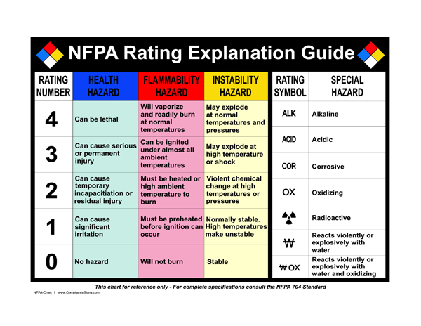
Notes:
Explanation of NFPA rating system:
Blue: health
Red: flammability
Yellow: reactivity
Numbers range
0: least severe hazard
4: most severe hazard
Very similar to HMIS

Slide 15
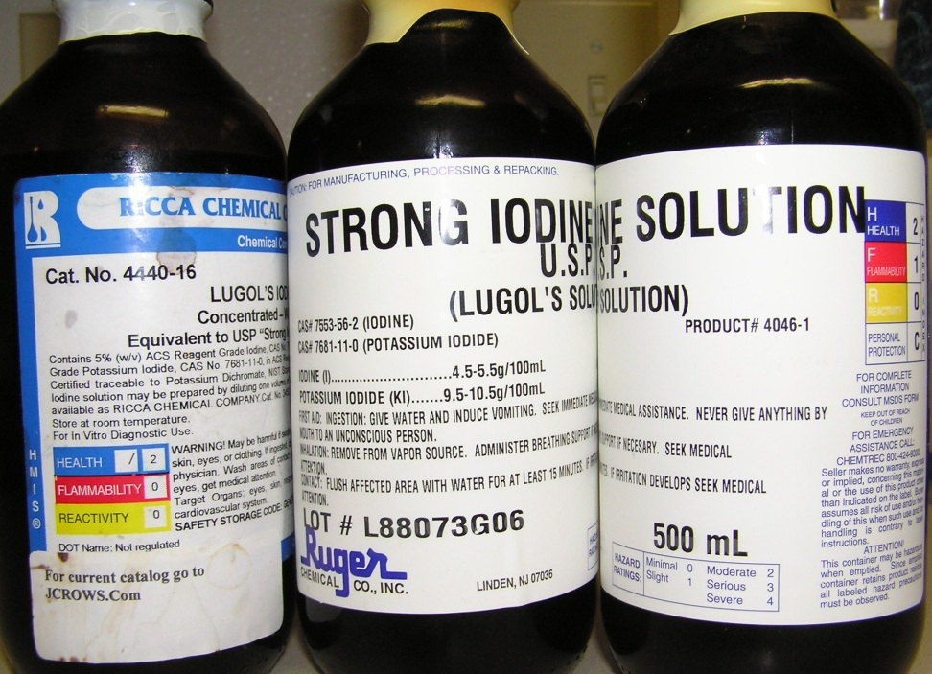
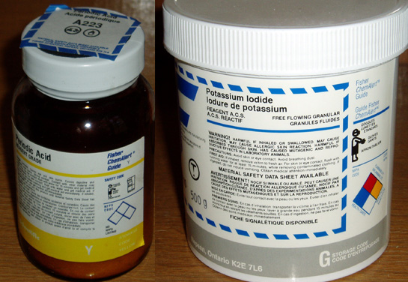
How to identify hazardous Materials
Examples of NFPA and HMIS® labels
Notes:
Examples

Slide 16
Is it a hazardous material?
HMIS or NFPA labels indicate it may be hazardous
Notes:
Example

Slide 17
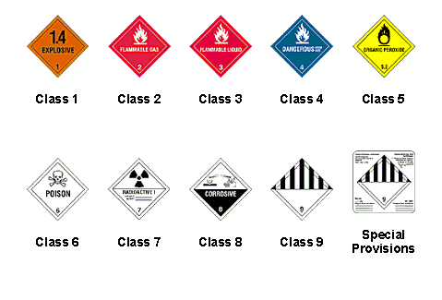
DOT Hazard Classification System
Notes:
Another way to tell if the material you’re dealing with is a hazardous material:
The U.S. DOT hazard classification system is used for hazardous materials in transport
Based on the United Nations (U.N.) marking system
Hazardous materials are broken down into nine hazard classes:
system is in HMR: 49 CFR 173.2
Hazard class 1: explosives
Hazard class 2: compressed gases
Hazard class 3: flammable liquids
Hazard class 4: flammable solids
Hazard class 5: oxidizers and organic peroxides
Hazard class 6: toxic materials
Hazard class 7: radioactive material
Hazard class 8: corrosive material
Hazard class 9: miscellaneous

Slide 18
DOT Hazard Classification System
Notes:
Example
This not DOT sanctioned size, but it is still a way to ID a haz mat
Adopted a well recognized label

Slide 19
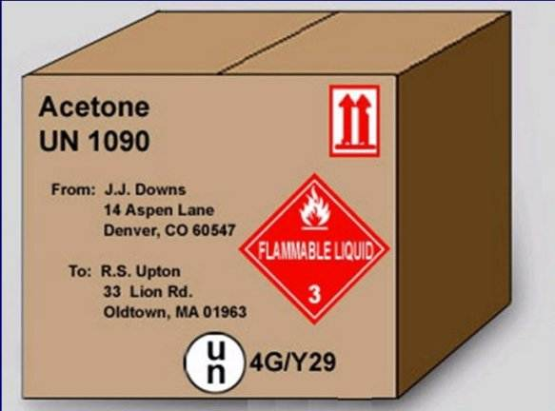
Package labels & Markings
UN numbers:
Notes:
Another package label or marking that indicates a hazardous material: UN number
Four digit number
Assigned by the United Nations Committee of Experts on the Transport of Dangerous Goods
Represents a particular chemical or group of chemicals
E.g. UN1170 represents Ethanol
Range from UN0001 to about UN 3500

Slide 20
Is this a DOT Hazardous Material?
Yes, if it has a “UN” number, which refers to the DOT Hazardous Materials Table
Notes:
Example

Slide 21
Recognizing Packages of Hazardous Material...
Look for a HazMat label
HazMat labels
Notes:
Example

Slide 22
Is it a hazardous material?
If any material has any kind of “hazard” label, it is an indication that it might be a hazardous material
CPSC: caution, warning, danger
NFPA 704 label
HMIS
DOT hazard classification number
UN number
There are others…..?

Slide 23
Hazardous Materials Table 49 CFR 172.101
Identifies and classifies hazardous materials
Notes:
Hazardous Materials Table
Found in 49 CFR 172.101 is part of the Hazardous Materials Regulation
Contains more than 3000 entries the DOT has designated as hazardous materials
So if the material you are dealing with is found in this table, it is a hazardous material according to the DOT and has very stringent requirements for transport.
Governs the transportation of hazardous materials by all modes: air, water, rail and highway
For each material listed, the table:
Identifies the hazard class for each shipping description or specifies that it is forbidden in transportation.
Gives the proper shipping name or directs the user to the preferred proper shipping name.
Specifies or references requirements in the HMR pertaining to labeling, packaging, quantity limits aboard aircraft and stowage of hazardous materials aboard vessels
The information in the Hazardous Materials Table applies to:
Anyone who offers hazardous material for transportation;
Anyone who performs a packaging, labeling, or marking function required by the HMR; or
Carriers who transport hazardous material by any mode
The Table is used when preparing materials for transportation, selecting packaging, preparing shipping papers, and determining appropriate modes for transportation. It can also be used - in the course of transportation - to check the requirements for a specific hazardous material.

Slide 24
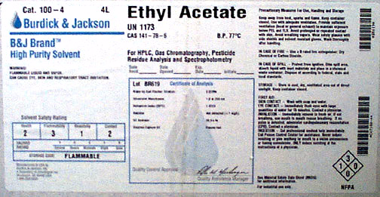
Is this a DOT Hazardous Material?
Yes, if it is listed in the DOT Hazardous Materials Table
Notes:
Example

Slide 25
Hazardous Materials Table
Columns 1 – 5 contain the information needed to identify and classify the material on the shipping paper
Notes:
Columns contain the information needed to identify and classify the material :
Column 1: Symbols
Column 2: Proper shipping name
Column 3: Hazard class
Column 4: Identification number, often the UN number
Column 5: Packing class

Slide 26
Hazardous Materials Table 49 CFR 172.101
Columns 6 – 10 of the Hazardous Materials Table contain information necessary for the proper packaging, labeling, marking, placarding and mode-specific requirements. The modes of transportation are air, water, rail and highway.
Notes:
Columns contain the information needed to identify and classify the material :
Column 6: Label codes
Column 7: Special provisions
Column 8: Packaging
Column 9: Quantity limitations
Column 10: Vessel stowage

Slide 27
Hazardous Materials Table
Column (9) – Quantity limitations
Columns 9A and 9B specify the maximum quantities that may be offered for transportation in one package by passenger-carrying aircraft or passenger-carrying rail car (Column 9A) or by cargo aircraft only (Column 9B).
If the material is not allowed on that mode of transportation, the word ‘forbidden’ is entered in that column
Notes:
Column 9:
Specifies maximum quantities that can be offered in one package by:
Passenger-carrying aircraft
Passenger-carrying rail
Cargo aircraft only
If the material is not allowed on that mode: forbidden is entered in column

Slide 28
Airlines and Flammable Gases
The Department of Transportation Hazardous Materials Regulations forbid the carriage of butane or other flammable gas products on passenger aircraft. Do not pack any flammable gas torches in checked or carry-on baggage. Torches come in many shapes and sizes, but all may be dangerous. Even if you think your torch is empty, it may still contain flammable gas vapors that could ignite.
Notes:
Example: see column 9

Slide 29
Regulations for Commercial Transportation
Hazardous materials sent using commercial transportation must comply with Hazardous Materials Regulations, 49 CFR Parts 171-179. These regulations apply to those who offer, accept, or carry hazardous materials to, from, within, and across the United States.
The HMR include training requirements in several sections of Title 49 CFR
171.2: No person may offer or accept a hazardous material for transportation in commerce unless it is properly classed, described, packaged, marked, labeled, etc.
Notes:
Any person who performs any transport-related function with hazardous materials needs to be trained in:
General awareness
Provide familiarity with requirements of HMR
Enable employee to recognize and ID hazardous materials
Function-specific training
Concerning requirements of HMR which are specific to functions that employee performs
Safety training
Security training
HMR (49 CFR 171.2) requires proper classification, description, packaging, marking, labeling etc.
Summary: If you want to ship a haz material, you will either have to be trained or have somebody who is trained ship it for you

Slide 30
Requirements for preparing and transporting Hazardous Materials…
In order to prepare or package a hazardous material for shipment, the HMR requires that you receive specific training in:
Approved packaging materials & procedures
Labeling packages
Marking packages
Preparing shipping papers
Emergency and safety procedures
Notes:
Almost any function you perform that might have an affect on the transportation of hazardous materials requires you to have hazmat employee certification. The terms ``hazmat employee'' and ``hazmat employer'' are defined in detail in 49 CFR 171.8. Stated briefly, a hazmat employee is anyone who directly affects hazardous materials transportation safety, and a hazmat employer is anyone who uses employees in connection with transporting hazardous materials in commerce, causing hazardous materials to be transported, or manufacturing or offering packagings as authorized for use in transportation of hazardous materials.
Anyone who prepares or packages a material for shipment must have specific training in:
Approved packaging materials & procedures
Labeling packages
Marking packages
Preparing shipping papers
Emergency & safety procedures

Slide 31
Requirements for preparing & transporting hazardous materials
Classification & packaging
Classify
Package
Mark
Label
Placard
Description on shipping papers
Notes:
Requirements for preparing & transporting hazardous materials
The Hazardous Materials Table (49 CFR Sec 172.101)
is primary guide to offerors, carriers, and enforcement personnel in determining compliance with the regulations
lists, by name, several thousand of the most commonly transported hazardous materials.
specifies (for each entry) the proper shipping name, hazard class or division, identification number, packing group, required hazard warning labels, packaging authorizations, per-package quantity limitations for passenger and cargo aircraft, and special provisions.
specifically designates some materials as ``forbidden'‘ - these may not be offered for transportation or transported in commerce. Some require special review and approval. Others are designated as ``forbidden'' from transportation by specific modes, such as air transportation.

Slide 32
Take home message…..
If you suspect that you might have something that is a hazardous material, you need to pay attention and seek further information before you travel with it…
But preparing a hazardous material for shipment is very different than bringing something along on a passenger aircraft

Slide 33
Passenger Travel
49 CFR 175.10 - Exceptions for passengers, crewmembers, and air operators.
In general, Federal regulations prohibit passengers and crewmembers from carrying hazardous materials aboard an aircraft. However, exceptions are made for some personal hazardous materials
Notes:
Passenger travel
Many everyday materials are classified as hazardous materials: pressurized gases, acetone (nail polish remover), oven cleaner, aerosol disinfectants, white gas
As a general rule, hazardous materials are not acceptable in checked or carry-on baggage.
Some items that are permitted if strict guidelines are followed
FAA has made exemptions for certain personal hazardous materials that do not pose an unreasonable risk to the passengers, crew or aircraft.

Slide 34
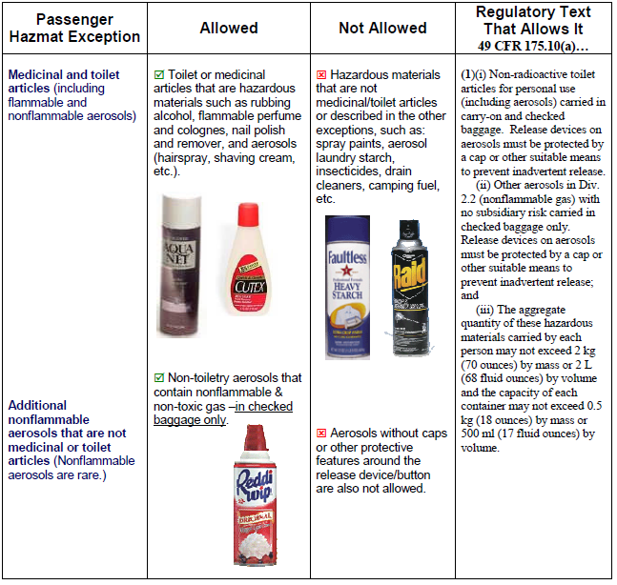
Passenger Travel
49 CFR 175.10(a)(1)(i) revised: “Non-radioactive medicinal and toilet articles for personal use…..”
Notes:
Since publication of this document in 2008, 49 CFR 175.10 has been revised. Current citation reads “Non-radioactive medicinal and toilet articles for personal use….”

Slide 35
Passenger Travel

Slide 36
Passenger Travel
Citation is now: 49 CFR 175.10(a)(18)
Notes:
49 CFR 175.10 revised since publication of this document in 2008: current citation is now 49 CFR 175.10(a)(18)

Slide 37
Passenger Travel

Slide 38
Passenger Travel

Slide 39
FAA ENFORCEMENT
When it comes to airplane regulation, safety truly is the first priority.
Civil penalties for passenger failure to comply with FAA hazardous materials regulations can be high, e.g. up to $27,500 per each violation.

Slide 40
FAA ENFORCEMENT
FAA considers whether conduct is intentional, reckless, careless, or systemic as well as the safety risks when determining the penalties.
Failing to declare prohibited hazardous contents in either carry-on or checked luggage is considered intentional conduct for FAA enforcement purposes.

Slide 41
Resources
http://www.faa.gov/about/office_org/headquarters_offices/ash/ash_programs/hazmat/passenger_info/

Slide 42
Resources
http://www.tsa.gov/travelers/airtravel/prohibited/permitted-prohibited-items.shtm

Slide 43
Resources
http://www.tsa.gov/travelers/index.shtm
http://www.faa.gov/about/office_org/headquarters_offices/ash/ash_programs/hazmat/passenger_info/
http://safetravel.dot.gov/
http://www.iata.org/whatwedo/cargo/dangerous_goods/pages/faq.aspx

Slide 44
Resources
If you have any questions…..contact us
Jill Fermanich
email: fermanij@uwgb.edu
Phone: 2273
Jennifer Sloan Lattis
email: jlattis@uwsa.edu
Phone: (608) 262-0747

