Slide 1
Workday:
Instructional Academic Staff (IAS)
PERFORMANCE REVIEWS

Slide 2
Performance Review Process

Slide 3
IAS Reviews in Workday
What’s Changing
What’s Staying the Same
New online modality for the IAS annual review in the Workday system
Timeline
Rating Scale (now consistent with non-instructional employees)
Employee self-evaluation process
Form does not auto-route to Dean in Workday
Unit process for engagement with the Executive Committee during IAS reviews
Unit process for any additional materials requested from the IAS member during the review process
Review criteria - still based upon the individual role of the IAS member
Unit chair as signatory authority for the review
Annual reviews in Workday will only be conducted for IAS in the teaching professor series (not Lecturers)

Slide 4
Annual Performance Review Timeline Overview
Annual Reviews opened in July (no requirement to start IAS process during the summer)
The process was launched for all institutions and all employee types at the same time
Expected completion in October each year
2024-2025 Academic Year Review
IAS employee and chair sections complete by October 31, 2025
Dean review and finalization in Workday by November 21, 2025
HR Talent Partners will have a report available to monitor progress and inform Deans/Dean Assistants of completion status.

Slide 5


High Level Overview: INSTRUCTIONAL ACADEMIC STAFF reviews
IAS Employee
Complete Self-Evaluation
Unit Chair
Complete evaluation with performance ratings
Upload Professional Activities Report (if applicable)
DO NOT Submit. Save for later
Unit Chair & IAS Employee
Final Acknowledgment
Unit Chair
With Dean’s approval, Clicks Submit to complete Review
DEAN REVIEW
PERFORMANCE EVALUATON
FINALIZE REVIEW & ACKNOWLEDGEMENT

Slide 6
DETAILED IAS Review Process & TIMELINE
Stakeholder | Step Name | 2025 Deadline | Process
IAS Employee | Self-Evaluation | 10/1/2025 | Comment on three areas Self-rate three areas (optional) Upload supporting documents (i.e. PAR) (optional)
Unit Chair | Manager Evaluation | 10/31/2025 | Comment on three areas Rate each of the three areas Upload supporting documents (optional) Provide overall rating Connect with Unit Executive Committee (as applicable) Meet with employee to discuss evaluation Stop – “save for later”, but do not submit
Dean | Review | 11/14/2025 | Dean reviews and consults with chair as needed Dean comments added by chair (if applicable)
Unit Chair and IAS Employee | Submit & Complete | 11/21/2025 | Chair connects back with employee if any changes are made to the evaluation after Dean Review Chair submits in Workday Employee acknowledges and provides optional comments Chair acknowledges and provides optional comments, after which the process is completed.

Slide 7
Evaluation Areas (IAS & Chair)
Describe/comment on teaching activities and effectiveness
Describe/comment on professional activities*
Describe/comment on service activities*
* If the role does not include professional or
service activities as a job responsibility,
write n/a and choose “not applicable” as
the rating

Slide 8
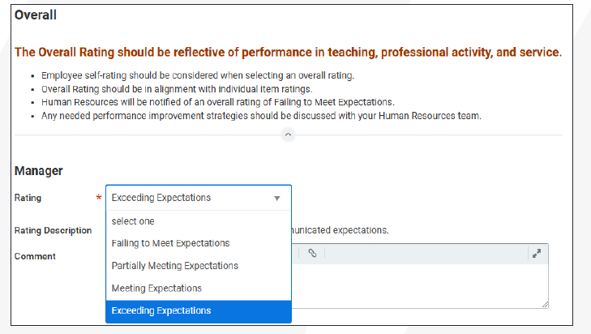
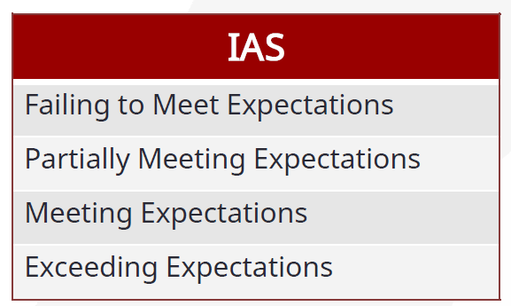
Rating Scale
* Rating scale is consistent with non-instructional Performance Evaluations
* If you would like support on writing performance reviews and assigning ratings,
please contact your HR Talent Partner

Slide 9
Rating Scale Definitions and Example
Example for Teaching Activities & Effectiveness*:
  Exceeds Expectations: Consistently delivers engaging, inclusive, and pedagogically sound instruction; innovates in teaching methods; renowned for excellent teaching, including receiving outstanding student feedback.
  Meets Expectations: Delivers clear and effective instruction; uses appropriate teaching methods; receives generally positive student feedback.
  Partially Meets Expectations: Instruction is occasionally unclear or lacks engagement; student feedback indicates areas for improvement.
  Does Not Meet Expectations: Instruction is frequently ineffective or unclear; student feedback is consistently negative.
Exceeds Expectations
Performance consistently exceeds the communicated expectations.
Meets Expectations
Performance consistently meets the communicated expectations.
Partially Meets Expectations
Performance does not consistently meet communicated expectations.
Failing to Meet Expectations
Performance is consistently below expectations and/or reasonable progress has not been made.
* This example is for instructional purposes only. Deans/Units may have rubrics for assessment unique to the individual college/unit.

Slide 10
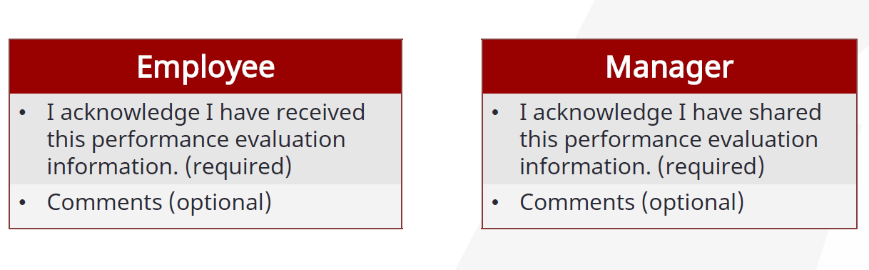
Acknowledgement Statement
Acknowledgement does not constitute agreement. If an employee disagrees with the evaluation, they
may provide comments which outline their reasons for disagreement. Those comments will then be
included as part of the performance evaluation document in the personnel file.

Slide 11


Unit Chairs – How to View IAS Performance Review Status in Workday
Log into Workday
Anything that is awaiting your action will be in your task list (top right folder icon )
If you would like to see a full snapshot of all reviews in your area:
  In the search bar, type “Team Performance” and select
  This will show a list of evaluations in your unit that have been launched and the applicable next step*:
    “Complete Self Evaluation for Performance Review” – Evaluation is with the employee for their self-evaluation
    “Complete Manager Evaluation for Performance Review” – Evaluation is with you (as manager) to do your part of the evaluation
    “Provide Employee Review Comments” – Evaluation is with the employee for acknowledgement
    “Provide Manager Review Comments” – Evaluation is with the manager for acknowledgement
* If you are also responsible for non-instructional reviews, you will see those reviews in your list, but the
“Next Step” vocabulary will be different.

Slide 12
Other Performance reviews for IAS Employees
First Semester Review:
  First semester reviews will still be conducted for new Instructional Academic Staff employees (those who start their position on 8/25/2025).
  The first semester review will do be done on a Word document, but will have the same structure as the Workday review.
  Form: Instructional Academic Staff Performance Review Form (Non-Workday)
Anytime Review:
  If performance concerns warrant a review be conducted outside of the annual process, you may be able to do an “anytime review”.
  This review would be done on the same form as the First Semester Review.
  Connect with your HR Talent Partner if you have need to perform an Anytime Review.

Slide 13

video demonstration
by Christine Ray from UW System

Slide 14
Best Practices for Performance Reviews

Slide 15
“performance assessments are a continuous process not a once-a-year event”
Source: a wise HR Professional who prefers to live in anonymity
Notes:
I know that we all know this, but let’s read it all together.

Slide 16

Why a performance review?
Source: https://www.pexels.com/photo/oval-brown-wooden-framed-hanging-mirror-1528975/
Notes:
The idea here is that Performance reviews ground and calibrate our self-perception which could only provide part of the story or could be misleading.
The mirror represents the standard or the expectations of the role.
Interestingly, we all have different views of how we perform in front of the “standard”
Some of us look at the reflection and believe we are the best…
Others may think they have many challenge areas…
If you invite your significant others to look at the same image, they may still give you a biased opinion
The idea is to calibrate your assessment so you can be as close to the reflection the mirror projects as possible.
Having a (well-calibrated) supervisor assessment will ensure that employee performance aligns with organizational objectives and accepted behaviors.

Slide 17

ENHANCING our assessments by eliminating biases
Notes:
Biases are errors in judgment that occur when supervisors allow their conscious or unconscious prejudices affect their assessment of an employee's performance. These biases can lead to unfair evaluations

Slide 18

Contrast
Rather than measuring performance against the standard, you measure the performance of an employee against the performance of another employee.
Source: https://www.pexels.com/photo/parents-measuring-their-child-s-height-7456803/

Slide 19
Halo
You rate an employee highly in all areas because of one thing they do really well

Slide 20
HORN
You rate an employee as a poor performer because of one thing they do not do well

Slide 21

Leniency
You rate everyone high ratings to avoid conflict

Slide 22
The negative impact of leniency
It Erodes Credibility & Trust in the Review Process
It dilutes the meaning of “exceeds expectations”
Employees perceive the process as arbitrary or political.
Reduces trust in the leader

Slide 23
The negative impact of leniency
It could damage Team Dynamics & Morale
Team members know who does not “exceeds expectations.” Lack of differentiation may cause resentment.
Top performers may disengage if they feel their extra effort is not recognized.

Slide 24

Severity
You rate everyone lower than their performance warrants to inspire average employees to improve their performance.

Slide 25

Recency
You rate performance for an employee based on the most recent behavior.

Slide 26
More tools to eliminate biases
Know the standard or target performance for each position
Document performance events throughout the year
Calibrate your assessment
  Know what each rating means
  Weigh feedback from peers/students fairly.
Practice continuous feedback during one-on-one sessions

Slide 27

Documenting
Performance journal
Student Feedback
Project & task tracking
One-on-one meeting notes
Email folders
Check-ins with employees’ peers and students
Notes:
A year is a long time to remember everything that your direct reports have accomplished. Relying on pure memory is obviously not feasible. These are some of the tools you may use to ensure all or most employee performance-related events are considered in your review.
Journal. Whether you keep in in OneNote, notes in MS Outlook, MS Word notes, etc. Saving thoughts or comments about employees is a great
Task tracking. In your workload meetings you may ask employees to report on status of various projects.
One-on-One meeting notes. These meetings provide a great opportunity to give feedback throughout the year. Notes on the feedback provided are beneficial for the annual review
Email folders. Save notes, emails, feedback from customers in a folder.
360 Feedback from Customers. Ensure that feedback is weighed fairly considering

Slide 28

The don'ts when writing feedback comments in performance reviews
Notes:
Biases are errors in judgment that occur when supervisors allow their conscious or unconscious prejudices affect their assessment of an employee's performance. These biases can lead to unfair evaluations

Slide 29
personal characteristics
Avoid mentioning age, race, gender, religion, disability, or any other protected characteristic. For example, saying "Kevin doesn't have the energy level anymore" could be seen as age discrimination.

Slide 30
subjective terms
Words like "attitude," "lazy," or "unmotivated" are vague and can be interpreted as personal attacks. Instead, focus on specific behaviors and outcomes.
Notes:
DON’T SAY: “ Word processing of documents is unacceptable”
SAY: “Errors were found in over 40% of the documents produced over the evaluation period”
DON’T SAY: “You are unprofessional”
SAY: “We have received three complaints from customers not getting called back in the last month”

Slide 31
medical information
Do not reference an employee's medical conditions or health issues. This can violate privacy laws and be seen as discriminatory

Slide 32
personal life
Comments about an employee's personal life, such as family issues or lifestyle choices, are inappropriate and irrelevant to job performance
Notes:
DON’T SAY:
“Since your divorce, your customer service has declined”
SAY:
“Since the summer, we have received a 50% increase in the number of complaints from your customers.”

