Slide 1
Feedback, Expectations & Performance Management of Student Employees
Student Employee Supervisor Training – Part 3
October 17, 2023
Presented by: Erin Van Daalwyk, Katie Morois, Amy Henniges, Kimberly Deering, Beverly Pence, Megan Noltner

Slide 2
Agenda
Americans Disability Act “ADA”
Dean of Students Resources & Involvement
Wellness Center Resources
Managing Performance & Providing Feedback
Addressing Concerns / Employee Relations

Slide 3
Americans with Disabilities Act
Federal law prohibiting discrimination against qualified individuals with disabilities in all conditions of employment (recruitment, interviewing, discipline, etc.).
A disability is defined as a physical or mental impairment that substantially limits one or more of a person's major life activities, a history of such impairment, or being regarded as having such impairment.
Prohibits an employer from retaliating against an employee that exercises ADA rights.

Slide 4
Why the ADA?
Intended to "level the playing field" for employees with disabilities.
Qualified employees must be afforded the same opportunities to succeed.
Reasonable accommodations must be made to allow individuals to participate equally, unless it would impose an undue hardship on the institution.
Performance standards must still be met.

Slide 5
University's Legal Obligation
Failure to make or offer a reasonable accommodation can constitute discrimination on the basis of disability.
The laws do not provide an all-inclusive list of what may constitute reasonable accommodations.
Determinations of whether reasonable accommodation is required are generally made on a case-by-case basis.
Reasonable accommodations can come in a wide variety of forms.

Slide 6
Reasonable Accommodation
Changes or adjustments to the job or work environment may include:
  Acquiring or modifying equipment or devices
  Job restructuring
  Modified work schedules
  Reassignment to vacant positions
  Making the workplace readily accessible and usable by people with disabilities

Slide 7
Initiating ADA Process
Employee is responsible for requesting accommodation
Two forms need to be completed
  Request for Reasonable Accommodation
  Documentation of Disability
Once issue is raised, Human Resources will help facilitate the interactive process with the employee and supervisor.
  Do not make assumptions;
  Do not voluntarily create accommodations;
  Contact HR and determine how to proceed

Slide 8
Tips for Employee Discussion
You should not ask questions about the nature or extent of an employee's disability or chronic medical condition.
Medical documentation is handled by HR, should not be submitted to supervisor.
You can make clear what level of performance is required and ask questions related to job duties
  What duties of your job are difficult for you to perform?
  What do you need to do your job successfully?

Slide 9
Best Practices
If you suspect an employee is struggling with a health condition that is affecting work or attendance, consult with HR
  Do not sit back and wait
  Do not take action yourself
  Do not discuss in office/department
No good deed goes unpunished
  Do not provide modifications or adjustments to essential functions unless process has been followed

Slide 10
Best Practices, cont.
If accommodation is granted, accept it and treat employee like any other employee
If co-workers complain about accommodation, properly respond to it
  Adhere to confidentiality
  Contact HR for assistance
Do not assume that condition is no longer present because employee acts certain way
Do work with HR to receive regular evaluation of need for accommodation through appropriate processes

Slide 11
Dean of Students Office
Conduct, Compliance and Student Support

Slide 12
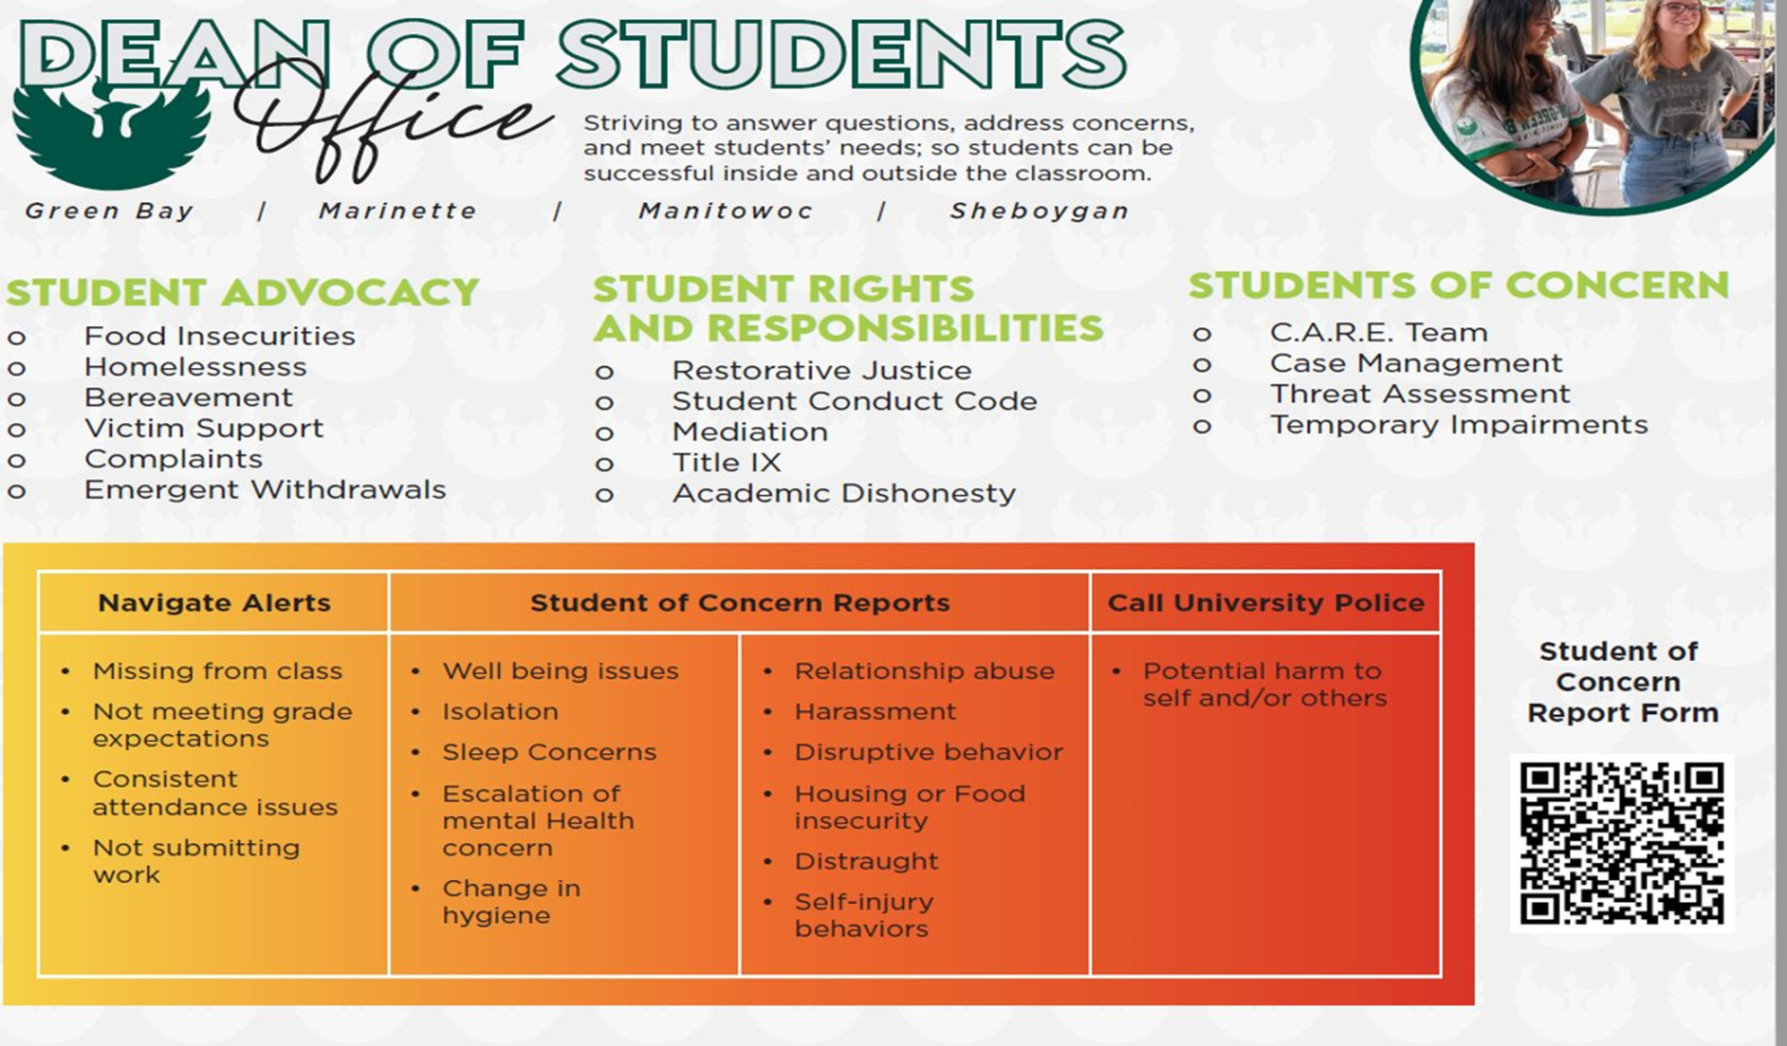
Notes:
Erin

Slide 13
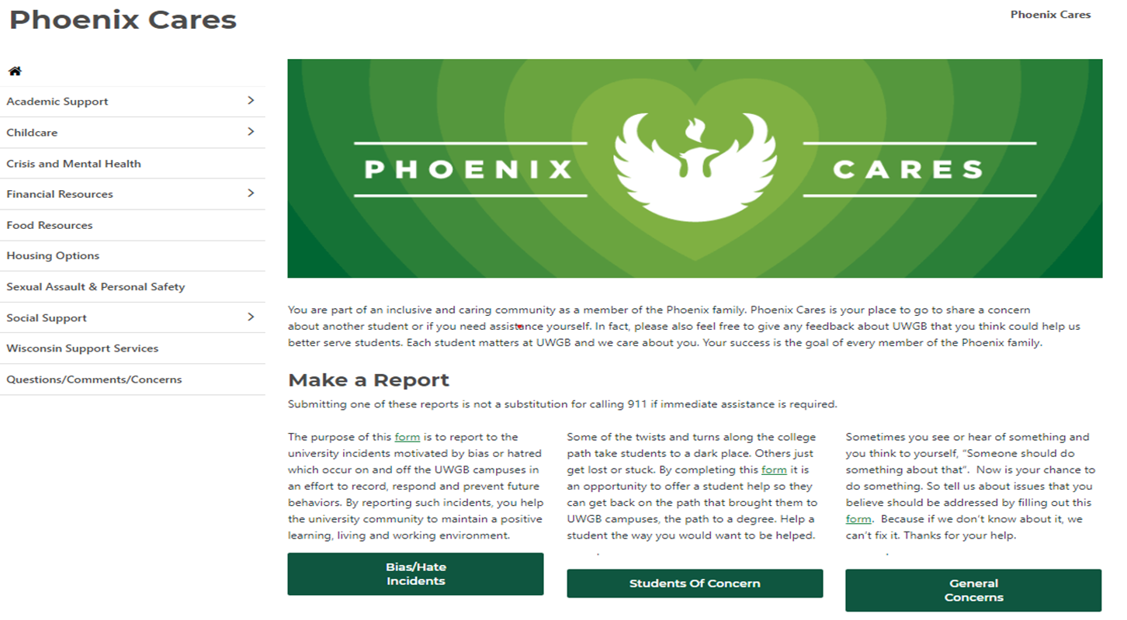
Phoenix Cares
Notes:
Erin

Slide 14
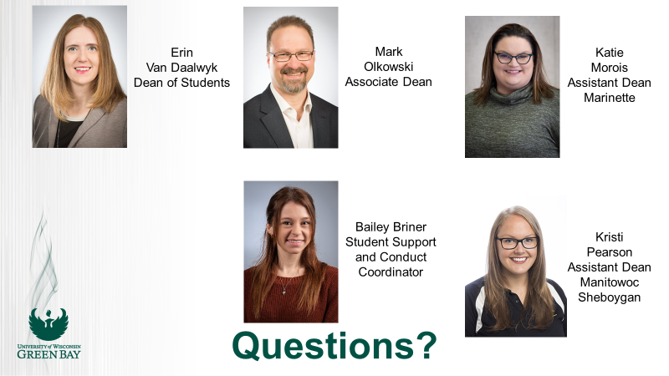

Slide 15
Student Misconduct
Understanding University Policies and Community Standards
Opportunity to Learn From Mistakes
Learn about and be referred to University support resources
Academic, Non-Academic, Student Organization
Referrals for students interacting inappropriately with staff, interpersonal violence/abuse
Rude Behavior and Setting Good Boundaries
Notes:
Erin

Slide 16
Behavioral Intervention Team
Discusses Complex Cases
  Threat Assessment
  Serious Conduct and will likely result in suspension/expulsion
Develop Action Plan
Membership: DOS, HRE, WC, Police, Provost's Office (invite other offices as necessary)
Due Process
Notes:
Erin

Slide 17
Bias Incident Response
Bias Incident
Hate Crime
Largely issues of rude or uncivil behavior, not policy violations or crimes
Chaired by Stacie Christian, AVC for inclusivity
Reporting form found of variety of websites, most accessed from Phoenix Cares
Kognito Training: Cultivating Inclusive Communities
Notes:
Erin

Slide 18
Title IX incident response at UWGB
Compliance efforts to support gender equity on college campuses
Incidents involving sexual violence, sexual harassment, stalking
Most time spent on providing resources and referrals (R&R) to students that have been victims of gender based harassment- Caitlin Henricksen primary contact
Wellness Center is the only anonymous reporting on campus (still reported, omit name)
Pregnant and Parenting Students- DOS advocacy
Notes:
Erin

Slide 19
Student Support Functions of DOS
Reporting Options
  Students of Concern Reports
  CARE Self Reports
  Calls, emails, walk-ins
CARE Team
  Nonclinical Case Management
  Professional Staff
  MSW Inters
Welfare Checks
Notes:
Katie's slide

Slide 20
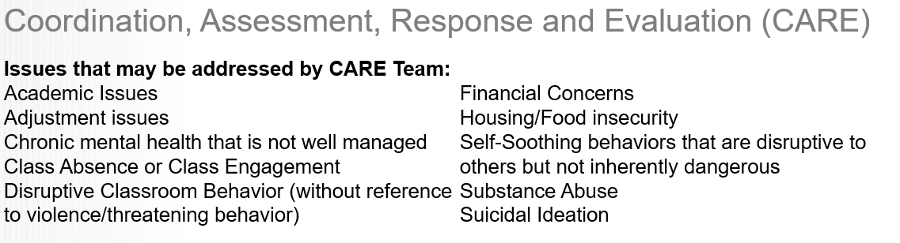
CARE Team
Notes:
Katie's Slide

Slide 21
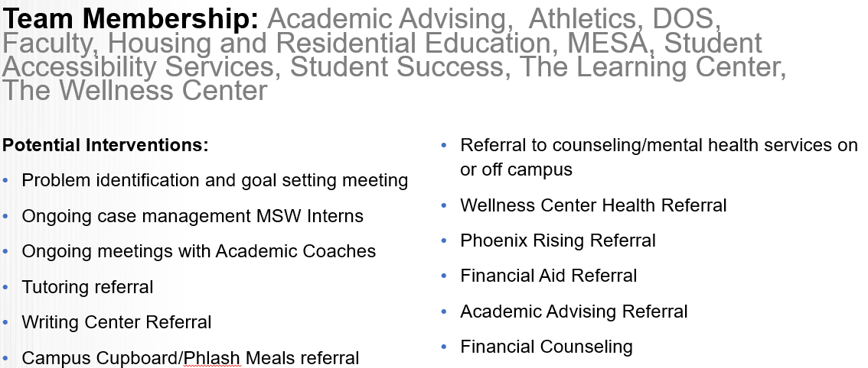
CARE (continued)
Notes:
Katie's slide

Slide 22
Case Managers
Meet regularly with students to help them through difficult patches or help them access university and community-based resources.
Non-Clinical-Not counseling, but support, coaching, education, and referrals.
Katie Morois-Assistant Dean for Marinette; Primary case assignments and scheduling.
Bailey Briner-Student Support and Conduct Coordinator
Katy Johnson-Student Support Intern, Non-Clinical case manager
Wendy Castro-Phoenix Childcare Intern; Administrative work and case management for parenting students
Erin-Supervision of non-clinical case managers and oversight of services.
Notes:
Katie's slide

Slide 23
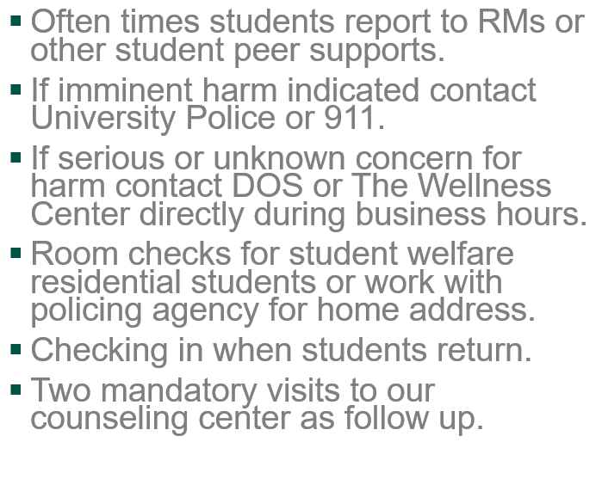
Check on Student Welfare
Suicidal Ideation v. Self Harm Behaviors
Notes:
Katie's Slide

Slide 24


Other Stuff We Do
Phoenix Childcare Support
First Gen Forward
Notes:
Erin

Slide 25

The UW-Green Bay
Wellness Center
Offering health and counseling services for students
Notes:
Welcome from the UW- Green Bay Wellness Center Team.

Slide 26
The UW-Green Bay Wellness Center
Counseling Services
Why refer someone to Counseling Services?
    Personal counseling
    Sexual assault/domestic violence support
    Alcohol or other drug assessments
    Crisis intervention
    Skills workshops (Pathways)
    Group Counseling (when offered)
    Graduate Student Internship Site
    Referral services
    Resources
    You at college app/Mantra
Cost
  No additional fee
Hours
  Monday 8 a.m. to 4:30 p.m.
  Tuesday 8 a.m. to 4:30 p.m.
  Wednesday 8 a.m. to 4:30 p.m.
  Thursday 8 a.m. to 4:30 p.m.
  Friday 8 a.m. to 4:30 p.m.
  Open year round, closed holidays
Notes:
Amy H
All enrolled students at any of our 4 UW-Green Bay campuses have access to see a licensed professional counselor at no cost. We offer short term 1:1 personal counseling. Our counselors also can provide crisis intervention. We also provide support and resources for survivors of sexual assault and domestic violence.
Some of the top reasons students come to see a counselor include: feeling stressed, symptoms of anxiety or depression, relationship issues and adjusting to college. No issue is really too small or too big. We can either help you directly or help connect you to additional resources in the community if needed.
The main campus counseling service also provides skills workshops and group counseling and serves as an internship site for MSW students.

Slide 27
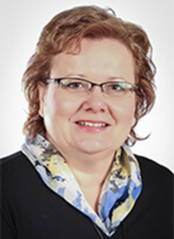

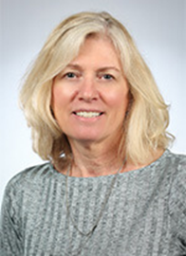

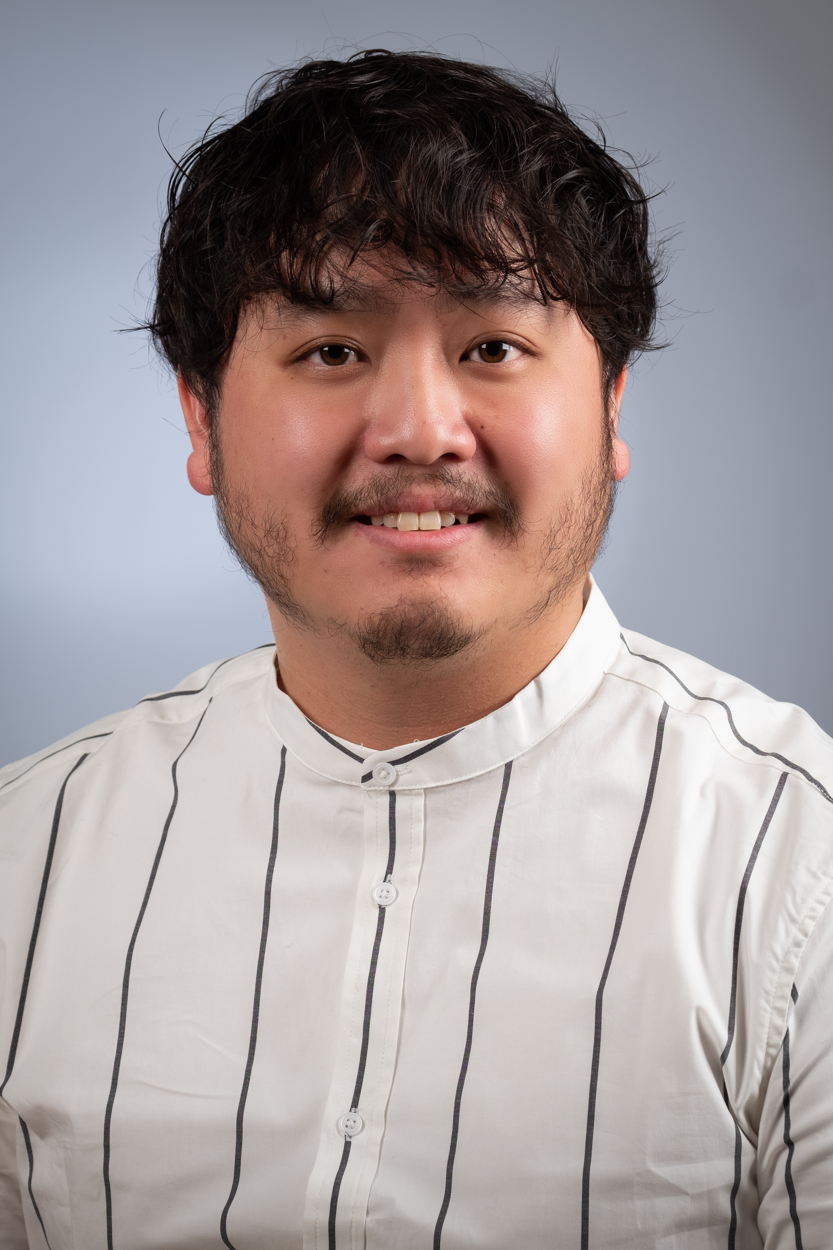


UW-Green Bay Wellness Center Counseling Services
Director:
Amy Henniges
Counselor:
Lissa Balison
Counselor:
Michelle Gauger
Counselor:
Emily Buske
Counselor:
Stephanie O’Connor
Counselor:
Fue Lee
Counselor:
Bruce Skovera
Health Educator: Caitlin Henriksen
Front Desk Staff: Kim McKeefry, Patty Terry and Sharon Ducat
Notes:
Amy H

Slide 28
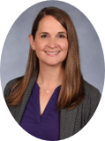
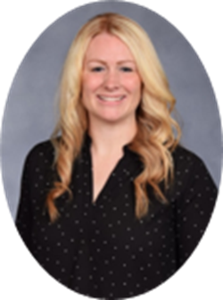


UW-Green Bay Counseling Center
Sheboygan & Manitowoc Campuses
Staci Salzmann, MS, LPC
UW-Manitowoc
Terra Braatz, ​
MSE, LPC​
UW-Sheboygan
Nicole Sanfilippo,MSW, CAPSW
UW-Sheboygan

Slide 29

Counseling Marinette Campus
  Fue Lee, Counselor, will have office hours on site at the Marinette Campus every other week on Wednesday
  Virtual visits can be scheduled on all other weekdays
  Available to triage urgent situations weekdays
  Call 920-465-2380 to schedule appointments and indicate appointment is for a Marinette student.
  Call 911 or 24/7 UW Mental Health Support Line at 888-531-2142 for emergencies or afterhours
Notes:
Amy

Slide 30
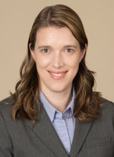
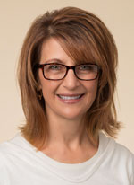
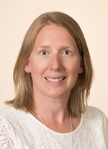


Medical Services in partnership with Prevea Health
Jennifer Fischer, MD
Prevea Child and Adolescent Psychiatrist
Michelle Cullen, MSN, APNP
Internal Medicine Nurse Practitioner
Katie Carlson, RN, BSN
Registered Nurse
Amy DePeau, RN, BSN
Registered Nurse

Slide 31
The UW-Green Bay Wellness Center
Medical Services in partnership with Prevea Health
Why contact Medical Services?
  Medical evaluation
  Wellness exams and physicals
  Non-emergency care of illness/injuries
  Contraceptive care
  Low cost medications
  Immunizations
  Lab services
        If labs/screenings/testing, immunizations, medications or pathology services are required, can be billed directly to your insurance.
        Cash, credit/debit, check
Cost
  Free
Hours
  Monday 8:00 a.m. to 4:00 p.m.
  Tuesday 9:30 a.m. to 5:30 p.m.
  Wednesday 8:00 a.m. to 4:00 p.m.
  Thursday 9:30 a.m. to 5:30 p.m.
  Friday 8:00 a.m. to 4:00 p.m.
  Open mid-August through mid-May
  Closed holidays and mid-May to mid-Aug
Notes:
In its partnership with Prevea Health, the Wellness Center offers a variety of medical services. Students can seek care for nonemergent illness and injury, as well as contraceptive management and evaluation for chronic concerns. Complete physicals, immunizations and lab services can also be done at the wellness center. Medical services are conveniently offered 6 days a week. Late day and weekend appointments are available. Medical services are offered throughout the school year from mid-August through mid-May.

Slide 32
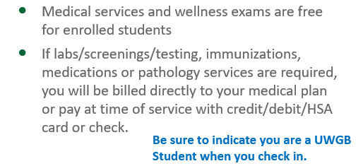
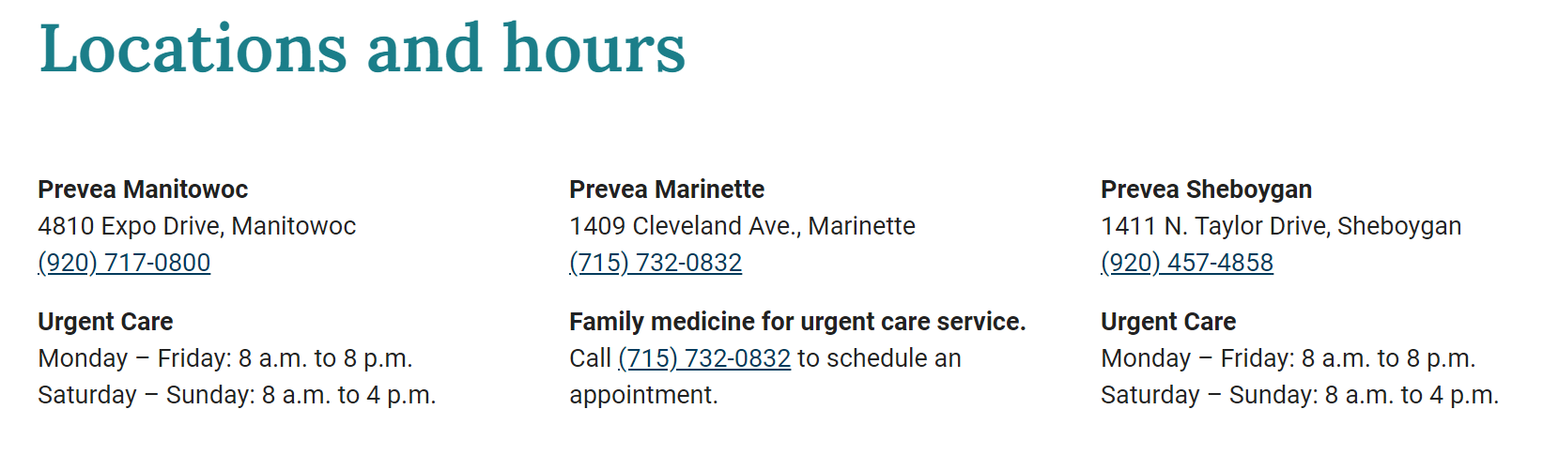
Medical Care for SHB, MAN, MNT Students

Slide 33
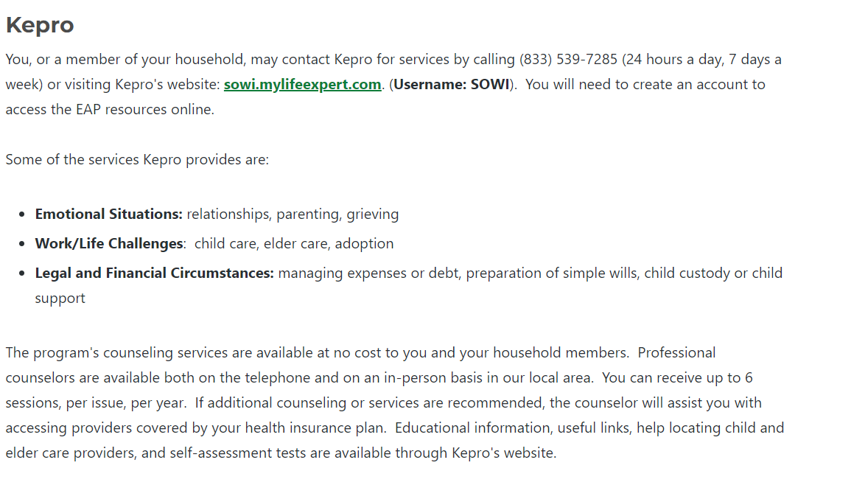
As UWGB Staff you have access to support services too
Notes:
Michelle

Slide 34

Notes:
Amy

Slide 35



Slide 36

Notes:
Amy H

Slide 37


Slide 38
Questions/Feedback
Notes:
All

Slide 39
Human Resources
Expectations, Performance Management, and Feedback

Slide 40
Setting Expectations
Clear communication
When to set expectations
Best Practices
Ways to set expectations
Notes:
Communication:
Providing clear communication when setting expectations of the role/position.
Communicate expectations verbally and/or written – helps eliminate misinterpretation.
If they are doing something they shouldn't be doing, communicate this to them. If no one says anything, you will most likely not see a change, which can develop a habit/routine for them which may be harder to correct later on.
When to set:
Set early and often – this should not be a one time and done type action or only after expectations are not being met. Be sure to check-in with employee (schedule regular check-in times).
When we don't set clear expectations from the start, we are setting them up for failure when, of course, what we should be doing is setting them up for success.
Best Practices:
Be open to collaborating on expectations with the employee. Be willing to listen if something should be done differently. Since a lot of student work is transactional – there are typically steps to follow and if we find later that it works better a different way – be open to that feedback from the employee and maybe alter what the expectations are for those tasks.
Keep expectations attainable and realistic - again we don't want to set anyone up for failure.
Ways to set:
Have a verbal conversation.
Follow-up with written communications.

Slide 41
Performance Management
The Importance of Evaluating Employee Performance
  Student Employee Performance Evaluation Form
Tips for Providing Feedback
Notes:
Performance evaluations are an important piece of employment, it allows
An employee to know how they are performing (i.e. what can they improve, what are they doing well)
Identifies training and development needs for the department
Aids in retention
Prepares the employee for positions they may obtain after college
Make sure to do them regularly, you should determine an evaluation schedule that works best for your department. Its important to that there is consistency and that the process is equitable.
Student Employee Performance Eval Form
There is a student employee performance evaluation form on the HR Forms webpage that can be used. (SHOW FORM)
We are actively looking to improve current tools for student supervisors / student employees so we would encourage that if there is feedback on how to enhance the form, please send it us.
These forms should be retained at the department level in the supervisor file and should not be sent to HR.
Be HONEST, telling an individual opportunities for improvement can be uncomfortable. Behaviors won't change unless someone knows they are doing it. Deficiencies impact rest of staff (increased workload, low morale, turnover)
Ensure you are providing feedback regularly. This is much more effective than discussing only once per year.

Slide 42
Policies
Workplace Conduct
Acceptable Use for Technology and the Internet
Harassment and Discrimination
Workplace Safety
Alcohol and Other Drugs
Code of Ethics
Notes:
We have various policies in place that we expect our employees to know and abide by. It is your job as a supervisor to know and enforce these policies to ensure equitable treatment.
It is important that employees know what the "rules" are. If there are department policies, make sure those are shared early in the training and reviewed often!

Slide 43
Corrective Action
Changing unwanted behaviors
  Verbal Discussion of Expectations
  Written Documentation
    Student Employment Corrective Action Notice
When to get HR involved
Notes:
Verbal:
Feedback is usually verbal, specific and held in a confidential setting. Should be down in real time – do not wait.
Written:
Written opportunity for the supervisor to reaffirm expectations in order to change the behavior.
FORM: A way to document and notice the employee of the behavior and expectations moving forward. This could be achieved through other written means of communication (I.e. email)
For conduct such as theft, harassment, etc. Get HR involved & early.
SYS 1237 Student Employment, Student employment is intended to help meet the needs of the university, provide university students with financial support in pursuit of their academic goals, and provide opportunities for academic or administrative job experience. The job duties and responsibilities of student workers vary greatly and may or may not be related to their field of study.
All student hourly positions are at-will employment positions and may be terminated at any time provided the reason is not prohibited by law.

Slide 44
Case Studies

Slide 45
Scenario #1
Tania Marble has worked as an office assistant in the Human Resources Department on campus for the last two semesters. Tania's manager, Teddy Rye, would describe her performance as great! She is friendly to guests both on the phone and in person, excels in her attention to detail and always completes tasks on time. But Tania is absent often and lately, it is happening more frequently and has begun to disrupt the office.
Notes:
How should Teddy address the absenteeism with Tania?

Slide 46
Scenario #2
During the meeting between Manager Teddy Rye and Student Employee Tania Marble, Tania discloses she suffers from depression which somedays makes it difficult to come to work.
Notes:
What should Teddy do in this situation?

Slide 47
Questions
Please fill out our feedback survey
Next Session November 9th, 9:00 – 10:00am
  What's Next?
Notes:
All

