Slide 1


BUDGET IN BRIEF
2021 – 2022 Budget Report

Slide 2
UW-Green Bay Budget in Brief
Welcome to the Budget in Brief, a look into the budget for the 2021-22 school year, as well as a review of the 2020-21 school year.
The budget is presented from a place of fiscal health. While the on-going pandemic has created an uncertain, and sometime chaotic environment, the combination of Federal HEERF funds, strong enrollment and tuition revenue, and sound financial management, has allowed us to limit reserve fund spending. The planned lapse to UW System was not required in FY21, allowing us to retain additional funds that had been planned to be unavailable.
The Budget in Brief highlights revenue and expense budgets for fiscal year 2021-22, including staffing. There is also a look back at the 2020-21 fiscal year, with a review of actual expenses as well as budget-to-actual comparisons across the major fund sources, general program revenue, tuition, and auxiliaries.
Wrapping up the Budget-in-brief are metrics provided by UW System. The Composite Financial Index (CFI), and Instructional Margin Ratio are widely used in higher education as measures of financial health.

Slide 3
Budgeted Source of Revenue
The total UW-Green Bay budget in 2021-22 is $141.7M. The largest revenue source, $41.1M, is from Tuition and Fees. The second highest amount is Federal Aid. State support of $31.7M is the third largest contribution the budget.
Of the state support, UW-Green Bay has discretion of $24.4M, while the remaining $7.3M is for predetermined, specific programs and services, and debt service.
Auxiliary operations, such as University Housing, University Dining, Student Segregated Fees, and Parking, contribute approximately 15% of the budget, at $20.9M.
Source: WISER

Slide 4
2021-22 Expense Budget
Employee compensation makes up a significant portion of UW-Green Bay’s budget. Payroll and fringe benefits make up over 50% of the expense budget. Financial aid makes up 27% of the expense budget.

Slide 5
Trend of Budgeted Expenses by Fund Group
Tuition has consistently been the source of more than 35% of UW-Green Bay’s budget. Expenses funded by state appropriations have increased slightly, corresponding with the additional locations joining the main campus to form our Four Campuses, One University model. Auxiliary & Other Receipts is the other major source of funding for our expense budget. These three sources have routinely made up 90% of our budget.
Source: FY18-19 – Redbook, FY20-22 - WISER
*Excludes Financial Aid received by students

Slide 6
Budgeted Staffing Model
Division | FTE’s
Chancellor's Office | 4
Athletics | 29.79
U Rec | 6.65
Academic Affairs | 45.1
CECE | 32.57
Enrollment Services | 70.66
University Inclusivity | 48.59
CSET | 101.15
CAHSS | 118.34
CHESW | 51.71
AECSB | 40.42
IT | 35
Library | 19.78
Business & Finance | 44.58
Facilities | 66
University Union | 9.75
Weidner Center | 6.6
Advancement | 9
Marketing | 16
Manitowoc | 1
Marinette | 1.83
Sheboygan | 4
Unit Wide | -3.21
Total | 759.31
Source: FY22 Budget CAT Report

Slide 7
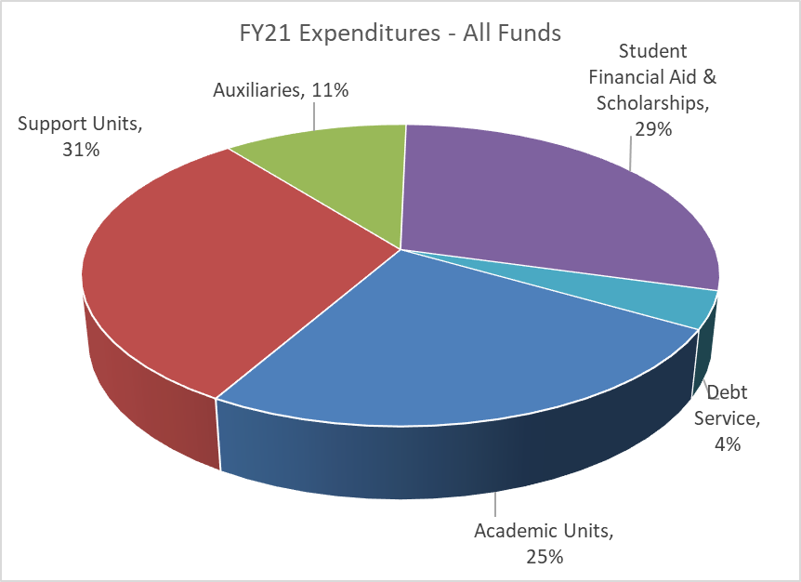
Actual Expenditures in FY21 (in millions)
Source: WISER

Slide 8
FY21 Actual Expenditures by Functional Classification
The five largest areas of spending in Fiscal Year ‘21 were Financial Aid, Instruction, Academic Support, Student Services, and Institutional Support. These five groups accounted for 82% of the total spend for the year.
Source: WISER

Slide 9
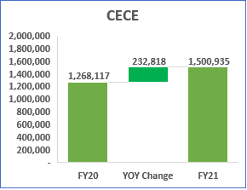
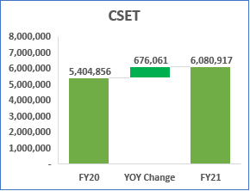
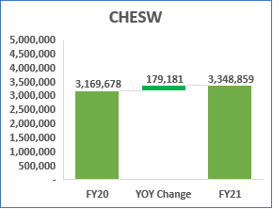
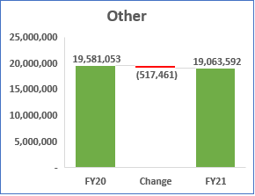
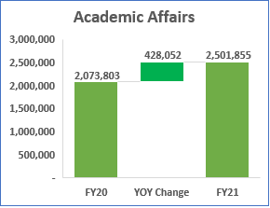
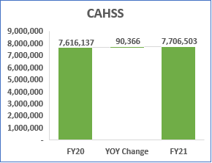
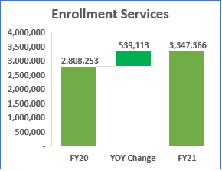
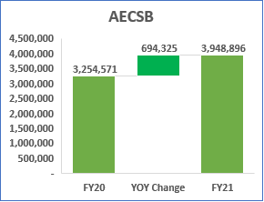
Salary Spend Change Year over Year
Salary spending increased in all four colleges in FY21. Additionally, investments have been made in Graduate Studies, CECE and Enrollment Services. Salary spending across the remainder of the university was down 2.6% in FY21.
Source: WISER

Slide 10
Salary Summary by Division
 |  |  |  |  | Summary of Change |  |  | New Positions Added
Division | 2018-19 | 2019-20 | 2020-21 |  | Incr (Decr) 2018-19 to 2019-20 | Incr (Decr) 2019-20 to 2020-21 |  | 2018-19 | 2019-20 | 2020-21 | 2021-22
01 - Chancellor | $ 483,612 | $ 408,823 | $ 457,464 |  | $ (74,789) | $ 48,641 |  | $ - | $ - | $ - | $ 60,000
03 - Athletics | 2,095,146 | 2,069,846 | 2,033,377 |  | (25,300) | (36,469) |  | - | - | - | 55,000
09 - Urec & Kress Events Center | 276,216 | 263,943 | 286,690 |  | (12,273) | 22,748 |  | - | - | - | -
12 - Academic Affairs | 1,783,324 | 2,073,803 | 2,501,855 |  | 290,479 | 428,051 |  | - | 178,497 | 454,860 | 55,000
13 - CECE | 1,042,701 | 1,268,117 | 1,500,935 |  | 225,416 | 232,818 |  | - | 136,363 | 441,190 | -
14 - Enrollment Services | 2,712,489 | 2,808,253 | 3,347,366 |  | 95,764 | 539,114 |  | 47,859 | 45,702 | 251,000 | 351,000
18 - Univ Inclusivity & Student Affairs | 2,456,725 | 2,582,111 | 2,191,451 |  | 125,386 | (390,660) |  | 162,129 | - | 65,000 | 43,000
24 - CSET | 4,940,536 | 5,404,856 | 6,080,917 |  | 464,320 | 676,061 |  | 67,626 | 142,800 | 476,260 | 90,000
26 - CAHSS | 7,233,214 | 7,616,137 | 7,706,503 |  | 382,923 | 90,366 |  | - | 55,080 | 181,400 | 155,000
30 - CHESW | 3,199,934 | 3,169,678 | 3,348,859 |  | (30,256) | 179,181 |  | - | - | 199,900 | 227,000
32 - Business School | 2,874,672 | 3,254,571 | 3,948,896 |  | 379,899 | 694,325 |  | - | - | 346,830 | 345,500
33 - Information Technology | 1,877,206 | 2,090,672 | 2,085,385 |  | 213,466 | (5,287) |  | - | 201,246 | - | 91,163
36 - Library | 702,812 | 721,515 | 722,335 |  | 18,703 | 820 |  | - | - | -
40 - Business & Finance | 2,342,853 | 2,305,326 | 2,426,390 |  | (37,527) | 121,064 |  | - | - | - | 100,560
45 - Facilities | 2,262,063 | 2,287,374 | 2,193,673 |  | 25,311 | (93,701) |  | 53,500 | - | 78,030 | 76,000
50 - University Union | 513,645 | 465,470 | 474,750 |  | (48,175) | 9,280 |  | - | - | 38,000 | -
55 - Weidner Center | 384,258 | 403,610 | 281,838 |  | 19,352 | (121,772) |  | - | - | - | -
65 - Univ. Advancement | 572,725 | 624,549 | 587,815 |  | 51,824 | (36,734) |  | - | - | 70,000 | -
67 - Marketing | 581,399 | 628,244 | 725,172 |  | 46,845 | 96,928 |  | 57,222 | 44,720 | - | -
71 - Manitowoc Campus | 110,263 | 1,520,701 | 1,480,071 |  | 1,410,438 | (40,630) |  | - | 46,410 | - | 43,000
72 - Marinette Campus | 151,824 | 1,392,448 | 1,124,593 |  | 1,240,624 | (267,855) |  | - | 135,645 | 127,500 | 43,000
73 - Sheboygan Campus | 112,147 | 1,777,347 | 1,434,392 |  | 1,665,200 | (342,954) |  | - | 92,820 | - | 119,599
98 - Unitwide/Central | 91,877 | 39,077 | 558,195 |  | (52,800) | 519,118 |  | - | - | - | -
Total | $ 38,801,641 | $ 45,176,468 | $ 47,498,923 |  | $ 6,374,827 | $ 2,322,455 |  | $ 388,336 | $ 1,079,283 | $ 2,729,970 | $ 1,854,822

Slide 11
Budget-to-Actual Comparison
All Funds |  | 2019-20 | 2019-20 |  | 2020-21 | 2020-21 |  | Year-Over-Year
 |  | Budget | Actuals |  | Budget | Actuals |  | Change in Actuals
Revenues |  | $ 139,421,171 | $ 113,980,928 |  | $ 142,123,439 | $ 118,924,490 |  | $ 4,943,562
GPR Appropriations |  | 33,692,839 | 33,475,290 |  | 33,447,714 | 34,518,639 |  | $ 1,043,349
Total Revenue |  | $ 173,114,010 | $ 147,456,218 |  | $ 175,571,153 | $ 153,443,129 |  | $ 5,986,911
Expenses
 | Permanent Salaries | $ 46,779,771 | $ 45,176,468 |  | $ 50,208,377 | $ 47,498,923 |  | $ 2,322,455
 | LTE and Student Salaries | 3,182,657 | 2,696,299 |  | 3,060,944 | 1,918,914 |  | (777,384)
 | Fringe Benefits | 18,835,368 | 20,352,166 |  | 20,955,008 | 21,298,065 |  | 945,898
 | Supplies | 33,701,663 | 26,194,343 |  | 33,842,476 | 24,948,696 |  | (1,245,647)
 | Capital | 2,603,716 | 2,040,771 |  | 3,287,899 | 1,320,515 |  | (720,256)
 | Special Purpose | 8,156,579 | 8,112,218 |  | 7,433,287 | 8,687,662 |  | 575,444
 | Aid to Individuals | 39,688,540 | 41,573,580 |  | 42,223,560 | 43,020,880 |  | 1,447,300
 | Sales Credits | (1,901,504) | (2,581,070) |  | (1,871,504) | (2,504,067) |  | 77,003
Total Expenses |  | $ 151,046,791 | $ 143,564,775 |  | $ 159,140,047 | $ 146,189,589 |  | $ 2,624,813
 | Net Increase (Decrease) |  | $ 3,891,443 |  |  | $ 7,253,540

Slide 12
GPR Budget-to-Actual Comparison
GPR Summary (102 and 103) - exclude fringes |  | 2019-20 | 2019-20 |  | 2020-21 | 2020-21 |  | Year-Over-Year
 |  | Budget | Actuals |  | Budget | Actuals |  | Change in Actuals
Expenses
 | Permanent Salaries | $ 31,603,482 | $ 31,461,376 |  | $ 33,370,182 | $ 33,273,930 |  | $ 1,812,554
 | LTE and Student Salaries | 502,069 | 561,133 |  | 530,999 | 310,546 |  | (250,587)
 | Supplies | 16,391,185 | 6,989,634 |  | 17,452,012 | 8,851,442 |  | 1,861,808
 | Capital | 1,144,230 | 980,845 |  | 861,607 | 793,949 |  | (186,896)
 | Special Purpose | - | 500 |  | - | 183,667 |  | 183,167
 | Aid to Individuals | 478,221 | 2,555,317 |  | 2,795,780 | 2,778,418 |  | 223,101
 | Sales Credits | (1,901,504) | (2,134,872) |  | (1,871,504) | (1,694,228) |  | 440,644
 |  | $ 48,217,683 | $ 40,413,934 |  | $ 53,139,076 | $ 44,497,725 |  | $ 4,083,791
 | FY21 Net activity - includes FY21 carryover of $7.7M |  | 7,805,338 |  |  | 8,641,352
 | Fund 402 balance |  | 17,954 |  |  | 8,891
 | Excess tuition collections - sweep to 102/103 |  | - |  |  | 2,163,612
 | First 2 month health insurance, fringes on covid leave, etc |  | (55,510) |  |  | (98,759)
GPR Balance |  |  | $ 7,767,782 |  |  | $ 10,715,096
 | Less: FY2021 open PO encumbrances |  | (91,450) |  |  | (656,299)
GPR Carryover FY2021 |  |  | $ 7,676,332 |  |  | $ 10,058,797

Slide 13
Tuition Budget-to-Actual
Fund 131 - Tuition |  | 2019-20 | 2019-20 | 2019-20 |  | 2020-21 | 2020-21 |  | Year-Over-Year
 |  | Budget | Budget | Actuals |  | Budget | Actuals |  | Change in Actuals
Revenue
 | Tuition Collected | $ 37,340,187 | $ 37,340,187 | $ 37,458,463 |  | $ 38,547,709 | $ 38,747,958 |  | $ 1,289,495
 | Other Revenue - Recapture of prior year lapse $1,426,725 and other expenses from CARES Funds | - | - | - |  |  | 1,438,291 |  | 1,438,291
 | UW Colleges restructure balance transfer | - | - | (13,674) |  |  | - |  | 13,674
 | Transfer from CECE | 800,000 | 800,000 | 800,000 |  |  | 800,000 |  | -
 | Transfer from UWSA | - | - | 200,000 |  |  | 503,000 |  | 303,000
Total Revenue |  | $ 38,140,187 | $ 38,140,187 | $ 38,444,789 |  | $ 38,547,709 | $ 41,489,250 |  | $ 3,044,461
Expenses
 | Permanent Salaries | $ 2,260,317 | $ 2,260,317 | $ 3,561,231 |  | $ 2,292,775 | $ 4,104,340 |  | $ 543,109
 | LTE and Student Salaries | 63,590 | 63,590 | 22,968 |  | 46,440 | 9,973 |  | (12,995)
 | Fringe Benefits | 963,314 | 963,314 | 899,506 |  | 966,539 | 1,025,866 |  | 126,360
 | Supplies PlanUW | 218,823 | 218,823 | 963,079 |  | 146,246 | 1,013,548 |  | 50,469
 | Capital | 20,000 | 20,000 | 33,550 |  | 20,000 | 72,673 |  | 39,123
 | Special Purpose | - | - | 11,585 |  | - | 9,697 |  | (1,888)
 | Sales Credits | - | - | (9,242) |  | - | (132,602) |  | (123,360)
Total Expenses |  | $ 3,526,044 | $ 3,526,044 | $ 5,482,677 |  | $ 3,472,000 | $ 6,103,494 |  | $ 620,817
 | Net |  |  | $ 32,962,112 |  |  | $ 35,385,756
 | Beginning fund balance |  |  | 2,311,533 |  |  | 2,139,597
 | Funds available |  |  | 35,273,645 |  |  | 37,525,353
 | Tuition target - required |  |  | (33,134,048) |  |  | (33,134,048)
 | Tuition sweep to Fund 102/103 GPR Carryover |  |  | - |  |  | (2,163,612)
 | Ending Fund Balance |  |  | $ 2,139,597 |  |  | $ 2,227,693

Slide 14
Tuition Extension Budget-to-Actual
Fund 189 - Tuition Extension |  | 2019-20 | 2019-20 |  | 2020-21 | 2020-21 |  | Year-Over-Year
 |  | Budget | Actuals |  | Budget | Actuals |  | Change in Actuals
Revenue
 | Tuition Collected | $ 1,739,836 | $ 3,912,420 |  | $ 1,950,345 | $ 4,659,154 |  | $ 746,734
 | Transfer to tuition pool | - |  |  | - | (200,000) |  | (200,000)
 | Transfers | - | (1,811,019) |  | 447,405 | (1,648,894) |  | 162,125
Total Revenue |  | $ 1,739,836 | $ 2,101,401 |  | $ 2,397,750 | $ 2,810,260 |  | $ 708,859
Expenses
 | Permanent Salaries | $ 1,199,183 | $ 1,023,443 |  | $ 1,408,602 | $ 1,334,011 |  | $ 310,568
 | LTE and Student Salaries | 30,000 | 8,175 |  | 15,000 | - |  | (8,175)
 | Fringe Benefits | 382,153 | 326,451 |  | 565,033 | 431,378 |  | 104,927
 | Supplies PlanUW | 128,500 | 206,200 |  | 488,901 | 303,687 |  | 97,487
 | Aid to Individuals | - | - |  |  | 14,400 |  | 14,400
Total Expenses |  | $ 1,739,836 | $ 1,564,268 |  | $ 2,477,536 | $ 2,083,476 |  | $ 519,208
 | Net |  | $ 537,133 |  |  | $ 726,784
 | Beginning fund balance |  | 1,886,394 |  |  | 2,423,527
 | Ending Fund Balance |  | $ 2,423,527 |  |  | $ 3,150,311
Total Tuition Fund Balance (Funds 102, 103, 131 & 189) |  |  | $ 12,330,906 |  |  | $ 16,093,100

Slide 15
Auxiliaries Budget-to-Actual
Fund 128 - Auxiliaries |  | 2019-20 | 2019-20 |  | 2020-21 | 2020-21 |  | Actuals
 |  | Budget | Actuals |  | Budget | Actuals |  | Variance
Revenue
 | Total Tuition | $ 53,864 | $ 450,505 |  | $ 61,562 | $ 417,250 |  | $ (33,255)
 | Other Revenue | 20,981,413 | 19,584,846 |  | 19,786,793 | 18,401,067 |  | (1,183,778)
 | Gift, Grant, and Trust | 34,988 | 217,773 |  | 19,730 | 12,975 |  | (204,798)
 | Transfers | (954,308) | (790,032) |  | (775,958) | (763,316) |  | 26,716
Total Revenue |  | $ 20,115,957 | $ 19,463,092 |  | $ 19,092,127 | $ 18,067,976 |  | $ (1,395,115)
Expenses
 | Permanent Salaries | $ 5,505,365 | $ 4,833,650 |  | $ 5,665,276 | $ 3,721,127 |  | $ (1,112,523)
 | LTE and Student Salaries | 1,915,226 | 1,124,158 |  | 1,789,501 | 781,725 |  | (342,433)
 | Fringe Benefits | 2,798,708 | 2,436,806 |  | 2,651,373 | 2,085,689 |  | (351,117)
 | Supplies | 9,616,727 | 10,528,836 |  | 10,028,856 | 7,830,486 |  | (2,698,350)
 | Capital | 733,000 | 281,173 |  | 1,717,755 | 131,738 |  | (149,435)
 | Special Purpose | 75,171 | 1,480,136 |  | 207,965 | 1,416,048 |  | (64,088)
 | Aid to Individuals | - | 387,691 |  | - | 106,966 |  | (280,724)
 | Sales Credits | - | (400,000) |  | - | (667,860) |  | (267,860)
Total Expenses |  | $ 20,644,197 | $ 20,672,449 |  | $ 22,060,726 | $ 15,405,919 |  | $ (5,266,530)
 | Net Income (Loss) |  | $ (1,209,358) |  |  | $ 2,662,057
 | Beginning fund balance |  | 12,461,363 |  |  | 11,252,005
 | Funds available |  | $ 11,252,005 |  |  | $ 13,914,061

Slide 16
Year-over-year Change in Actual Expenses – All Funds

Slide 17
2020-21 Budget-to-Actual Expenditure Comparison

Slide 18
Budget-to-Actual Comparison

Slide 19
Program Revenue Fund FY21 Year End Fund Balances
Fund balances are a necessary component of a well-functioning university system. Each year, UW-Green Bay provides information on program revenue balances by level of commitment. Committed balances may be held to save for large future purchases, investing in new initiatives and programs, for unexpected budget changes, emergency reserves, or are designated for a certain purpose.
At the end of Fiscal ‘21, 92% of UW-Green Bay’s PR balances are committed.
Of the total committed balances, $15M is designated for a specific program or purpose (ex. Seg Fees, parking fees) and $10M is obligated to enumerated projects or other purchases. There is $5.5 million held for reserve, as required by UW System policy.
Source: PR Balance Report FY21

Slide 20
Composite Financial Index (CFI) and Components
The CFI is a measure of overall financial performance based on four core financial ratios, each representing a particular domain of financial operations: (1) the primary reserve ratio, indicating resource sufficiency; (2) the viability ratio as a gauge of debt management; (3) the return on net assets ratio to track financial asset performance; and (4) the net operating revenues ratio measuring operating results. These ratios are then standardized, weighted, and combined into a single index score, the CFI, to indicate the financial health of the institution.
The Higher Learning Commission considers a total CFI of 1.1 or higher as indicative of good financial health. UW-Green Bay has a CFI score of 5.2.
Source: UW System Accountability Dashboard

Slide 21
Instructional Margin Ratio
Instructional margin ratio is a measure of financial health related to an institution’s instructional mission. It compares the instructional revenue of an institution to its instruction-related expenses.
A ratio above 1 indicates that revenues exceed expenses, while a ratio below 1 indicates deficit spending.
Higher revenue amounts indicate additional resources available to invest.
Source: UW System Accountability Dashboard

Slide 22
UW System Cost to Attend
Tuition and fees are part of the overall cost to attend UW-Green Bay. Tuition for in-state undergraduate students has been frozen across UW System since 2013. UW-Green Bay is among the least expensive across UW System for on-campus and commuter students.
Cost to Attend assumes Resident Undergraduate student taking courses at the school’s main campus as a full-time student during the fall and spring semesters. Room rate and meal rate based on average cost for majority of students.
Commuter student assumes required Tuition and Segregated Fees.
Source: UW System 2021-22 Operating Budget and Fee Schedules

