Slide 1
What’s Next
Student Employee Supervisor Training – Part 4
November 9, 2023
Presented by: Rachel Wautier & Megan Noltner
Q&A Panel: Career Services, Financial Aid & Human Resources

Slide 2
Agenda
Ending Student Employment
Rehire Process
Compliance Reminders
Maintaining Supervisory Files
Gathering Feedback for future sessions & resources
Q&A

Slide 3
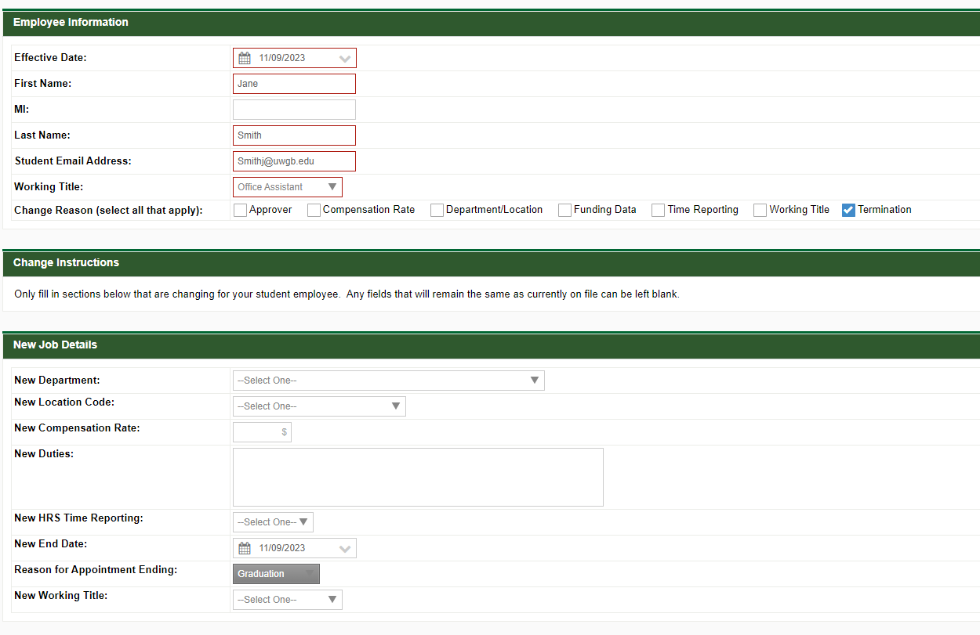
Ending Student Employment
Submit a Student Employment Change Request Form

Slide 4

Rehiring Students
Submit a Student Employment Request Form
Same process as hiring the first time

Slide 5
HR Compliance Reminders
Criminal Background Checks
  Assessment is done at department level to determine if position requires a CBC.
  HR reviews CBC requirement and initiates process.
  A student employee is required to authorize the CBC prior to starting employment
  Resource:
I-9, Two Part form authorizing student is eligible to work in the U.S.
  Section 1: Employee Information & Attestation
    Completed by employee no later than first day of work
  Section 2: Employer or Authorized Representative Review & Verification
    Employee is required to present form(s) of identification to HR no later than 3rd business day (start day + 3 days)
Notes:
POT Designation: Access to vulnerable populations (under 18), property access or Financial Responsibility.
Information about the Criminal Background Check is automatically provided to the employee during the BP Logix process.
For students who have multiple positions on campus, HR will verify if a CBC has previously been completed and is current for use of new position.
Any break of service greater than 1 year requires a new CBC to be conducted.
I-9
After the three days the University has the ability to terminate the employee who fails to present acceptable documentation, failure to be in compliance puts the University at risk for violation of 274A of the INA and may be subject to civil money penalties.
Student employee received information regarding I-9 requirement during the student hiring process, an additional email from HireRight third party vendor and from our office.
Often we will hear from students that they do not have their forms of identification with them at school, we are required to view original documents in person (no copies and/or via facetime) We have been lenient in allowing students to have documents mailed. However, we will continue to provide a reminder from our office and then will connect with supervisors about ability for continued employment if not complete.
The University has an obligation to ensure timely completion of both the CBC and I9 in line with UW System policies and Federal Law. Therefor, hiring paperwork for employees needs to be received timely (ideally five days prior to the employees start date). When paperwork is late, we are usually already out of compliance and are not giving adequate time to employees to complete what is required of them.

Slide 6
Mandatory Employee Training
In line with SYS 1293, Mandatory Employee Training all student employees are required to take:
  Information Security Awareness (annually)
  Mandated Reporter (once at time of hire)
Should be completed within 30 days of hire and done during work time.
Training is tracked by person not position.
An employee may be granted a waiver of mandatory training requirements by our HR department, only in circumstances where the determination is made that the employee has completed training that is substantially identical to UW System mandatory training.

Slide 7
Maintaining a Supervisory File
Supervisor Working Files contain information that the supervisor believes is helpful or necessary to manage workload and employees.
  Supervisory files should be secure and confidential
  Supervisory files main contain personal supervisory notes, which are not considered to be an official personnel record if they are prepared by the supervisor for their own use and are not shared with anyone else.
  Sharing information with any other person may subject the file to public records law requests.
  Utilize and refer to the UW-Green Bay Records Management webpage for further information and proper disposal.

Slide 8

We want to hear from you!

